Slide 1
Mission and Pastoral Plan
Joint Meeting of
Rural Deans and Lay Chairs
22-4-21
“My Father is glorified by this: that you
bear much fruit and become my disciples” John 15v8

Slide 2
A brighter future...
Rooted in our confidence in God
Focused on a Godly vision
Committed to a local presence
Attentive to significant institutional change
Grounded in prayer

Slide 3
Priority one: Clearer paths to Mission & Ministry
Key areas for growth:
Growing vocations
Releasing lay ministry
Resourcing mission
Overview
Mission and ministry grow from the call and commission of Christ. As we follow and serve him, vocations naturally arise. Our Pastoral Plan intends to resource and encourage growth in mission & ministry

Slide 4
Priority two: Better care for those who serve
Key point
Research tells us that anxiety about finance, sustainability of church buildings and future posts are a real concern to clergy and lay leaders. All of which are impacting the welfare of our leaders.
Overview
The welfare and training of our ministers and volunteers is of paramount importance, and the demands upon them (as upon all those who serve the church) are changing with the times.

Slide 5
Priority three: Stronger roots for the local church
Key points
Encourage new forms of deanery financial collaboration
Consider setting local aspirations for meeting the costs of ministry and mission
Review the Fairer Share scheme when the time is right
Deliver a successful stewardship campaign
Overview
While the parish share remains the foundation of our finances, it will be reassessed in the light of the changes we are seeing and the need to develop sustainable models, especially for the smaller village churches.

Slide 6
The essential dilemma

Slide 7
The essential dilemma
How to fund our aspirations?
We need to address the deficit but equally do not want to act precipitately as there are currently many unknowns
Loss of clergy posts may be one of the levers to achieving financial stability but there is also a risk of this diminishing our ability to raise income and to achieve out ministry aspirations
Decreasing membership puts more onus on fewer people

Slide 8
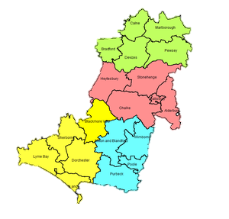
The Diocese of Salisbury in context National Church Report 25.06.2020 – ranking out of 41 dioceses
Attendance
per capita
2.3%
4th highest
Avg. planned
giving per person
per week
£10
27th highest
Population 958,000
28th
Clergy per
10,000 people
2
2nd highest
Giving as %
of income
2.9%
36th highest

Slide 9
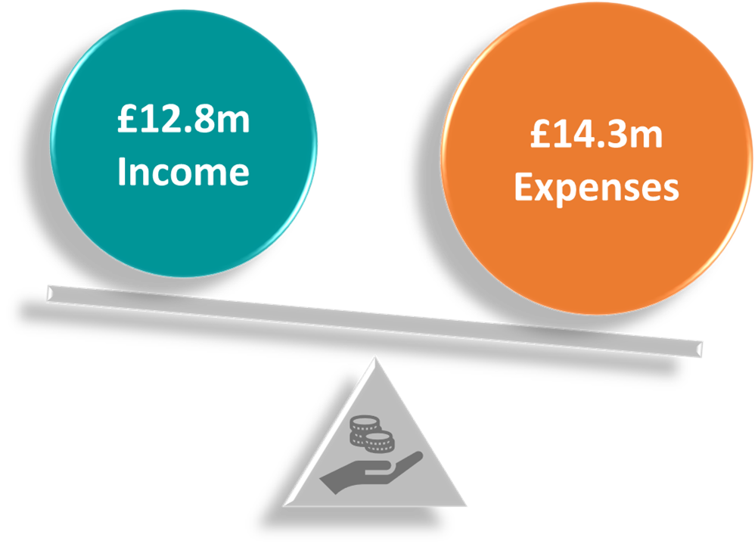
Difficult years 2020 and 2021
Actual of £1.5m for 2020
Forecast of £1.9m for 2021
020:
020:
2020

Slide 10
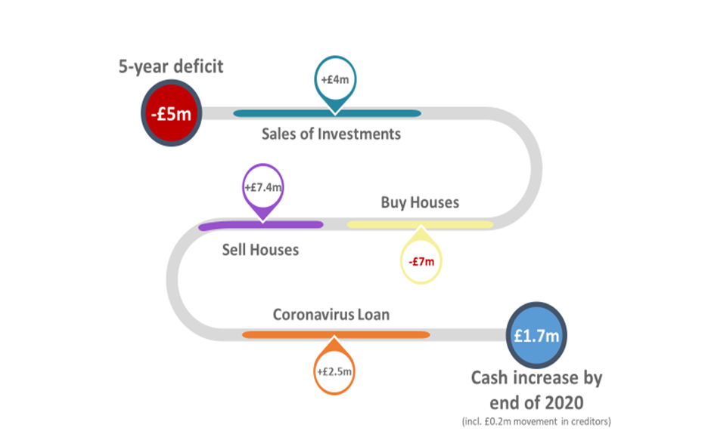
How do we finance our aspirations without continuing to sell assets? Not a new problem
2016-2020 the Diocese have operated with a deficit each year, totalling £5m
We have lost income and capital growth on the £4m investments we have sold, and future income generation reduced by est. £200k p.a.
We are committed to safeguard our assets for the future church, therefore we must balance the books
ALL dioceses predicting deficit for 2020 greatest London £7m : lowest Rochester £500k

Slide 11
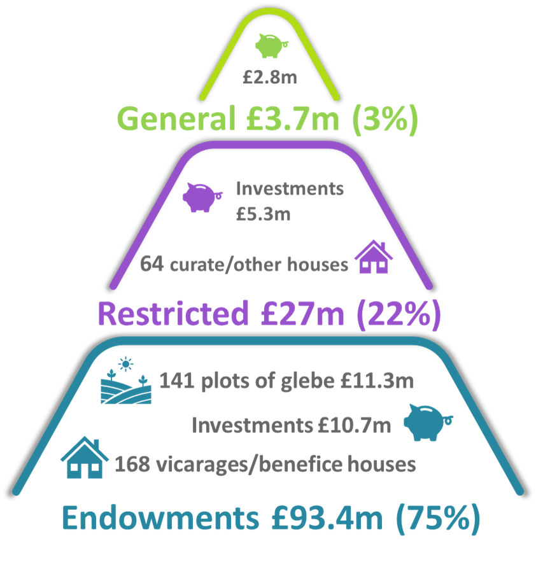
Diocesan Balance Sheet: Can we turn our assets into cash?
97% of our balance sheet is restricted or endowed
£124.1m total - £93.5m - 234
Most liquid are the investments totalling £18.8m but restrictions on use of £16.5m
Current assets in General fund do not cover the bank loan and will require use of cash from other funds
£1m deficit = sale of 3 curates houses
CV loan repayable over 6 years : interest 1.71% over base
Our amount of investment assets held, ranked 23 highest out of 41 dioceses: highest London £140m : lowest Newcastle £4m

Slide 12
Planning for the future- working together
Return to breakeven
At same time enabling a thriving future for the Church
Link the finance to the pastoral plan – different ways of working
Help parishes become more financially sustainable
Develop other income – use of total return
Explore funding opportunities National Church
Review all assets
Assist parishes systems : IT : insurance
Learning and working collaboratively with others

Slide 13
Questions for clarification
“My Father is glorified by this: that you
bear much fruit and become my disciples”
John 15v8

Slide 14
BREAK
“My Father is glorified by this: that you
bear much fruit and become my disciples” John 15v8

Slide 15
GENEROUS GIVING
Transforming our giving in response to God's generosity

Slide 16
Funding the future: Generous Giving Campaign
Looking after the tree...
Equipping every church in the Diocese to have a fruitful conversation about giving and generosity

Slide 17
Generous Giving Campaign: The details
Overall vision
Adopting Building a Generous Church model
Timeline
Getting involved in the preparation phase

Slide 18
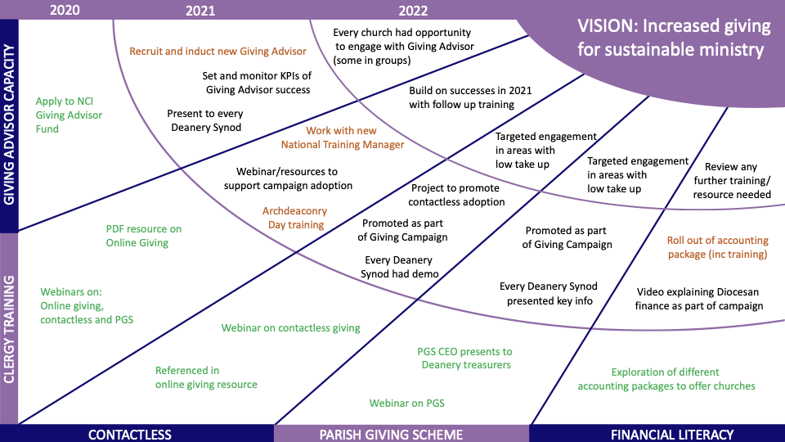

Slide 20
Timeline

Slide 21
What to expect in the preparation phase
Session for all treasurers on 18th May (evening)
Further sessions/content based on feedback
Sharing existing national resources – use Deanery Synod meetings
New Diocesan resources shared as they become available over summer
Use generosity toolkit with your PCC during this period to help reflect and focus your involvement
Please join week of prayer before the campaign starts
Simple leaflet with calendar of activities distributed for all churches to share with members

Slide 26
Questions for discussion
“My Father is glorified by this: that you
bear much fruit and become my disciples”
John 15v8

Slide 27
Appendix

Slide 28
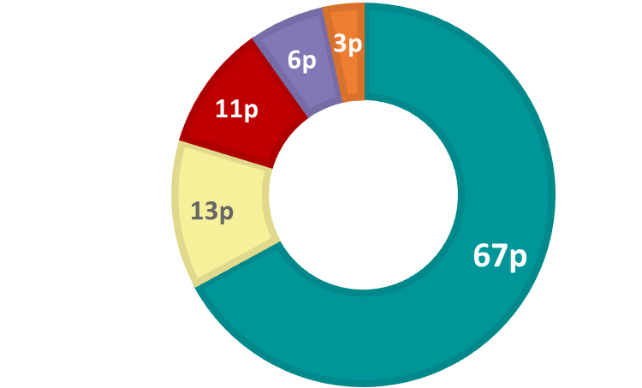
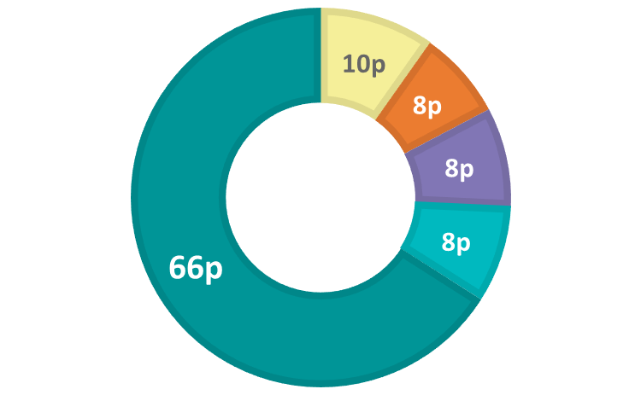
For every £1 the Diocese receives
Every £1 of income:
67p – Giving from parishes – Fairer Share
13p – National Church, donations, grants, parochial fees
11p – Deficit funded by sale of investments and houses
6p – Investment income
3p – Rent from vacant houses; fee income from SDBF BC Ltd
Every £1 is spent on:
66p – Stipends, pension and housing for xxx clergy and yy curates
8p – Mission & Ministry Team, Ordinands and Area offices
8p – DBE grant, Registry, Auditors and Other
8p – National Church incl. training of curates
10p – Other services: Church Buildings (DAC), Pastoral reorg, Trusts, Finance, Fundraising, Parish Support, IT, HR
Income
Expenses

Slide 29
Appendix 1 : Split of income
Income
National Church, donations, grants, parochial fees | National Church | 691
 | Grants and Donations | 430
 | Parochial fees and 3rd party stipend contributions | 683
 | Total | 1,805
Investment income | Equity investments | 731
 | Rental Glebe | 187
 | Total | 918
Rent from vacant houses; fee income from SDBF BC Ltd | Clergy houses | 275
 | Fee income SDBF BC Ltd | 205
 | Total | 475

Slide 30
Appendix 1 : Split of Expenditure 1
Stipends, pension and housing
Stipends and on costs | 7,272
Clergy Pension | 189
Clergy property | 1,983
Total | 9,444
Mission & Ministry Team, Ordinands and Area offices
Ministry | 598
Communications | 99
Social JustIce | 60
RME cost of ordinands at colleges | 271
Area Offices | 158
Total | 1,186

Slide 31
Appendix 1 : Split of Expenditure 2
DBE grant | 330
Legal and professional | 239
Depreciation | 97
Insurance and other | 66
Audit | 19

Slide 32
Core principles that are shaping the plan
Confidence in God
Vision & strategy
Committed to local presence
Face into significant institutional change
Scale
Style
Notes:
Confidence in God. The church is not an end in itself Our first task is to prayerfully renew our hope and confidence in God, whose future purpose is unshakeable. This will enable us to face those things that need to end or die in order for new life to rise
Vision & strategy lead finance. Resources serve a Godly vision, but that vision must be realised within the changing capacity of our resources . So, we must work out how to resource the local church differently.
Committed to local presence. A flourishing Christian presence in every community requires flourishing Christian ministers in every community. Our purpose in this Plan is to enable sufficient ‘labourers for the harvest’.
Face into significant institutional change. We must be midwives of the church to come, while yet curating the traditional ministry that remains our core, easing the burden of inherited pastoral ministry while extending the mission to those places and people this does not reach.
Scale What aspects of this plan need implementation at diocesan level, and what should be devolved to the Mission Oversight Groups and deaneries? i.e. that no more should be kept at the ‘centre’ than is necessary for the
Style The Plan is intended to be as simple and practical as possible – with the main goals for the next four-year period and an indication of how, when and through whom these will be achieved. It aims to be concise, attractive and energising. It doesn’t and needn’t cover everything. The local church usually knows what to do: what it needs are structures that assist growth, not frustrate it.

