Slide 1
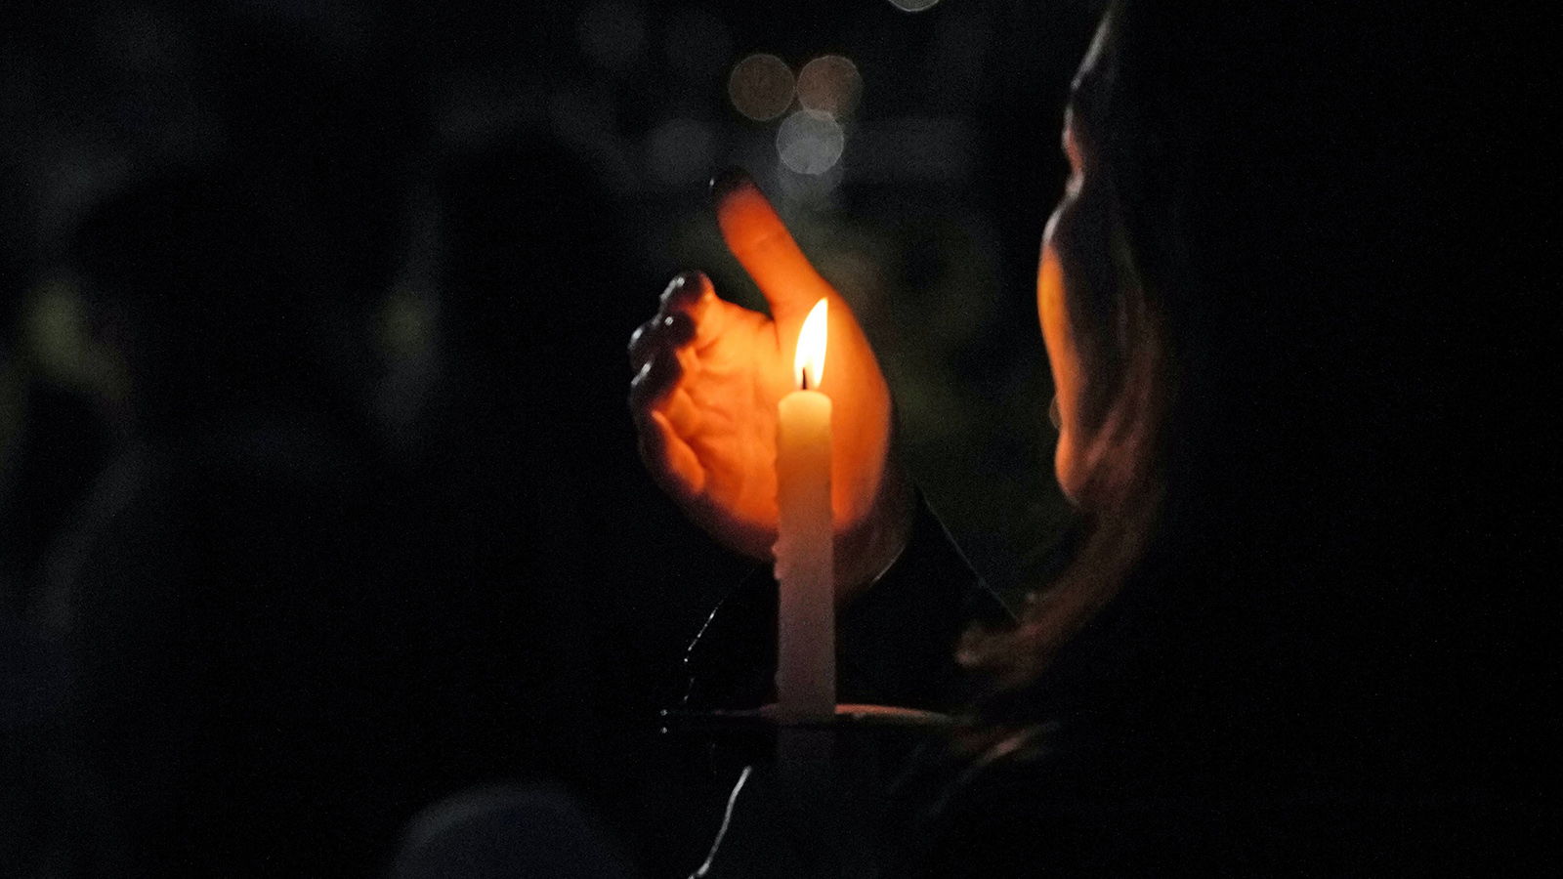

Slide 2
God of a deep and deepening peace,
God of a calm that steadies our pace:
may we take whatever moment we need to gather ourselves for the journey ahead.
May we feel the rock of your presence beneath us; the assurance of shelter you provide in embrace; and the promise of company gathered close by your spirit;
so that as we approach the unknown ahead we remember a strength that can never give way.
Amen.
From the Corrymeela Community, Prayers in a time of pandemic

Slide 3
Opening Prayer
Reading
1 Corinthians chapter 2
“For who has known the mind of the Lord so as to instruct him?”

Slide 4
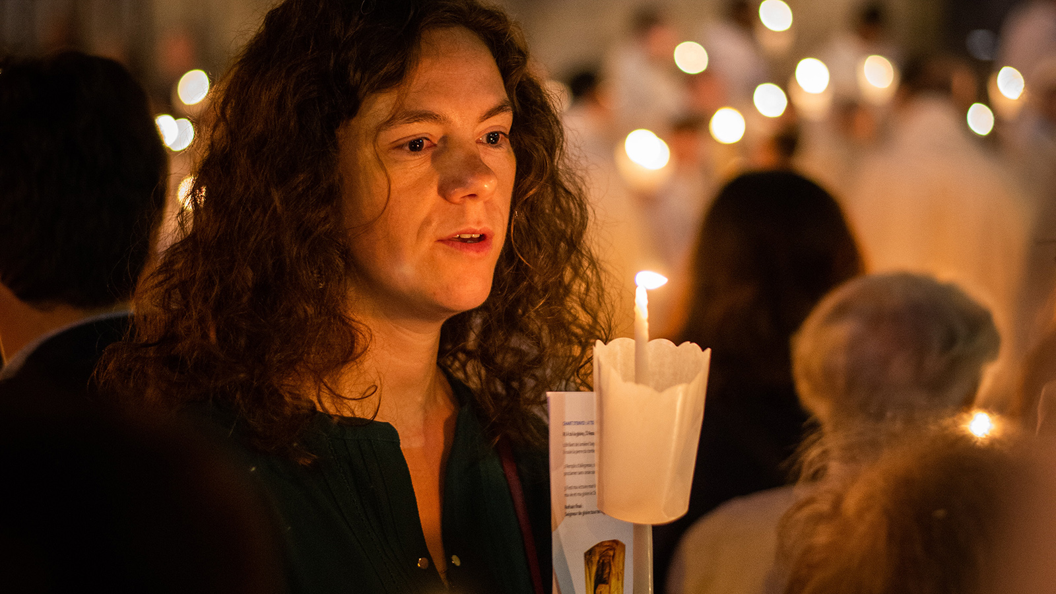

Slide 5
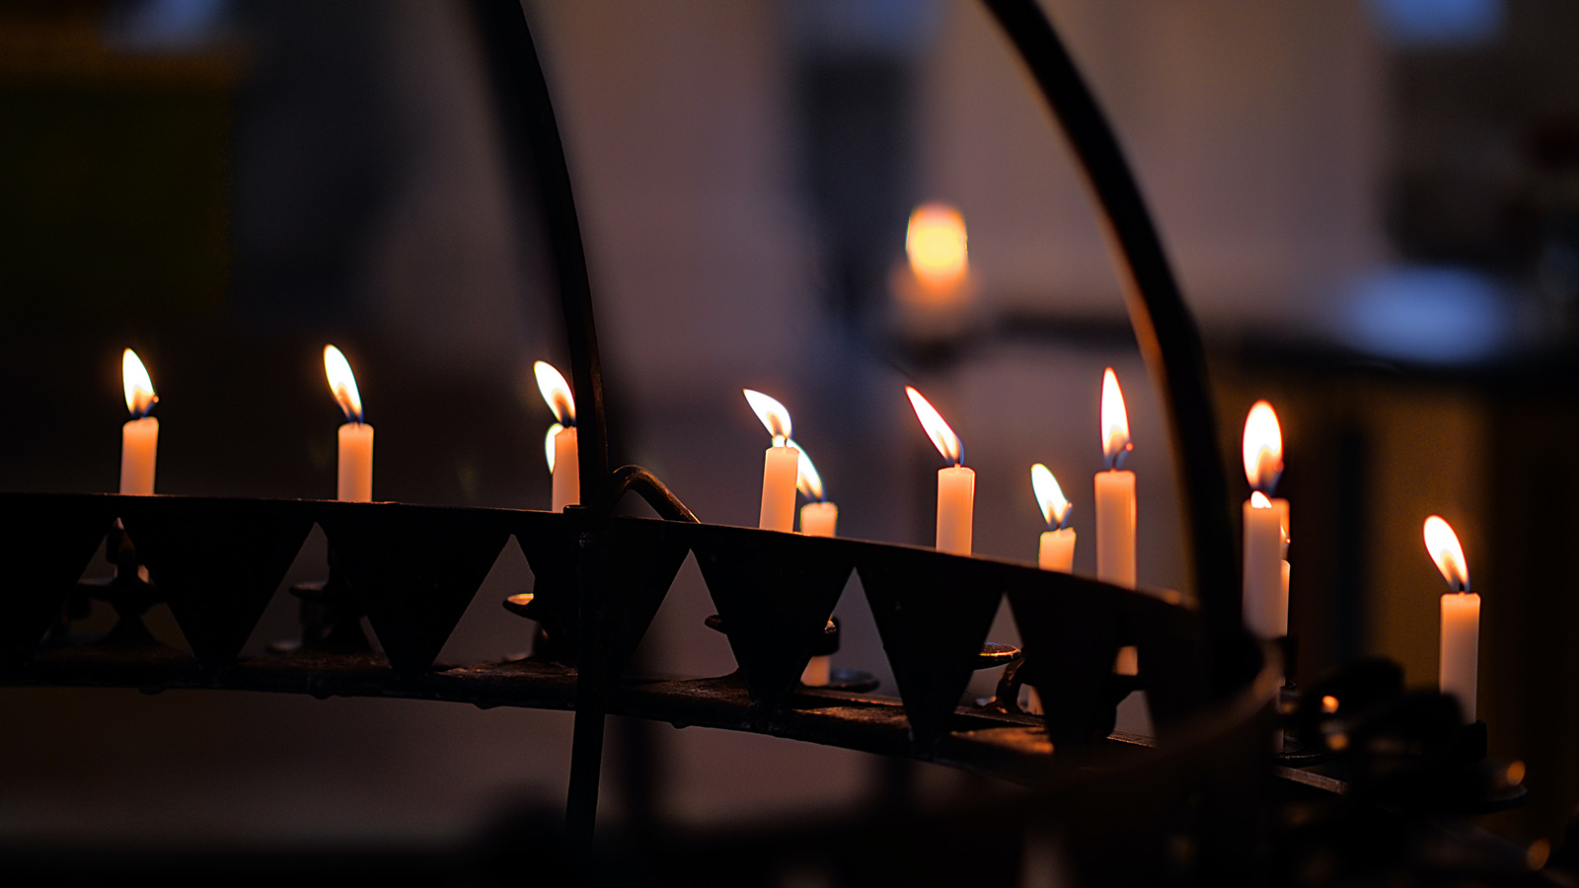

Slide 6
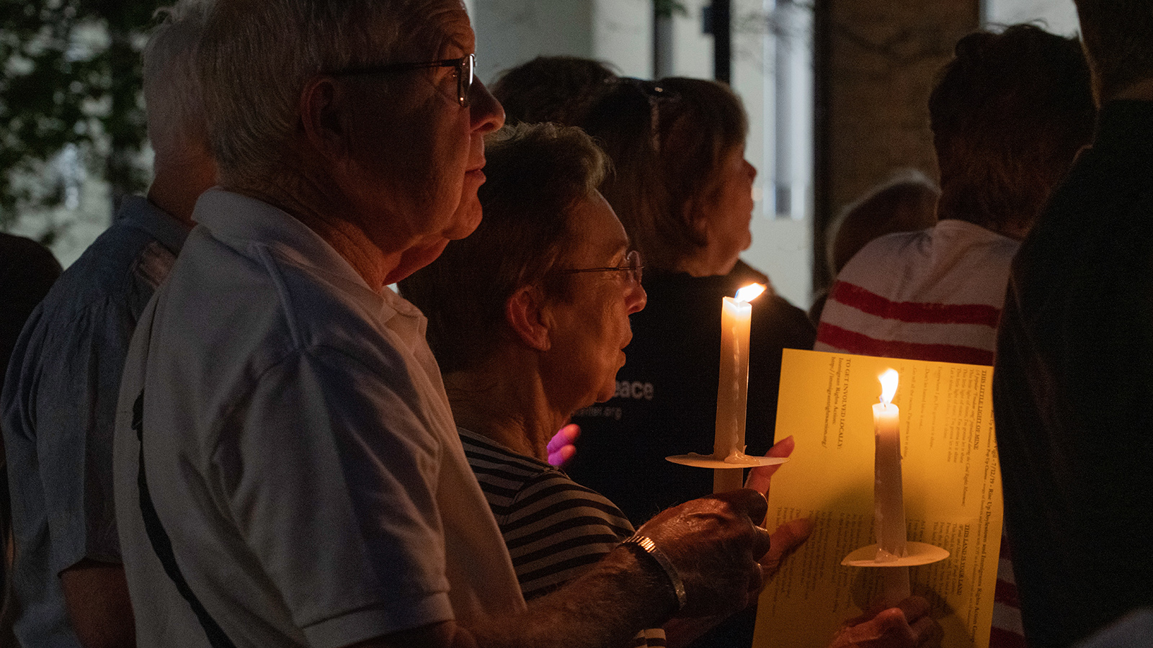

Slide 7
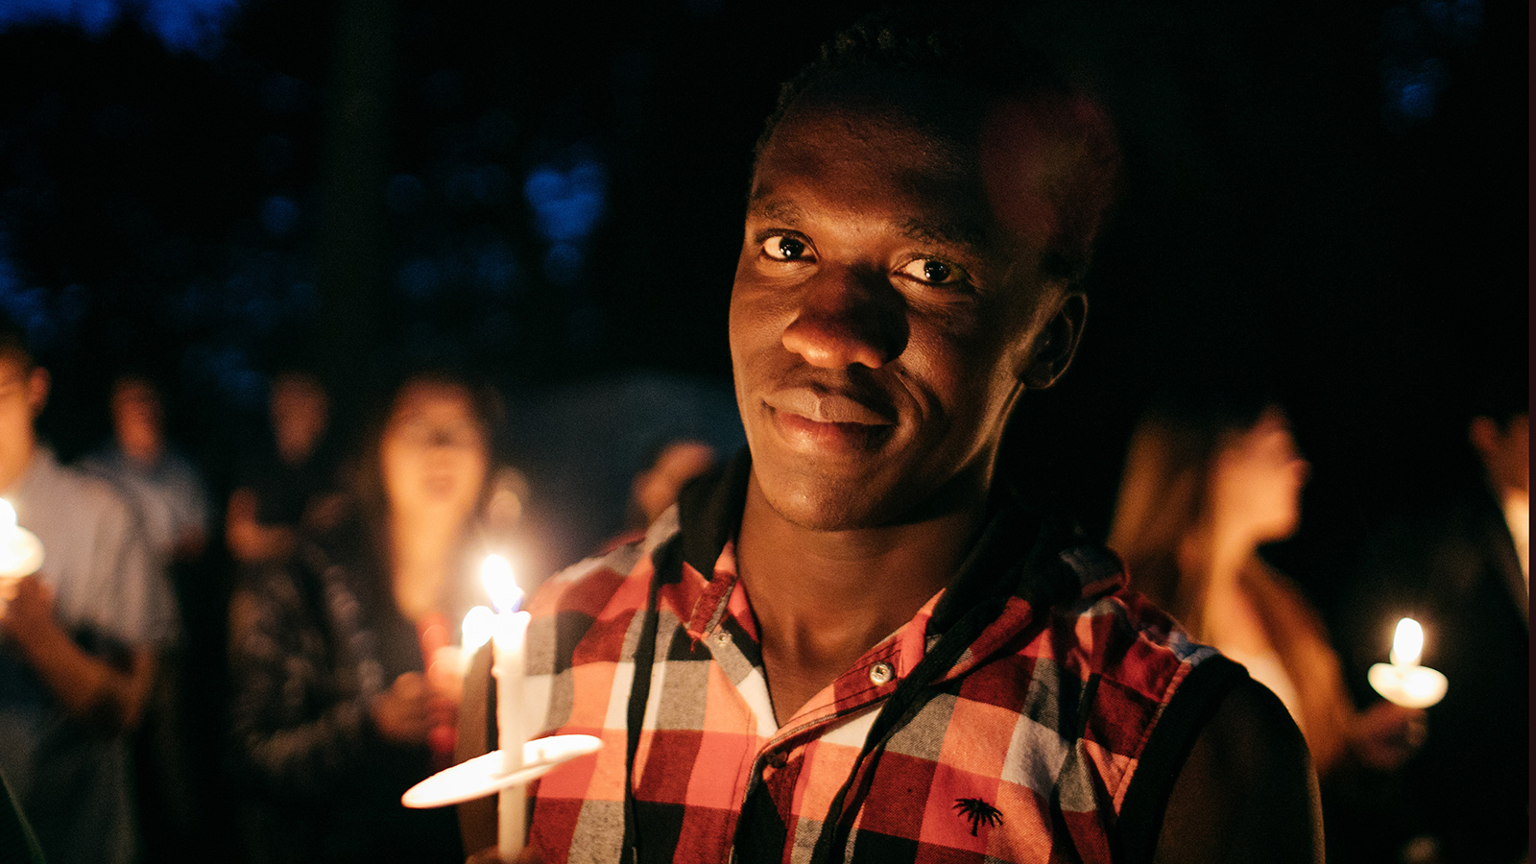

Slide 8
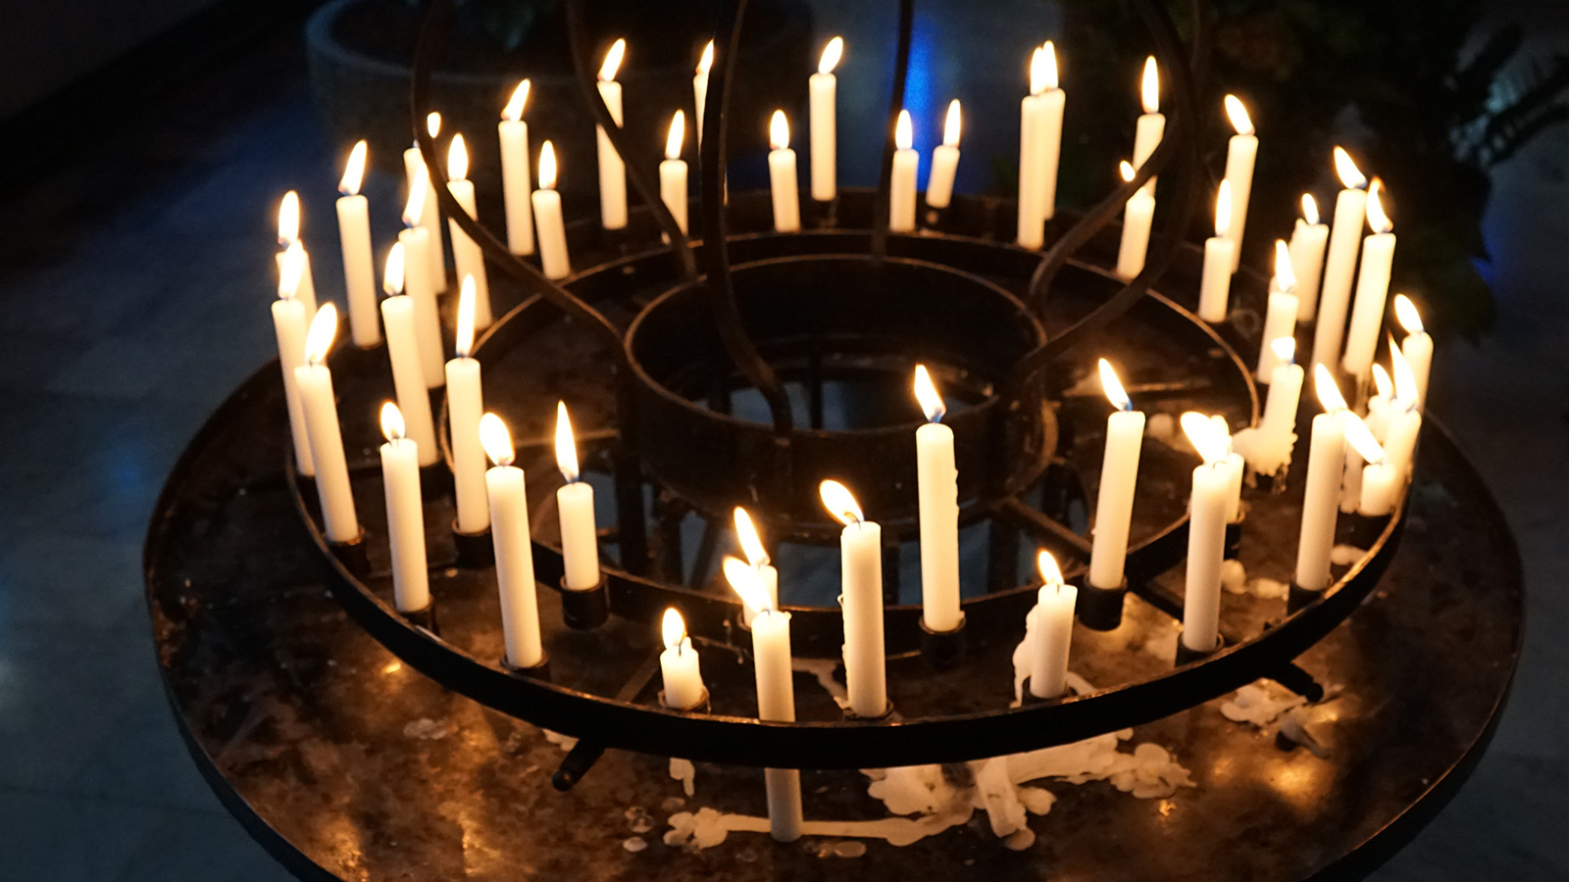

Slide 9
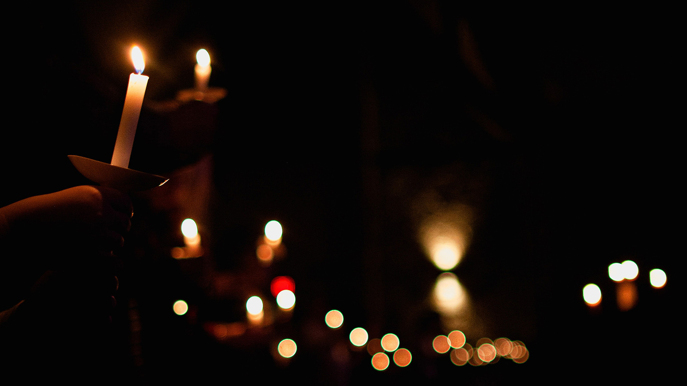

Slide 10
God of life, you have created every human being in your image and likeness. We sing your praise for the gift of our many cultures, expressions of faith, traditions and ethnicities. Grant us the courage always to stand against injustice and hatred based on race, class, gender, religion, and fear of those not like ourselves.
God of peace, God of love, in you is our hope!

Slide 11
Merciful God, you have shown us in Christ that we are one in you. Teach us to use this gift in the world so that believers of all faiths in every country may be able to listen to each other and live in peace.
God of peace, God of love, in you is our hope!

Slide 12
O Jesus, you came into the world and shared fully in our humanity. You know the hardships of life for people who suffer in so many different ways. May the Spirit of compassion move us to share our time, life and goods with all those in need.
God of peace, God of love, in you is our hope!

Slide 13
Holy Spirit, you hear the fury of your wounded creation and the cries of those already suffering from climate change. Guide us toward new behaviours. May we learn to live in harmony as part of your creation.
God of peace, God of love, in you is our hope!

Slide 14
Our Father in heaven, hallowed be your name,
your kingdom come, your will be done, on earth as in heaven.
Give us today our daily bread.
Forgive us our sins as we forgive those who sin against us.
Lead us not into temptation but deliver us from evil.
For the kingdom, the power, and the glory are yours now and for ever. Amen.

Slide 15
Spirituality and solidarity are inseparably linked. Prayer and action belong together. When we abide in Christ, we receive the Spirit of courage and wisdom to act against all injustice and oppression. We say together:
Pray and work that God may reign.
Throughout your day
let the Word of God breathe life into work and rest.
Maintain inner silence in all things
so as to dwell in Christ.
Be filled with the spirit of the Beatitudes:
joy, simplicity, mercy.
These words are recited daily by the Sisters of the Grandchamp Community.

Slide 16
Be one, so that the world may believe! Abide in God’s love, go into the world and bear the fruits of this love.
May the God of hope fill us with all joy and all peace in faith,
so that we may abound in hope by the power of the Holy Spirit.
In the name of the Father, the Son and the Holy Spirit. Amen.

