Slide 1
Church House Prayers
The Feast of the Epiphany
6 January 2021

Slide 2
Gathering in the Presence of God
Lord, you have led us here
to this time and place
to honour you in prayer.
Lead us now on that greater journey
which is to our hearts,
that we may discover there
the riches of your presence.
Nicholas Hutchinson

Slide 3
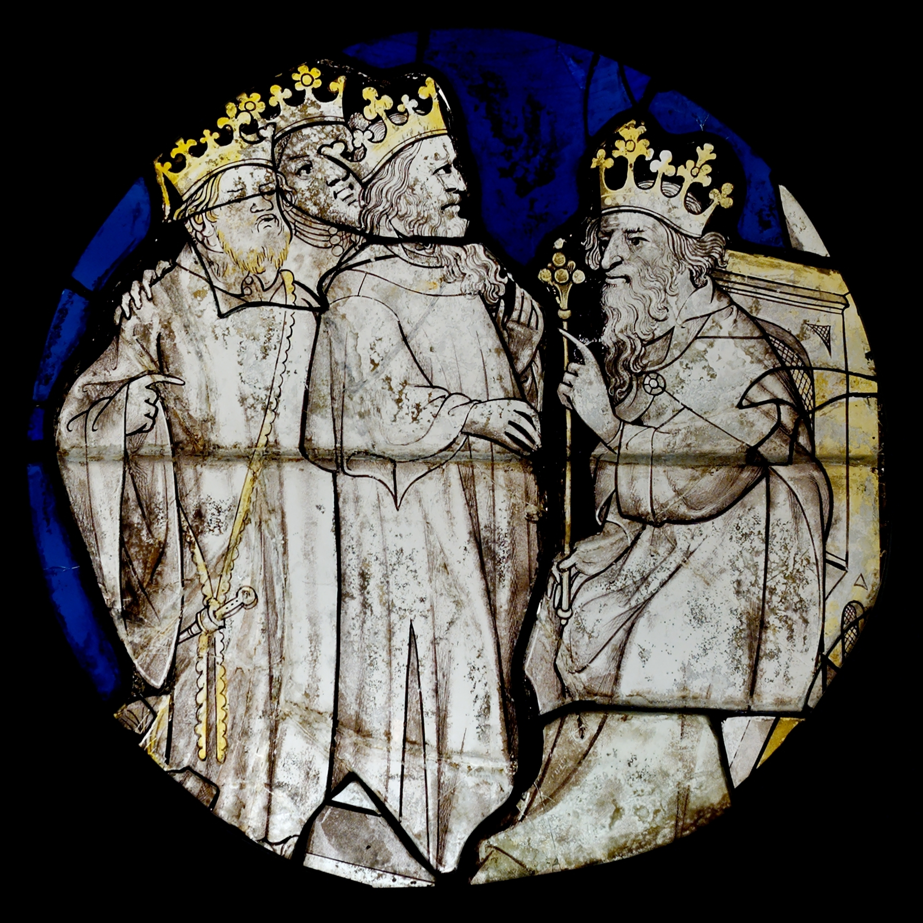
The Visit of the Wise Men
In the time of King Herod, after Jesus was born in Bethlehem of Judea, wise men from the East came to Jerusalem, asking, ‘Where is the child who has been born king of the Jews? For we observed his star at its rising, and have come to pay him homage.’ When King Herod heard this, he was frightened, and all Jerusalem with him; and calling together all the chief priests and scribes of the people, he inquired of them where the Messiah was to be born. They told him, ‘In Bethlehem of Judea; for so it has been written by the prophet: “And you, Bethlehem, in the land of Judah, are by no means least among the rulers of Judah; for from you shall come a ruler who is to shepherd my people Israel.” ’

Slide 4
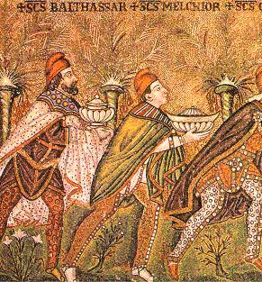
Then Herod secretly called for the wise men and learned from them the exact time when the star had appeared. Then he sent them to Bethlehem, saying, ‘Go and search diligently for the child; and when you have found him, bring me word so that I may also go and pay him homage.’ When they had heard the king, they set out; and there, ahead of them, went the star that they had seen at its rising, until it stopped over the place where the child was. When they saw that the star had stopped, they were overwhelmed with joy. On entering the house, they saw the child with Mary his mother; and they knelt down and paid him homage. Then, opening their treasure-chests, they offered him gifts of gold, frankincense, and myrrh. And having been warned in a dream not to return to Herod, they left for their own country by another road.
Matthew 2.1-12

Slide 5
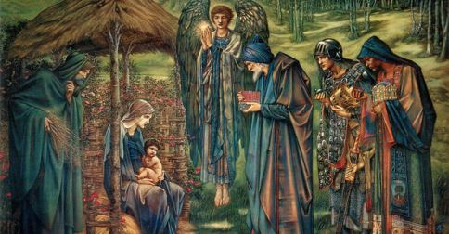
O worship the Lord in the beauty of holiness;
bow down before him, his glory proclaim;
with gold of obedience, and incense of lowliness,
kneel and adore him: the Lord is his name.
Low at his feet lay thy burden of carefulness:
high on is heart will he bear it for thee,
comfort thy sorrows, and answer thy prayerfulness,
guiding thy steps as may best for thee be.
Fear not to enter his courts in the slenderness
of the poor wealth thou wouldst reckon as thine:
truth in its beauty, and love in its tenderness,
these are the offerings to lay on his shrine.

Slide 6
These, though we bring them in trembling and fearfulness,
he will accept for the name that is dear;
mornings of joy give for evenings of tearfulness,
trust for our trembling and hope for our fear.
O worship the Lord in the beauty of holiness;
bow down before him, his glory proclaim;
with gold of obedience, and incense of lowliness,
kneel and adore him: the Lord is his name.
J S B Monsell 1811-1875

Slide 7
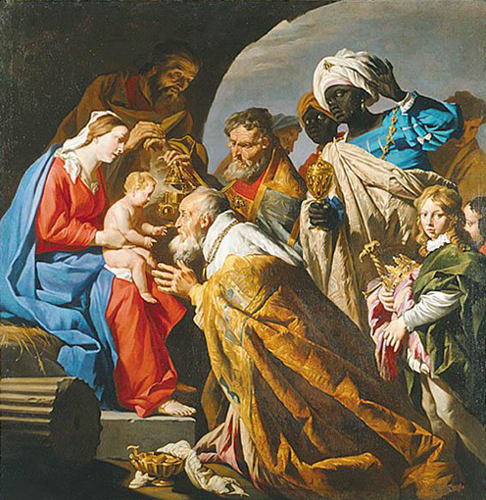
Reflection
Adoration and thanksgiving should be the chief part of our prayer.
Our relationship to God when we come to pray
is the relationship of those who adore him because he is what he is.
As we are filled with joy when we look upon some exquisite scene,
so we adore God because of his transcendent and unutterable beauty.
We adore him because he loved us, because he is Love;
because he has revealed himself to us
in a human life of unspeakable beauty and tenderness;
because when we treated him worst, he treated us best;
because when we rejected him, he did not reject us;
because his Holy Spirit is ever healing, restoring,
and following us with mercy.
We adore his unutterable love and his awe-ful holiness.
Father Andrew SDC

Slide 8
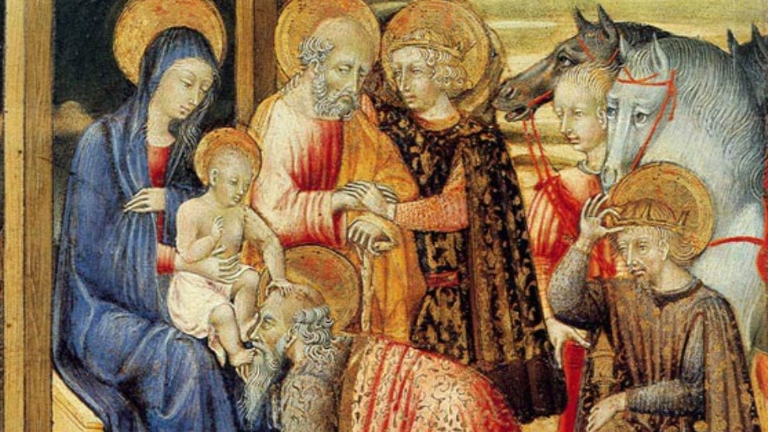
Great and wonderful God, we seek you.
We look for you.
We long for you.
We come and offer you our lives, our love,
our hopes to you.
God, richer than all we have to offer,
we offer you our worship.
We give thanks for the offering of frankincense
and pray for all who give their lives in adoration.
We pray for the congregation
and Church to which we belong.
We pray for all leaders of worship,
for all who bow in quiet adoration.
By the light of your presence,
fill us with your glory.

Slide 9
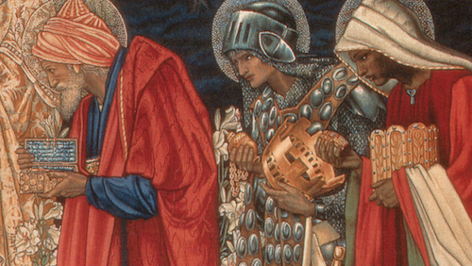
O God, Creator of all things,
we offer you all we have received.
We offer our talents our possessions,
ourselves in your service.
We give you thanks for the gift of gold.
We pray for all who work in commerce
and we remember the world’s poor,
the bankrupt, the underprivileged,
the starving.
May all who have received of your bounty
share generously with those in need.
By the light of your presence,
fill us with your glory.

Slide 10
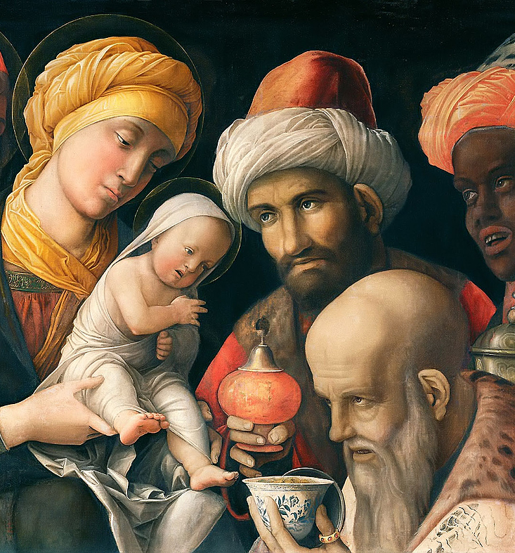
O God, you share in our sorrows,
you enter into our darkness.
You, Lord, come to redeem, release and restore us.
We give you thanks for the gift of myrrh.
We pray for all who are in pain or distress,
all who are troubled or anxious.
We pray for all who seek to relieve pain,
for doctors, nurses and dentists.
We pray for all who work for the redeeming of our world.
By the light of your presence,
fill us with your glory.

Slide 11
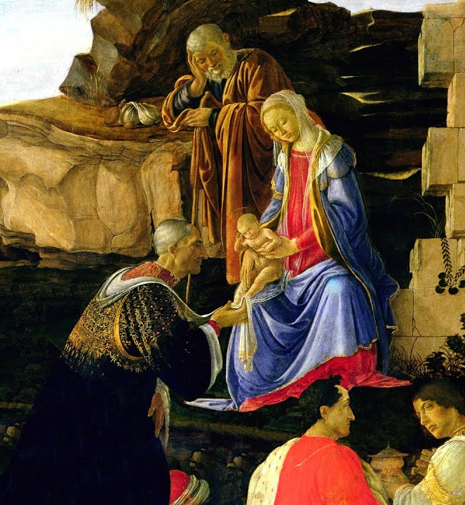
O God, whose Son was born into an earthly family,
bless our homes and loved ones.
Reveal your presence in our homes
and in our relationships.
We pray for all who are born into sordid homes
or into homelessness.
We pray for children who suffer from violence
or through neglect.
By the light of your presence,
fill us with your glory.
David Adams

Slide 12
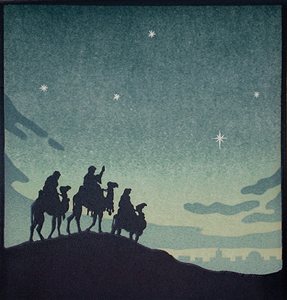
Poem
All this was a long time ago, I remember, and I would do it again, but set down this set down this: were we led all that way for Birth or Death? There was a Birth, certainly we had evidence and no doubt. I had seen birth and death, but had thought they were different; this Birth was hard and bitter agony for us, like Death, our death. We returned to our places, these Kingdoms, but no longer at ease here, in the old dispensation, with an alien people clutching their gods. I should be glad of another death.
Extract from The Journey of the Magi
T S Eliot

Slide 13
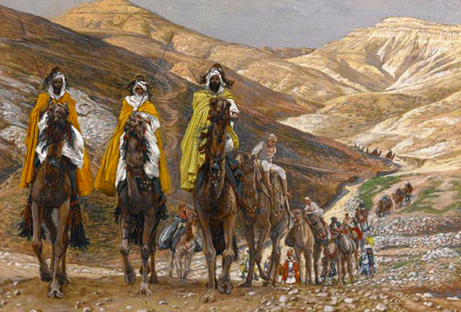
As with gladness men of old did the guiding star behold, as with joy they hailed its light, leading onward, beaming bright: so, most gracious God, may we evermore be led to thee.
As with joyful steps they sped to that lowly manger bed, there to bend the knee before him whom heaven and earth adore: so may we with willing feet
ever seek thy mercy-seat.
As they offered gifts most rare at that manger rude and bare.
so may we with holy joy, pure, and free from sin's alloy, all our costliest treasures bring, Christ, to thee, our heavenly king.

Slide 14
Holy Jesu, every day keep us in the narrow way, and, when earthly things are past, bring our ransomed souls at last where they need no star to guide, where no clouds thy glory hide.
In the heavenly country bright need they no created light; thou, its Light, its Joy, its Crown, thou its Sun which goes not down: there for ever may we sing alleluyas to our King.
W Chatterton Dix 1837-1998

Slide 15
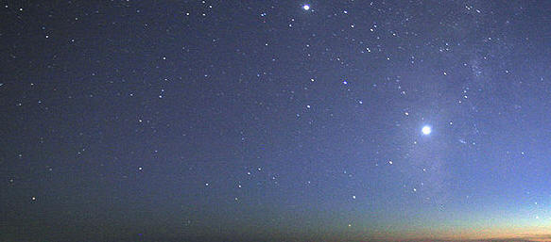
To discover how to be human now
is the reason we follow this star.
W H Auden

Slide 16
God our Father,
the star of Bethlehem
was a sign of faith for the Wise Men,
may we too perceive the vision you lay before us,
knowing that Jesus himself is the Way,
and enable us to remain committed
on the journey to its end.
And so we ask for the richness
of your blessing, Father,
that we may grow in faith and wisdom
and discover Jesus in our midst each day.
Amen.
Nicholas Hutchinson

