Slide 1
Diocesan Synod
6th November 2021
2022 Budget

Slide 2
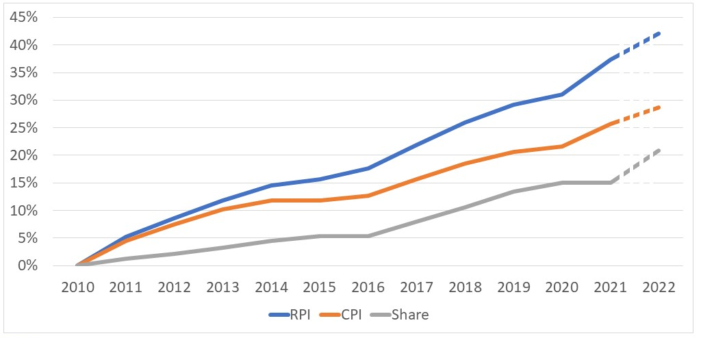
Divergence: Share v RPI and CPI
Notes:
From 2018 Presentation:
These trends start with a base of zero at Jan 2004, so represent the cumulative effects of inflation.
Budget for share in 2016 was £9.7m if it had risen inline with CPI it would have been £10.6m and if inline with RPI it would have been £11.5m.
Even taking into account that FS membership has dropped from 28,000 to 25,500 since 2004 - if the 25,500 were giving at the same amount today in real terms as in 2004 (and we take cumulative inflation as 20% - mid way between the RPI and the CPI) our FS income would be £800k higher than it is!
In 2016 Ave. tax efficient giving (excluding tax recovered) in CoE = £12.01, Salisbury Diocese = £9.23, we are currently 4th from the bottom of the Diocesan league table of generosity, so there is potential to up our game.

Slide 3
Introduction
We are committed to maintaining Christian ministry in every parish in this Diocese
Our budgeted stipendiary clergy numbers reflect the Mission and Pastoral Plan
Parish share is the means by which we cover the cost of ministry in our parishes
Our goal is to eliminate the current deficit and achieve sustainable finances by 2025
We will continue to seek savings in central costs and other forms of income generation
We hope the Generous Giving Campaign helps foster a culture of giving and generosity

Slide 4

Background
Historic deficit
Commitment to address in 2020
Intervening challenges of Covid
Rising inflation
Share is major source of income
Contribution fallen 97% 90%
Consulted on 5%/10% increases

Slide 5




Consultation Feedback
4
1
4: Clergy provision
1: Share increase
3: Church house services
3
2
2: Drop In clergy
Notes:
Share increase
10% too much of a step change too quickly for most parishes still reeling from the effects of Covid. There has only been 1 communication in specific support of 10% and all straw polls taken at meetings have been in support of 5% option and even that is reluctant approval in the absence of other options
5% is still a big step up but more manageable
Parishes need help not a request for more money
Why should those parishes paying in full effectively subsidise those unable or unwilling to pay
We should be more optimistic with our giving targets- cheerful investor argument
We need to look more closely at parish reserves and boost understanding of restricted funds
Drop in clergy
Not good to cut the frontline forces – i.e. the clergy on the ground
Drop in clergy has not been agreed by the members
Why was option not included with no loss of clergy posts?
Church House Services
Questioning value for money from services provided by Church House
Central costs are not being cut hard enough
Clergy provision
Questioning value for money from clergy provision
Clergy are too tied up in administration meaning pastoral work suffers

Slide 6
Proposed Way Ahead
A single revised proposal of a 5% increase in Share
backed by an updated and revised plan aimed to bring the deficit below
£1m in 2022

Slide 7
Key Reasons
Give parishes more time to recover & time for the Fairer Share Review
Allow for the Generous Giving campaign to be evaluated
Assist parishes with financial difficulties
Allow the Giving Adviser to get themselves established
Show parishes that we have listened to feedback from the consultation
Allow input from the new Bishop to longer terms plan

Slide 8
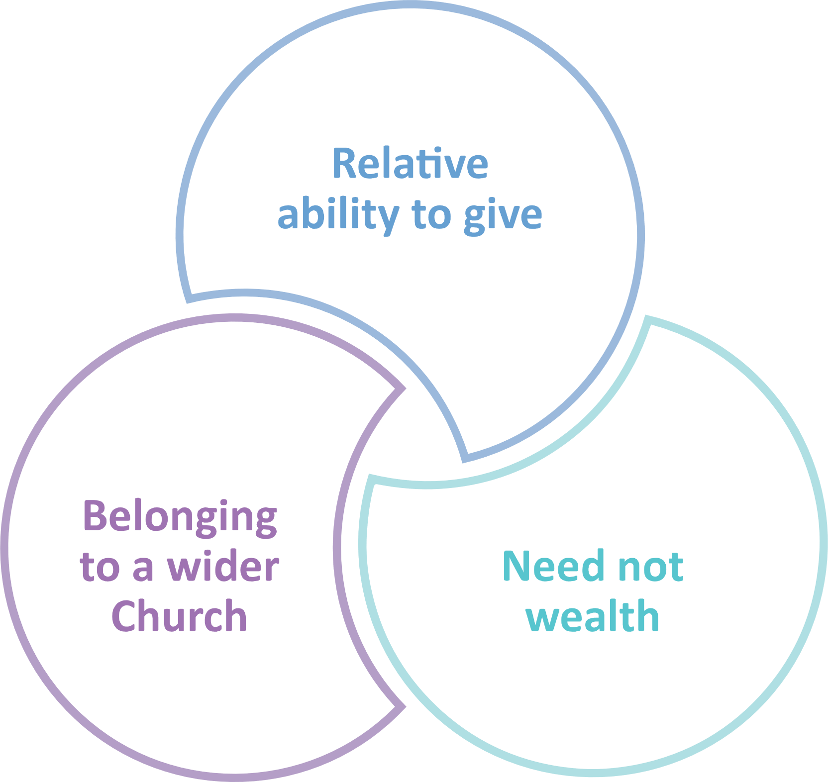
Impact on Share
5% increase in 2022 for all parishes where there are no stipendiary deployment changes to the benefice
Parishes with stipendiary deployment changes will have adjustment according to the current Fairer Share rules
In year appeal process

Slide 9
Adjustments made since September
Net increase in costs to reflect recent events | £'000 | Reduction to Church House costs | £'000
Inflation increased to 3% certain areas | 60 | Mission & Ministry | (70)
Parochial fees revised downwards | 50 | Social justice, Comms & Safeguarding | (64)
Changes to NIC and staffing estimates | 11 | Additional Challenge | (156)
One curate less and saving on clergy pension cost | (64)
Total net increase | 57 | Total Reduction | (290)
Net Increase in costs
Net Decrease
Total Change (£233k)

Slide 10
Impact on Deficit since September Synod
Original Deficit September Synod (£1.232m)
After Changes/Challenges (£1.155m)
Additional Challenge (£156k)
Deficit <(£1m) for 2022

Slide 11
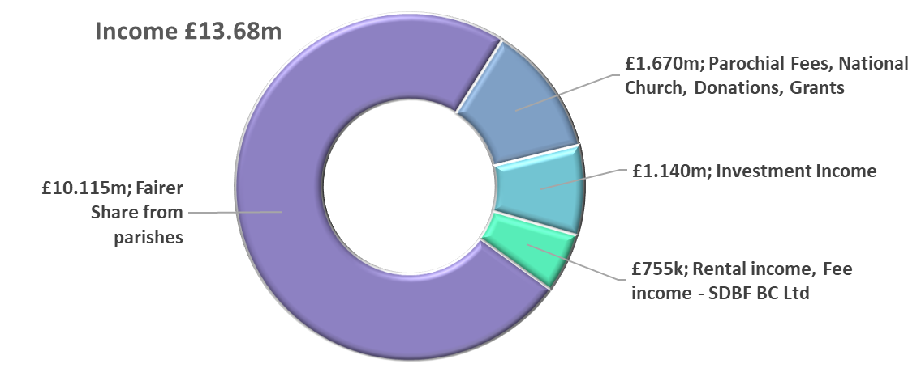
Income & Expenditure
Expenditure £14.835m
 | £,000
Income | 13,680
Expenditure | (14,835)
Challenge | 156
Deficit < 1m | (999)

Slide 12
Detailed Income

Slide 13
Detailed Expenditure

Slide 14
Looking Ahead
Total Return
Church House
Giving Adviser
Parish Support
Fairer Share Review

Slide 15
David Robinson
Bradford Deanery Treasurer

Slide 16

Discussion

Slide 17
Motion
Diocesan Budget for 2022 - The Chair of the Diocesan Board of Finance to move:
“That the Diocesan Board of Finance/Synod approves the Annual Budget for 2022.”

Slide 18



SPARE Where is income spent?
Total Expenditure £14.835m
Clergy, housing and services to parishes
£12.932m 87%
This pays for:
Administration and other costs
£1.903m 13%
Deficit to be further reduced by Church House challenge of £156k to under £1m

Slide 19

SPARE Deployment Changes 2021 and 2022
Loss of 10 Stipendiary posts
But loss is spread across 13 benefices & does not represent total loss of service
  5 FTE post to HfD
  1.5 Frozen Vacancies, pending final decision
  3.5 lost (2.5 half time)

