Slide 1
Diocesan Synod 22 June 2021
Directors’ and Trustees’ report and Consolidated Financial Statements :
A presentation of the main points

Slide 2
Resilience in adversity
Successful remote working/ IT investment
Integration of the Channel Islands proceeded
Support for the Sudans – generous giving
Worship moved online
Care in the community flourished

Slide 3
Summary Statement of Financial Activities
 | 2020 | 2019 | Variance
 | £,000 | £,000 | £,000
Total income | 13,011 | 13,854 | (843)
Total expenditure | (14,524) | (14,635) | 111
Operating Deficit | (1,513) | (781) | (732)
Net gains on properties, investment and glebe | 300 | 2,661 | (2,361)
Reduction in clergy pension deficit | 483 | 2,482 | (1,999)
(Decrease)/Increase in funds | (730) | 4,362 | 5,092

Slide 4
Net gains/(losses) on Properties, Investment & Glebe
 | 2020 | 2019
 | £,000 | £,000
Realised gains and losses investments, properties and Glebe | (38) | 69
(Decrease)/ Increase value investments | (722) | 2592
Increase in value of Glebe | 1,060 | -
Total movement | 300 | 2,661

Slide 5
Balance sheet – snapshot at year ends
 | 2020 | 2019 | Movement
 | £,000 | £,000 | £,000
Fixed assets mainly Clergy properties | 93,555 | 94,264 | (709)
Investments | 31,179 | 31,901 | (722)
Net current assets | 4,201 | 1,608 | 2,593
Long term liabilities | (3,269) | (1,377) | (1,892)
Net assets | 125,666 | 126,396 | (730)

Slide 6
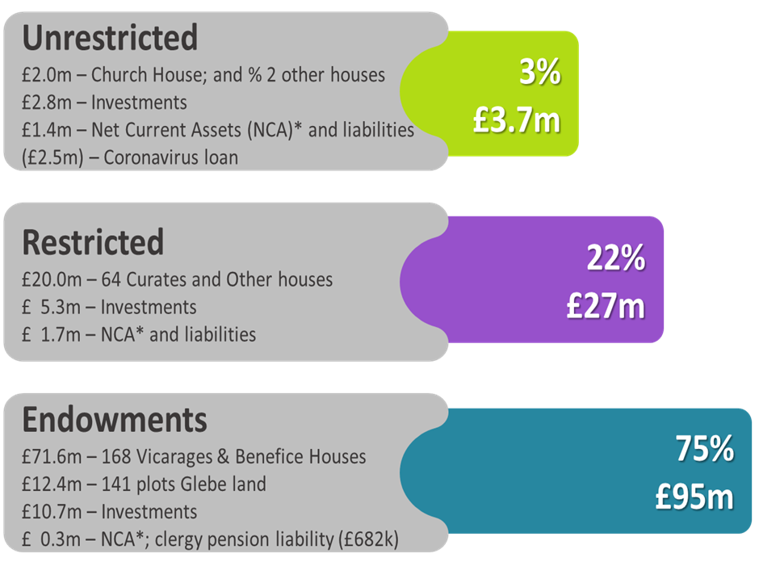
Balance sheet by Fund

Slide 7
What happened to cash?
Cash was raised from :- £,000
Sale of 3 curates houses 878
Investments sold in March 2020 988
Coronavirus bank loan 2,500
Total raised 4,366
Spent on :-
Deficit 1,416
Purchase IT 222
Purchase investment 10
Decreasing liabilities 361
Total Spent 2,009
Cash end of year UP
+ £2.357m

Slide 8
Going concern
Why do trustees consider the DBF to be a going concern
Strong balance sheet even with restrictions etc gives options
Credible plan to eliminate operating deficit by 2025
All possible sources of income being explored
Tight control of costs
Unqualified Audit Opinion for 2020
Welcome to Adam Halsey – charity partner Haysmacintyre

Slide 9
Motions
The Chairman of the Diocesan Board of Finance to move:
“That the Diocesan Board of Finance receives the Directors’ and Trustees’ Report and Consolidated Financial Statements for the year ended 31 December 2020.”
The Chairman of the Diocesan Board of Finance to move
“That the Diocesan Board of Finance approves the appointment of Haysmacintyre as the auditors for the Diocesan Board of Finance.”

