Slide 1
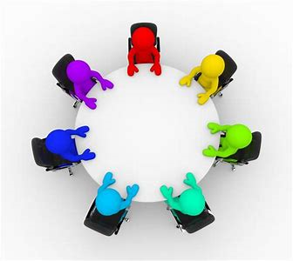
Table Talk
A simple ice-breaker

Slide 2
Resources to help us talk to one another

Slide 3
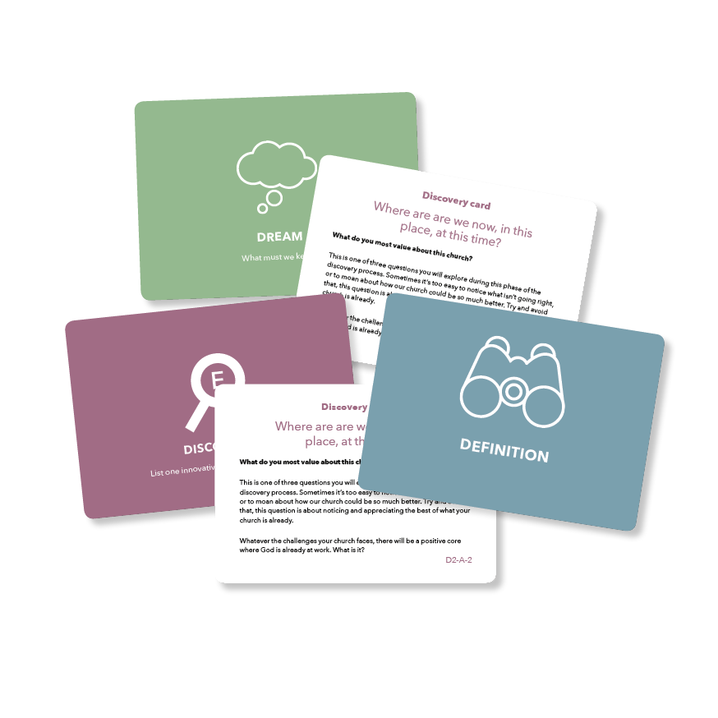

Slide 4
We all have a story to tell

Slide 5
Develop Discipleship and Evangelism
Encourage dynamic and collaborative leadership
Transform Lives and Communities

Slide 10
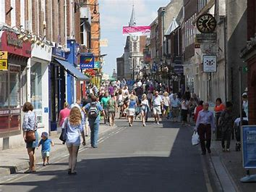
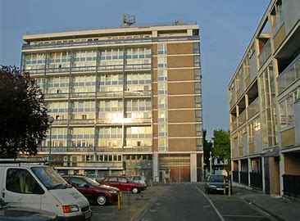
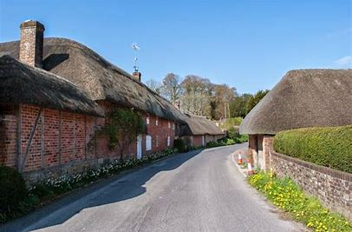
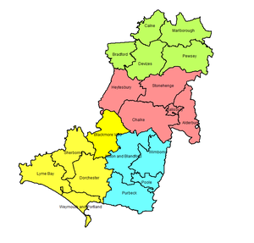
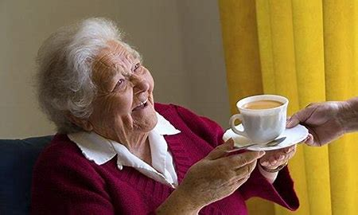
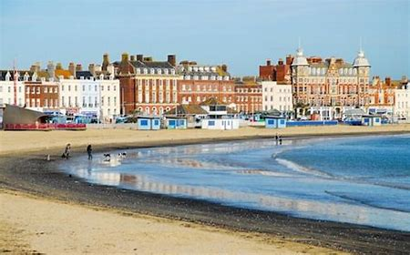

Slide 11
Local Engagement
Greater Integration
Partnership
Simplification
Review

Slide 12
Develop Discipleship and Evangelism
Encourage dynamic and collaborative leadership
Transform Lives and Communities

Slide 13
‘That this Synod celebrates the Renewing Hope journey that the Diocese of Salisbury has been on and adopts the priorities for growth and next steps as proposed’

