Slide 1
Salisbury Diocesan Board of Finance
Annual General Meeting
Wednesday 19th June 2019

Slide 2
AGM - Agenda
Part 1:- Directors’ and Trustees’ Report and Consolidated Financial Statements
Part 2:- Appointment of Auditors
Part 3:- Diocesan Budget 2020
There will be opportunities for questions on Parts 1 and 3 within each section

Slide 3
Salisbury DBF: AGM Part 1
Directors’ and Trustees’ Report and Consolidated Financial Statements 2018

Slide 4

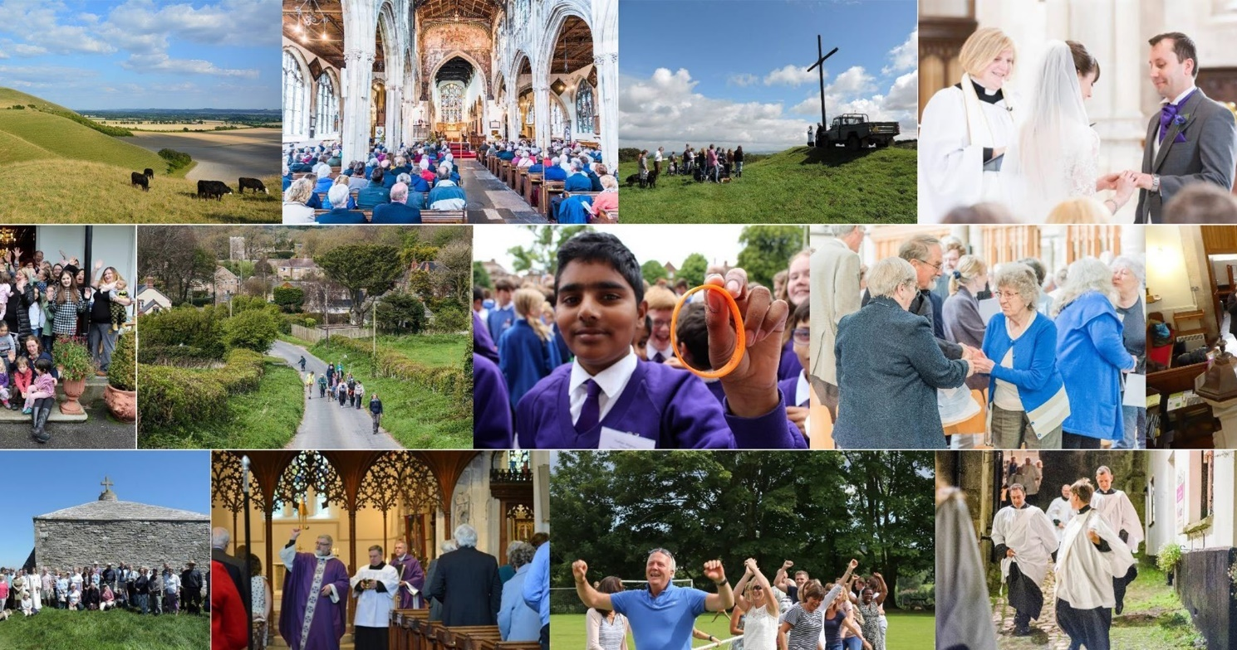
Financial Overview
Report and Accounts 31.12.2018
4

Slide 5
Annual Report
New layout to the Directors and the Trustees report
What is the report’s purpose?

Slide 6
Objectives
Deepening discipleship
Nurturing vocations
Sustaining ministry
Engaging with children and young people

Slide 7
How have we done?
194 schools 43,000 children
How have we served?
Rural Hope
1st Eco Diocese

Slide 8
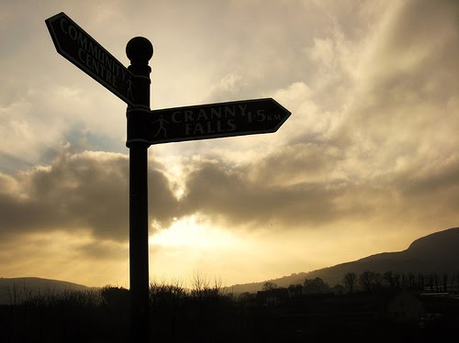
Looking to the future

Slide 9
Audit Report
UNQUALIFIED OPINION
A TRUE AND FAIR VIEW
COMPLIANT WITH UK GAAP
COMPLIANT WITH COMPANIES ACT 2006

Slide 10
3 Main Statements of Account
Statement of Financial Activities
Balance Sheet
Cash flow Statement

Slide 11
SOFA YEAR ENDED 31/12/2018 | 2018 | 2017 | Variance
 | £,000 | £,000 | £,000
Income | 13,525 | 13,708 | (183)
Expenditure | (13,979) | (13,539) | (440)
Net deficit/ surplus | (454) | 169 | (623)
Movement investments | (1,208) | 2,311 | (3,519)
Net movement in funds | (1,662) | 2,480 | (4,142)
Notes:
The SOFA includes all transactions except for the loss on investments
As such it masks the operating deficit

Slide 12
Different layout Income and Expenditure
Income and Expenditure different layout | 2018 | 2017
 | £,000 | £,000
(Deficit)/surplus share | (262) | 23
Capital repairs Ingoing Works | (534) | (510)
Movement other funds | (369) | (179)
Profit sales property | 125 | 147
Total Operating Deficit | (1,040) | (519)
Movement portfolio investments | (1,208) | 1275
Increase investment property | - | 1,036
Movement clergy pension creditor | 586 | 688
Total movement in funds | (1,662) | 2,480
Notes:
The SOFA

Slide 13
Income
Income for the year | 2018 | 2017 | Variance
 | £,000 | £,000 | £,000
Parish Share | 9,916 | 9,895 | 21
National Church | 299 | 118 | 181
Other donations | 662 | 729 | (67)
Charitable activities | 812 | 814 | (2)
Other trading activities | 590 | 807 | (217)
Investments | 1,120 | 1,081 | 39
Gain sale properties | 126 | 264 | (138)
Total | 13,525 | 13,708 | (183)
Notes:
Parish share note 2 is after discount plus arrears and comes out at 96.5% : more share has been received since 31 January
National Church is
84k Rural Hope
148k RME – funding ordinands training
67k Area Bishop’s secs
299k
Other donatIons note 4
All churches trust 155
Milton abbey 307
Sudan grants and donations 168
Other 32
TOTAL 662
Charitable activities
Statutory fees and third party stipends 797
15k other
Other activities
Rental income from let clergy houses net 257
Fee income sdbf bc 333
Total 590
Investment income
From portfolio 881
Investment props 199
Other church house 33

Slide 14
Expenditure
Expenditure for the year | 2018 | 2017 | Variance
 | £,000 | £,000 | £,000
Raising funds | 121 | 95 | 26
Charitable activities | 13,696 | 13,232 | 464
Other | 162 | 212 | (50)
Total | 13,979 | 13,539 | 440
Notes:
Fund raising costs
Glebe agents fees 24
Other glebe expenses 21
Agents fees on other let property 28
Other expenses let property 48
121
Charitable activities
See p 35
Other = sdbf bc expenses 162

Slide 15
Balance Sheet
Balance Sheet | 31/12/2018 | 31/12/2017 | Movement
 | £,000 | £,000 | £,000
Tangible assets | 92,313 | 92,252 | 61
Investments | 31,035 | 32,243 | (1,208)
Clergy Houses resale | 600 | 716 | (116)
Debtors | 913 | 965 | (52)
CASH | 1,356 | 2,271 | (915)
Creditors | (324) | (373) | 49
Creditors > 1 year | (3,859) | (4,378) | 519
Net assets | 122,034 | 123,696 | (1,662)
Notes:
Balance sheet
Tangible assets
Sales from current assets
2018 92913 92968 decrease 55k
43 abbots way 266 and Witchampton 450 in current assets TOTAL 716
Purchases
Graycott close 342
Amesbury 275
IMS 38
TOTAL 665
So sales less purchases - 51
Equipment -4 additions 21 depreciation 25
Pension creditor

Slide 16
Cashflow Statement
Cashflow statement | 2018 | 2017
 | £,000 | £,000
Net movement in funds | (1,662) | 2,480
After adjustment | (1,071) | (1,178)
Purchase fixed assets | (686) | (2,943)
Sale fixed assets | 842 | 2,834
Sale investments | - | 833
Loan repayment DBE | - | 100
Movement in cash in period | (915) | (354)
Notes:
Adjsutment for non cash novements
(1,662)
(586) clergy pension put back as cash movement
1,208 net gain investments
(124) Profit sale assets
Movement debtors and creditors
Depreciation
(1071)

Slide 17

Questions on Financial Statements

Slide 18
Motion to Adopt
REPORT AND FINANCIAL STATEMENTS 2018
The Chairman of the Diocesan Board of Finance to move:
“ That the Diocesan Board of Finance adopts the Directors’ and Trustees’ Report and Consolidated Financial Statements for the year ended 31 December 2018.”

Slide 19
Salisbury DBF: AGM Part 2
APPOINTMENT OF AUDITORS
The Chairman of the Diocesan Board of Finance to move:
“That the Diocesan Board of Finance approves the appointment of haysmacintyre LLP as the auditors for the Diocesan Board of Finance.”

Slide 20
Salisbury DBF: AGM Part 3
Diocesan Budget 2020

Slide 21

Budget 2020 - Introduction

Slide 22
2020 - A Transitional Year
  Fairer Share (count) numbers declining
  We are running a cash/ operational deficit £1m p.a.
  Series of reviews underway
  These will feed into 3 year plan 2021-23
  We are responding to feedback:
    Simplified all-inclusive budget approach
    Need to view numbers in context of count
    Wish for greater transparency and clarity
    Mounting concern over ability to pay
  Count held early – thank you
  Holding budget with minimal increase

Slide 23
2020 - Budget
  Operating deficit falls in 2020 v 2019 £304k but remains significant at £901k
  Share Request
  Share request is an increase of 1.48%
  This enables progress against the deficit
  CPI forecast for 2020 is 2%
  Count
  Decline of 577 (2.33%)
  Per Capita Increase
  Per capita increase is therefore 2.86%

Slide 24
2020 - Budget Guide
Income and expenditure whole Diocese
Chairman’s letter
Total income and expenditure 2018-2020
What share contribution pays for?
Detailed explanation of 2020 figures
Looking to the future

Slide 25
Looking Ahead
What might thriving Christian presence in each community look like in 2030?
Eliminate deficit by 2023
Review process underway 2019

Slide 26
Review Process
Mission and Ministry
Fairer Share
Comms and Engagement
Property
Diocesan offices
IT

Slide 27
The Financial Imperative
Review process
Make choices
Address
costs
Balance budget
Increase income
S
U
S
T
A
I
N
A
B
I
L
I
T
Y

Slide 28
Questions on 2020 budget and reviews

Slide 29
Motion to Approve
BUDGET 2020
The Chairman of the Diocesan Board of Finance to move:
“ That the Diocesan Board of Finance approves the 2020 Budget”

