Slide 1


Welcome and Introduction
Thank you for joining us today
Helen Richardson
CEO, Parish Giving Scheme

Slide 2
Giving and Regular Giving
Church Giving – it’s big stuff
3 legged stool:
Why do we give?
What do we give?
How do we give? PGS: we will
concentrate today

Slide 3
Why do we give?
“Christianity is a kind of giving” CS Lewis
It is part of church life/our faith
We are excited by what our church does
Central to our community, schools
It is a “heart work”
“See that you also excel in this grace of giving”
2 Corrinthians

Slide 4
What do we give?
We need to know what it is about
To pay for things
Professionally and trust worthy
Generously with thanksgiving & celebration:
“Generosity is not just a transaction, it is
transformational”
“No one becomes poor by giving” Anne Frank

Slide 5
How do we give?
Collection or Offering – central to our worship
One off Gifts or Donations
Fundraising
Fees
Enterprises
Wills
Regular Giving with Gift Aid:
PARISH GIVING SCHEME

Slide 6
Salisbury Diocese - webinar
July 2020
Helen Richardson
Chief Executive

Slide 7
What is the PGS?
Donations made through this scheme use a Direct Debit.
This can be made on a monthly, quarterly or annual basis.
Each donation is restricted to the intended church.
Gift Aid is reclaimed and passed onto the church directly.

Slide 8

Unique benefit:
Giving to rise in line with inflation annually
Why is this important?

Slide 9
Ways to donate:
1) By paper form or PDF sent via post:

Slide 10
Ways to donate:
By phone:
0333 002 1271
Lines are open Monday – Friday 9-5pm

Slide 11
Ways to donate:
COMING SOON:
Donate online

Slide 12
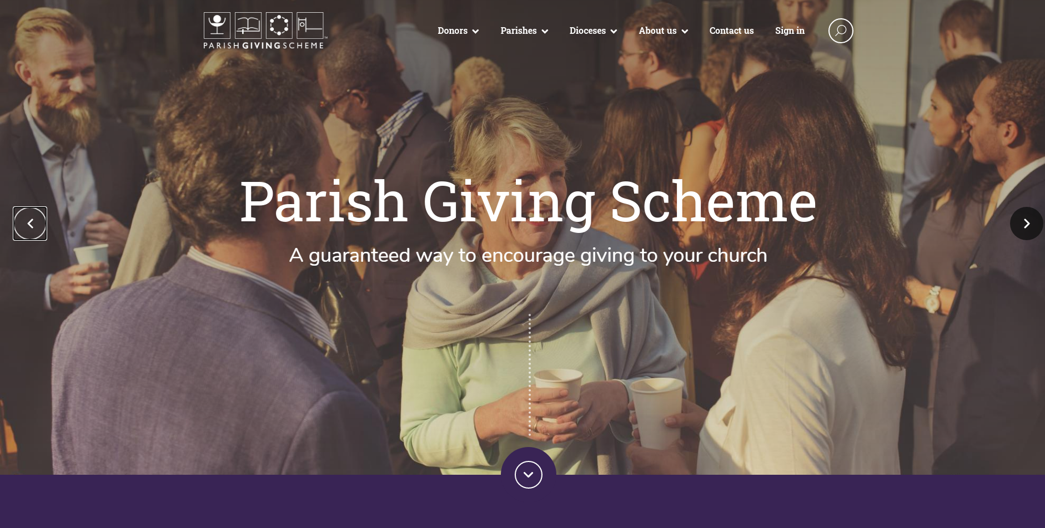
PGS – New website

Slide 13
First phase LIVE:
Statement Receiver Activation
16th June new site live – www.parishgiving.org.uk
Statement Receiver Account Activation
3,500 required - 1,952 have successfully activated
Considerable support required - 414 requests

Slide 14
Second phase - In development:
Online regular donation capability
- Parish Data Mapping exercise
- PGS team testing
- Volunteer testing
- Review and fix
- Phased roll-out – details and timeline to follow

Slide 15
PGS HEADLINES:
Since lockdown:
3,905 NEW donors
160 new parishes registered
£18.9m remitted to parishes
Forecast end of 2020
- Raise £57.5m (28% growth 2019)

Slide 16
Salisbury’s headline stats:
Last 12 months
- £1.95 million for the entire diocese
July 2020
1,986 donations -1,933 (M), 43 (Q), 10 (A)
121 churches
= £140k Gifts
= £32k Gift Aid
Average gift value
Monthly gift (exc: GA) = £15.51
NCI giving data 2017 = £9.95

Slide 17
Headline stats cont…
Deanery ranking – Churches registered:
1st – Joint - Dorchester & Chalke –13 parishes (169, 113 donors)
2nd - Calne – 9 churches (60 donors)
Deanery ranking – Donors registered:
1st – Purbeck – 213 (6 Churches)
2nd – Salisbury – 190 (6 Churches)
3rd – Devises – 188 (7 Churches)

Slide 18
Q & A

