Slide 1
SADNESS and Loss
2nd November

Slide 2
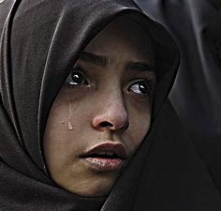
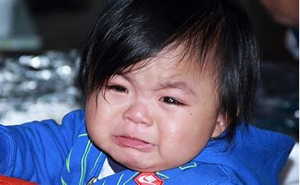
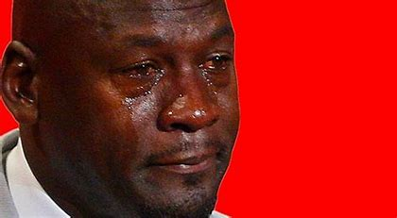
I wonder why these people are crying?

Slide 3
Can you think of a time when you have felt sad?

Slide 4
There have been lots of things we have missed in the past year…
Our friends Our family members that live far away
Going out Going on holiday
Some of us may also have lost someone we love because they died.
And while some of us may have got a new pet, others may have had a pet that has died.
When someone or an animal we love dies, we can feel sad, afraid or angry. What other feelings might we have?

Slide 5
Sometimes we are sad and sometimes we cry. That’s ok. In the bible it says that Jesus sometimes felt sad too. Christians believe that God understands our sadness. The bible says, 'You keep track of all my sorrows. You have collected all my tears in your bottle.' – Psalm 56:8

Slide 6
Staff choose one of the following stories and delete the rest from the PPT

Slide 7
A STory

Slide 8
Water Bugs and Dragonflies

Slide 9
The Heart and The Bottle

Slide 10
The Small Creature – British Heart Foundation

Slide 11
All souls’ day

Slide 12
People all over the world have their own ways to respond when someone has died.
Christians believe that everyone has a soul and so the death of our physical body is not ‘the end’. They believe the soul to be a non-physical part of us that will ‘live on’ after we stop breathing and living in our physical body. Many believe that it is the soul that will live on in the afterlife.
In the Christian Calendar, All Souls' Day is on Tuesday November 2nd each year. The day is dedicated to giving money or food to the poor and to say prayers and remember those who have died. People especially go to church or pray at home for their relatives who have died. There might be a list read out in church and people may light candles.

Slide 13
Who or what would you like to light a candle for?
Who would you want to remember or say a prayer for?

Slide 14
Your time to think and reflect…

Slide 15
Staff choose a school song or hymn. Or play some music such as Bridge over Troubled Water to play while children write on their tear shapes or treasury tags.
Or sing Shine Jesus Shine which is embedded in the last slide

Slide 16
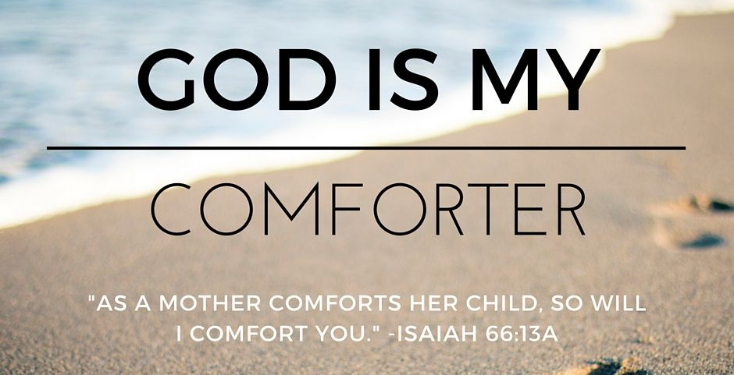
Some Bible quotes are comforting…

Slide 17
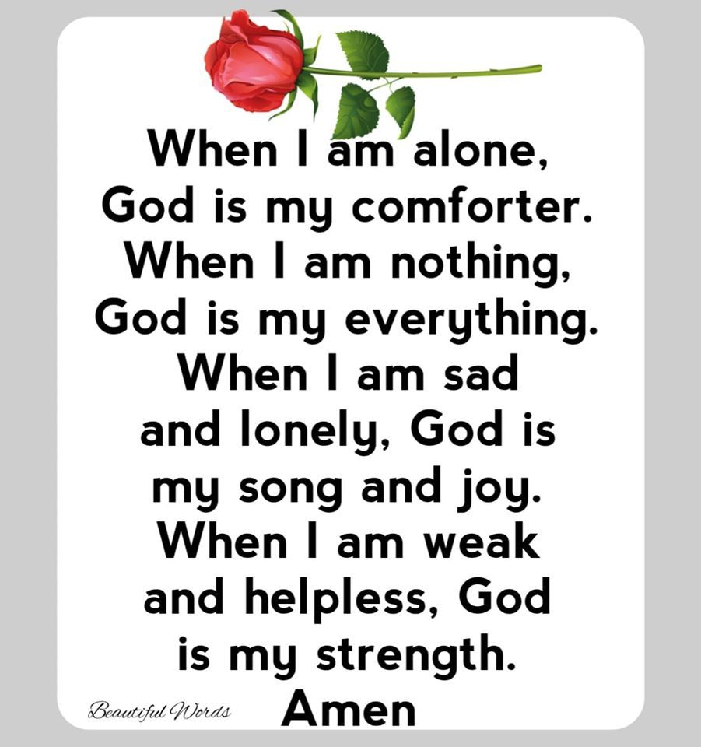

Slide 18
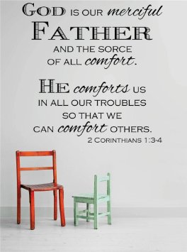
What comforts you when you feel sad?
How would you like to be comforted?
Can you think of someone who is sad sometimes? How could you help comfort them?

Slide 19
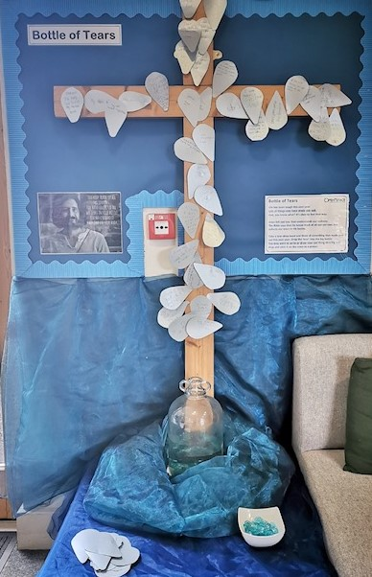
What might you write down about your own feelings of sadness?
You might want to share your sad feelings with God by writing them onto a teardrop.
You could say a prayer and give your sadness to God as you drop a ‘tear’ into the water.

Slide 20
Shine Jesus Shine!

