Slide 1
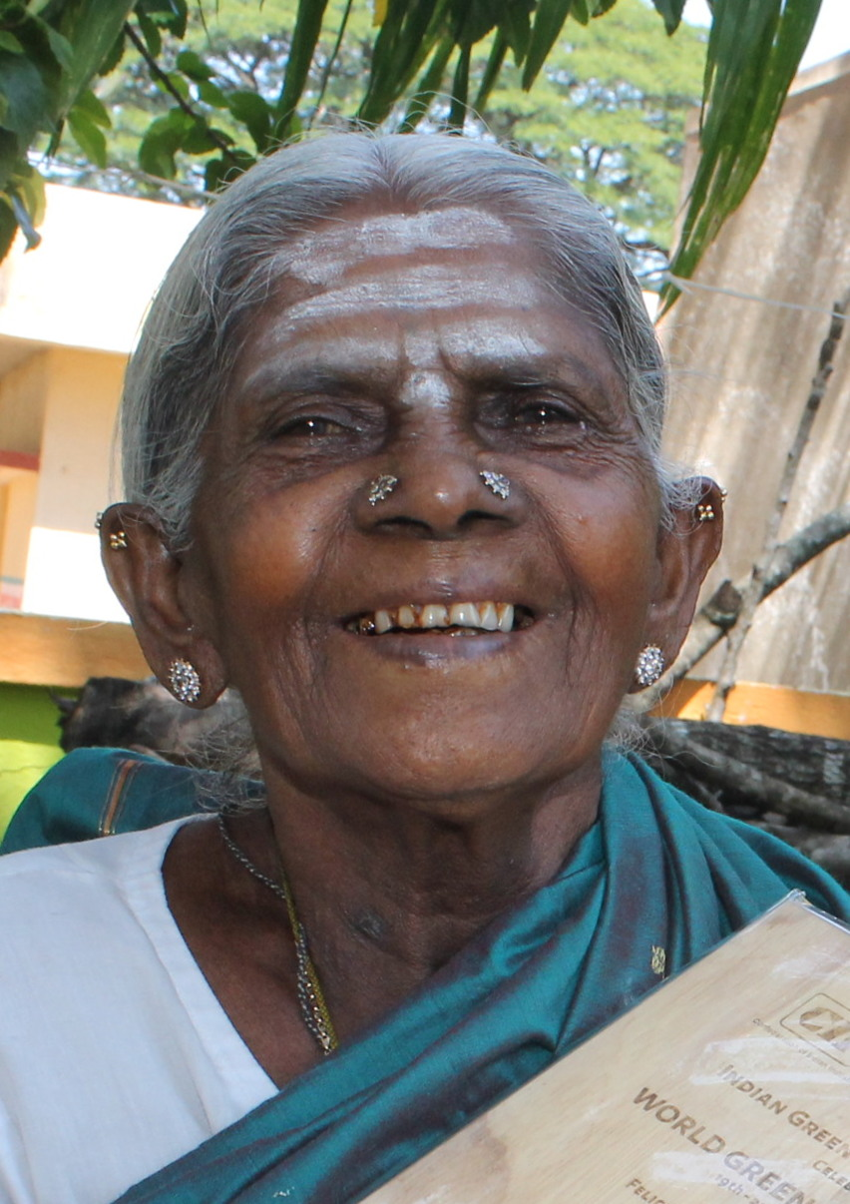
Saalumarada Thimmakka
An inspirational Hindu

Slide 2
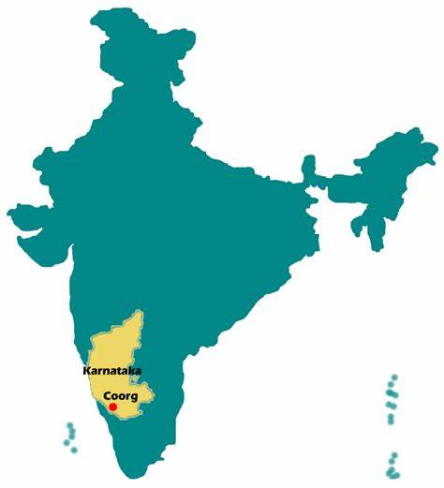
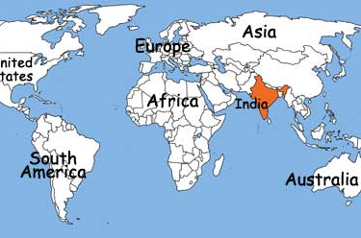
Saalumarada’s Story
Thimmakka was born in Gubbi Taluk
She was married to Chikkaiah
She received no formal education
She worked as a casual labourer in a nearby quarry
The couple could not have children
It is said that Thimmakka started to plant banyan trees so that she could care for them instead of children
She was very poor

Slide 3
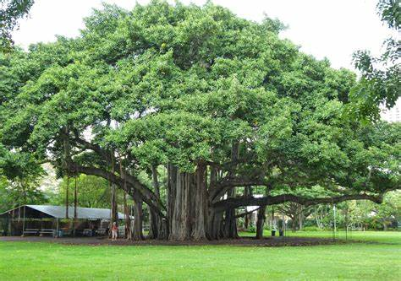
Banyan Trees
The leaves of the banyan tree are large, leathery, and used as animal fodder. The tree produces figs which are popular with birds and monkeys, and also produces flowers that attract wasps for pollination. Older trees can reach more than 200 meters (656 feet) in diameter, with a height of 30 meters (98 feet).

Slide 4
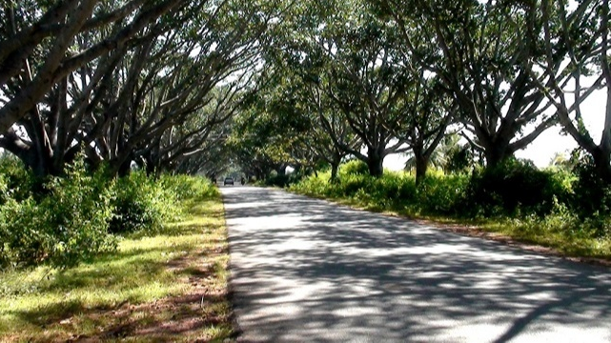
What did she do?
Both Thimmakka and her husband started with 10 banyan saplings on either side of the road along a stretch of 4 km in the first year
They took care of the plants just like their children
Every year, the count of these trees kept increasing
To date, there have been more than 8,000 other trees grown by her and her husband
Growing banyan trees was challenging in a place that was relatively dry
She not only planted those trees but also fenced, watered and guarded them

Slide 5
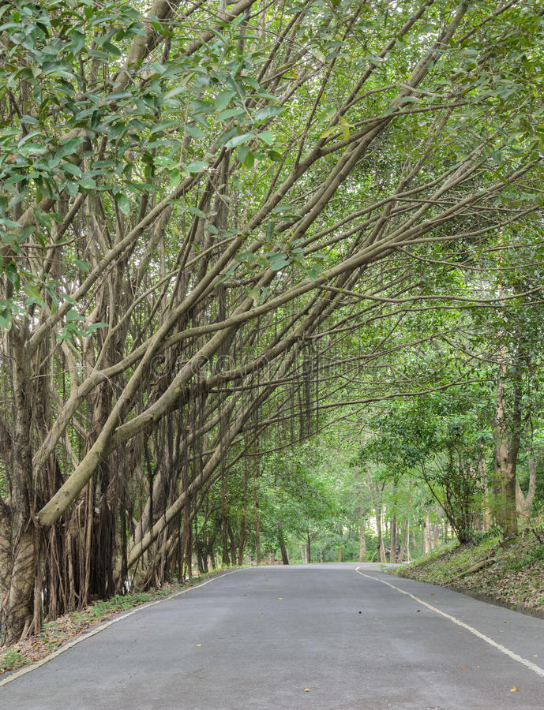
It was hard work
One might think that growing trees is not a big deal
Thimmakka and her husband used to carry four pails of water for 4 km to water the saplings
They used whatever little resources they had to plant trees
In order to get sufficient water for the trees, they started to plant the trees during monsoon
In this way, they could get sufficient rainwater for the saplings and the trees would have invariably taken root by the onset of the next monsoon
This became Thimmakka’s daily routine for many years

Slide 6
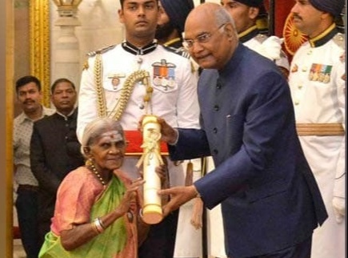
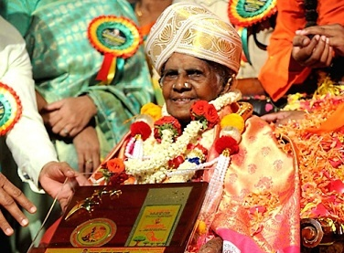
Recognition
her work has been honoured with the National Citizen’s Award of India
She has been recognized by the Government of India and was recently conferred with the Padma Shri award in 2019, which is the highest civilian award in the Republic of India
There is also an environmental organization named after her in the U.S. called Thimmakka’s Resources for Environmental Education
Saalumarada Thimmakka is an individual who has brought worldwide recognition to the state of Karnataka through her incredible and massive environmental services.

Slide 7
Her mission
Recognition began to come Thimmakka’s way from the year 1995, a good 5 years after her husband, Chikkanna’s death
Chikkana too had devoted his life towards nature and had quit working to take care of his young trees
He patrolled the stretch of trees and kept the cattle away from them
Despite receiving hundreds of awards, SaalumaradaThimmakka remains a modest person
She is 100 plus and still cherishes the dream of planting more trees in future
Her next mission is to bring a hospital close to her village, Kadur
Saalumarada Thimmakka has become a role model to the entire world

Slide 8
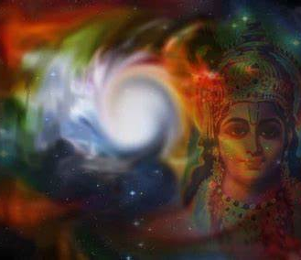
SaalumaradaThimmakk was influenced by her Hindu beliefs
Most Hindus believe that all living things are sacred because they are part of God, as is the natural world.
Many Hindus believe being non-violent means showing respect for all life, human, animal and vegetable
Many Hindus believe that nature cannot be destroyed without humans also being destroyed, because we need the natural world in order to survive

Slide 9
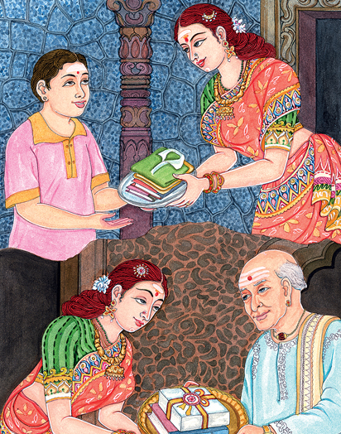
Karma
Karma is a belief that what happens to a person is a result of their actions in life
It makes people responsible for their own life and how they treat other people.
The Hindu belief in reincarnation draws on the idea of karma, if people do negative things in this life, they may pay for these in their next reincarnation
Belief in karma should encourage many Hindus to accept responsibility for their actions, including how they treat the environment

