Slide 1
Teaching Hinduism
Useful Resources

Slide 2
RE Today is a great site for RE teaching. Some resources are free and some you need to be a member. It is worth being a member.

Slide 3
They have free power point presentations too. https://www.natre.org.uk/uploads/Member%20Resources/RE%20Today%20Resources/Primary%20curriculum%20Publications/Inspiring%20RE/Hinduism/pptAshrama%20and%20the%20Five%20Duties.pptx

Slide 4
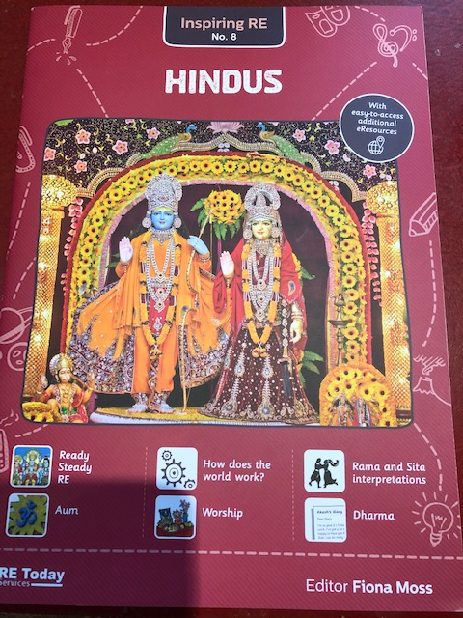
Inspiring RE No. 8
Hindus
Brilliant book – great for anyone not knowing where to start teaching Hinduism
Contains Key words and explanations – great for building knowledge organisers
Contains a progression grid at the end

Slide 5
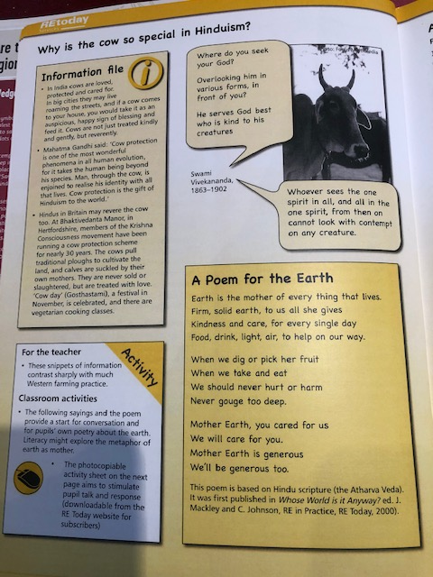
This is a brilliant set of books that deal with all the main world religions including Hinduism. The activities they provide for the children are really good.

Slide 6
Another Great RE today publication (£9.50)

Slide 7
RE:ONLINE A great starting point for any RE topic.

Slide 8
BBC Teach – on Youtube, has a lot of great RE clips for KS1 and KS2

Slide 9
BBC Bitesize. More great clips about different religions.

Slide 10
Truetube have some great RE clips, like this one on Hindu Worship

Slide 11
The story of Rama and Sita. The British Library have a ‘turning the pages’ version of this story – the Ramayana

Slide 12
Free Hindu fact cards https://www.teachingideas.co.uk/sites/default/files/hinduismfactcards.pdf great for displays

Slide 13
National Geographic have some good videos about Hinduism https://video.nationalgeographic.com/video/00000144-0a35-d3cb-a96c-7b3d59ac0000

Slide 14
And of course there is: TES, Pinterest and Primary Resources

