Slide 1
Collective Worship - PSA Session Two - virtual
Welcome!
Please sign in – in the Zoom Chat link – name & school
Plus email address if you are happy for people to get in touch from this course

Slide 2
AGENDA
Introduction & Reflection
Activity One – Development of worship - leadership
Pupil voice - impact
Leading worship in these times
Activity Two – Creative ways with prayer & reflection
#FaithatHome – worship in School/Household/Parish
Singing!
Activity Three – Planning worship
Build a series of reflections around a song
or The Lord’s Prayer
What next?

Slide 3
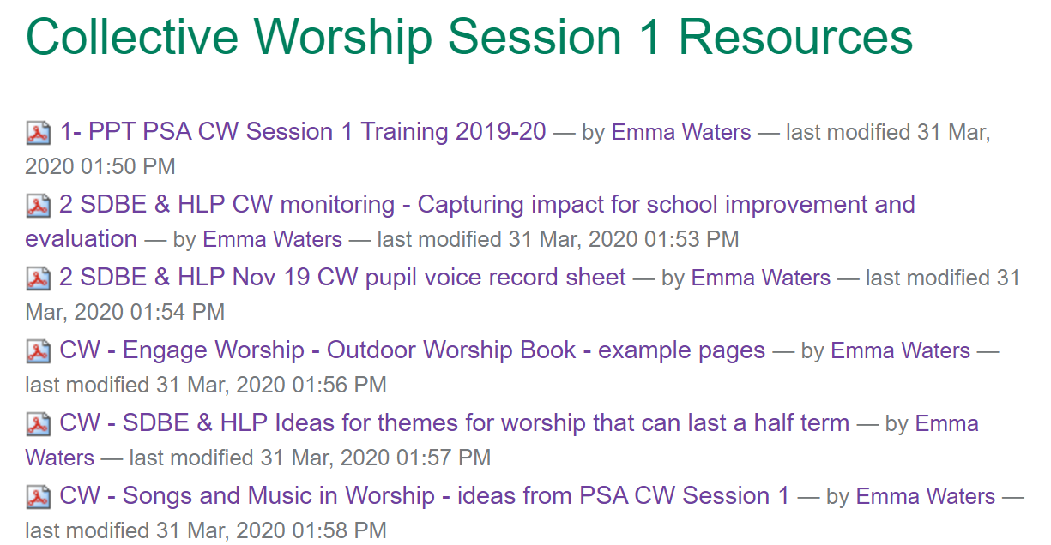
https://www.salisbury.anglican.org/schools/post-course-resources/collective-worship-session-1-resources

Slide 5
Restorative curriculum – book blankets
https://twitter.com/MrsHgrps/status/1259825541793951745/photo/2

Slide 6
Development of Prayer and Reflection
Across diocese - Local Prayer Spaces
Peg Dolls help Transition

Slide 7
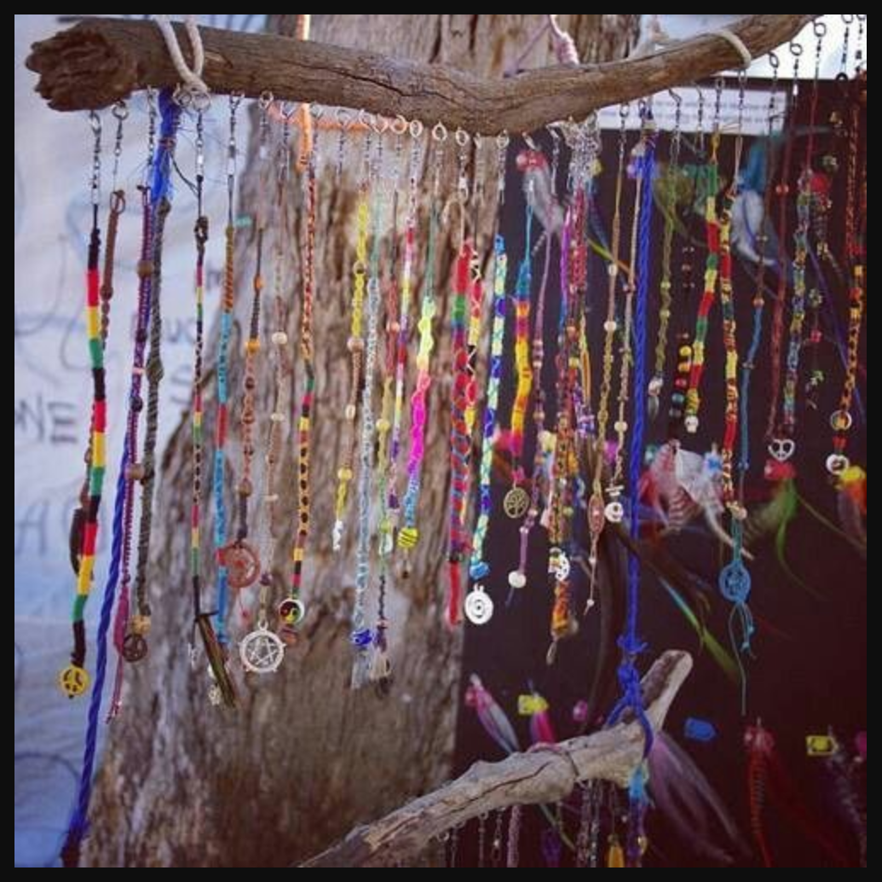
https://engageworship.org/ideas/were-going-prayer-hunt-outdoor-prayer-stations

Slide 8
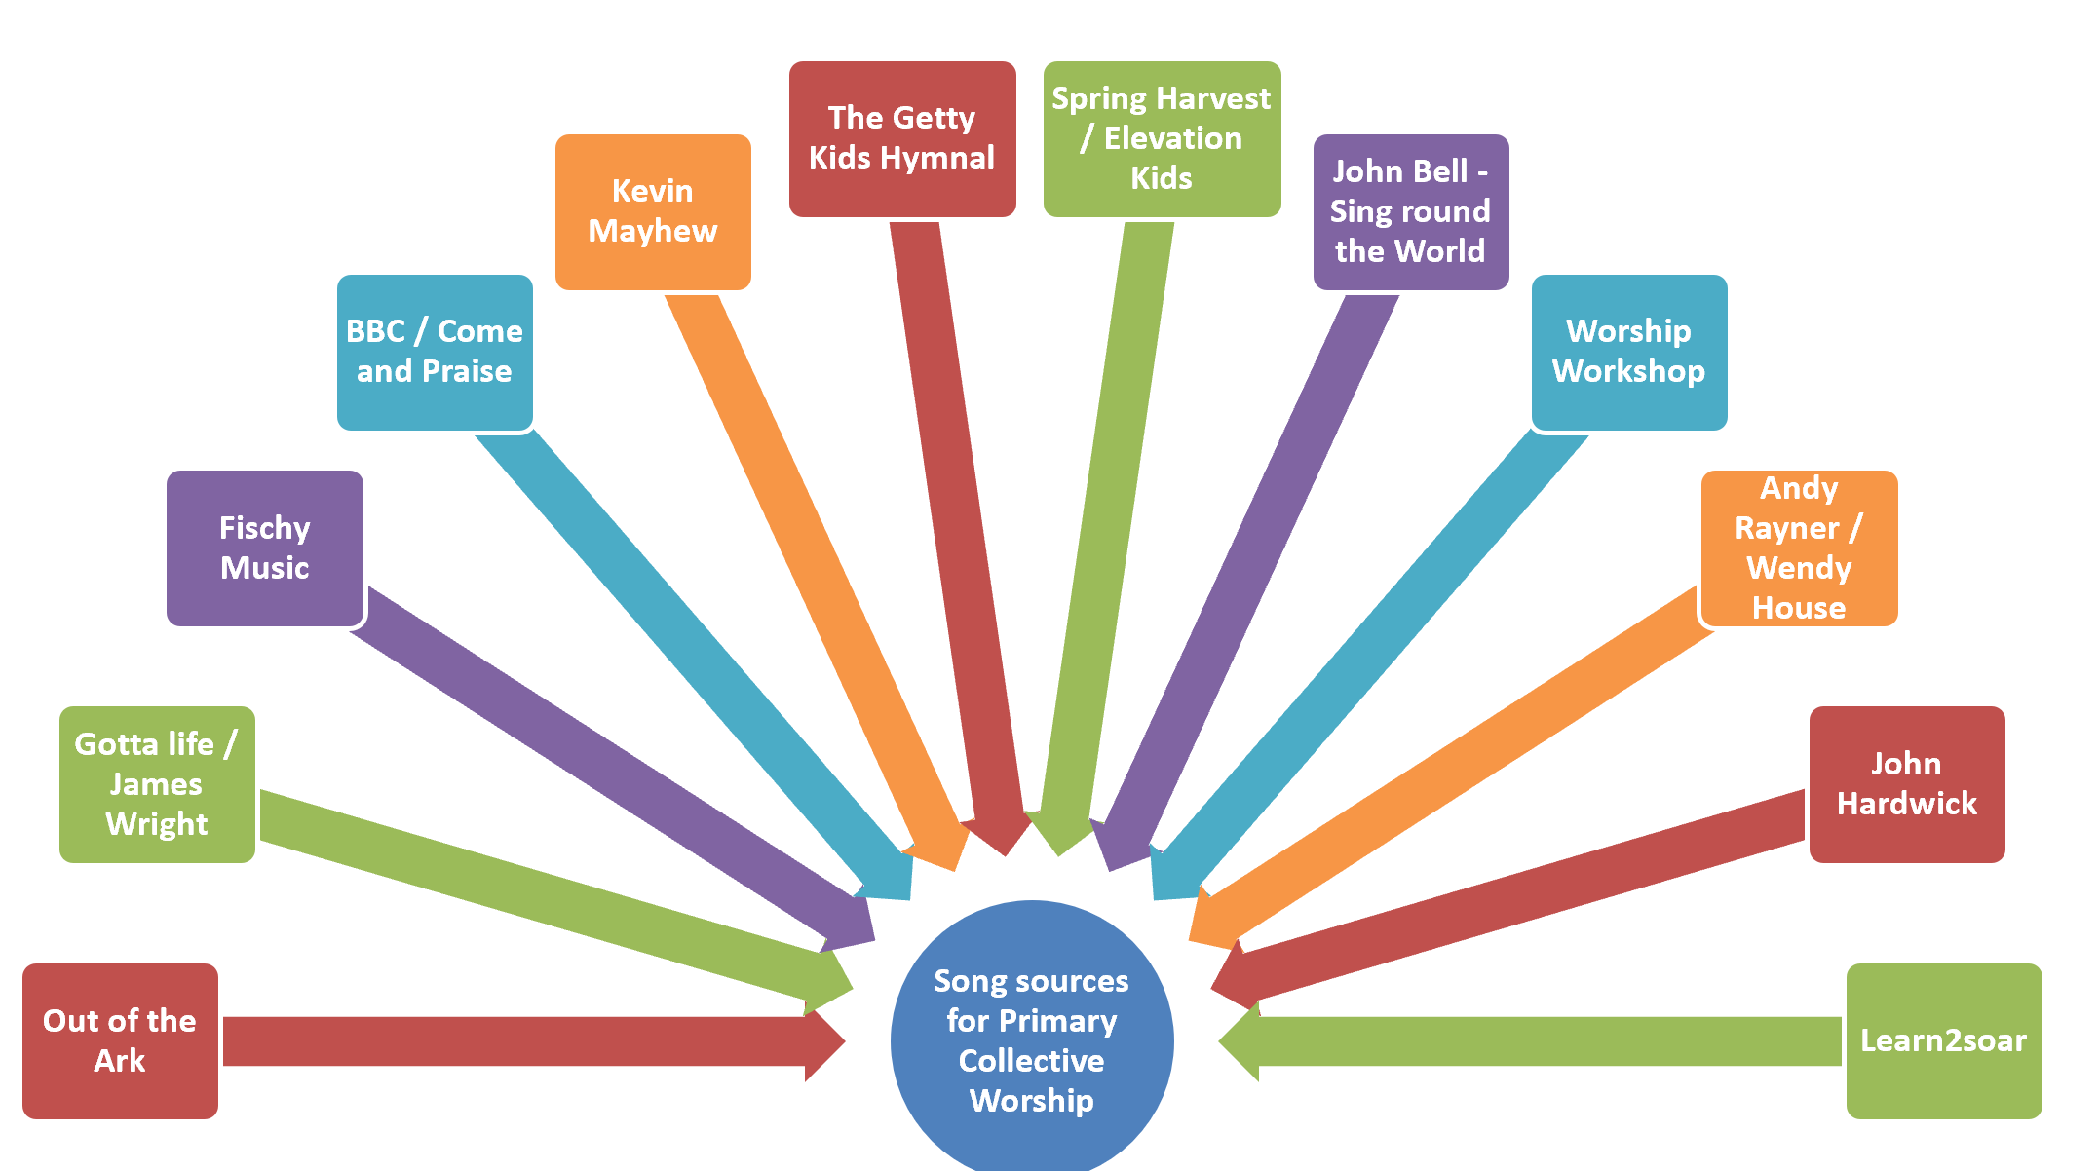
Songs and Singing in Collective Worship
http://www.worshipsongs.org.uk/
Notes:
James Wright – lots of Biblically based songs which manage not to be first person
Andy Rayner – good songs with Eco and justice themes; Mungu na sisi milele (God is with us forever) – Swahili song
Getty Kids – modern hymns – great accompaniment
Fischy Music – emotions etc

Slide 9
Resources to explore if you are looking for uplifting Christian and/or values-centred music for ‘all age’ church worship, school worship or lessons.
https://worshipsongs.org.uk/ Free resources written by Andy and Wendy Rayner. Some have youtube videos to watch and sign language – eg: God is With Us (Swahili song) https://www.youtube.com/watch?v=LovLvqwtxkY
Rend Collective – My Lighthouse
https://www.bing.com/videos/search?q=rain+collective+songs&view=detail&mid=D979891F3382145674B5D979891F3382145674B5&FORM=VIRE
Songs written by Nick and Becky Drake
https://www.weareworship.com/uk/worship-leaders/nick-and-becky-drake-
Sing Out! Written by John Wright and available at Gottalife.com
Fischy Music with online songs from £60 per year subscription.

Slide 10
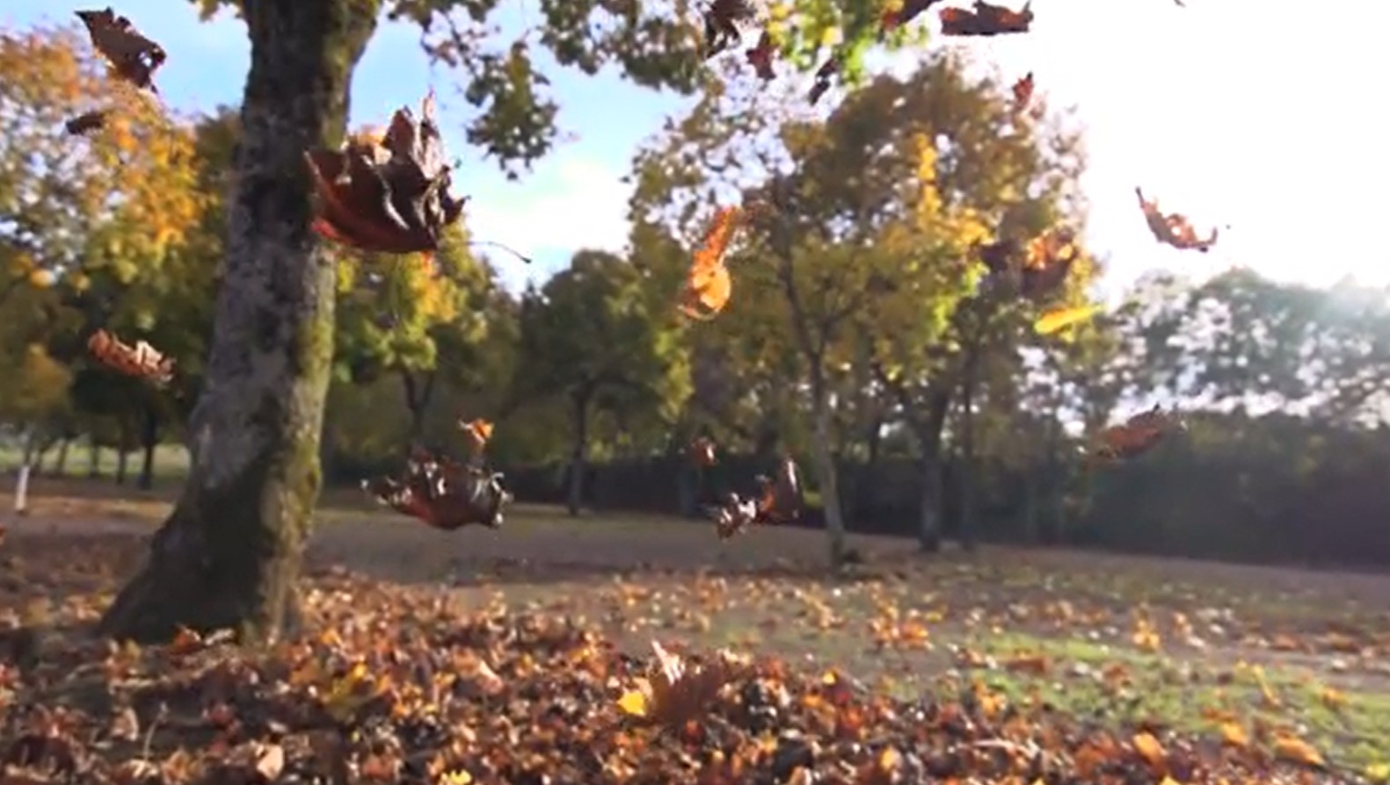
https://www.youtube.com/watch?time_continue=42&v=myzQ7FJLyCE&feature=emb_logo
Traditional
Our Father, who art in heaven, Hallowed be thy name. Thy kingdom come, Thy will be done, On earth as it is in heaven. Give us this day our daily bread, And forgive us our trespasses, As we forgive those who trespass against us. Lead us not into temptation, But deliver us from evil. For thine is the kingdom, The power and the glory, For ever and ever. Amen.
https://www.assemblies.org.uk/pri/3370/the-lords-prayer
Hillsong Worship Song – Our Father
https://www.youtube.com/watch?v=QzTxvOWpr7M

Slide 11
Introduction & Hub Lead Practitioners
https://www.salisbury.anglican.org/schools/re-cw-sp
https://us4.campaign-archive.com/home/?u=13775daf7f4cffbb5e976438a&id=696fdcf179
@HeLP_REgroups
HeLP_REgroups
SDBE_Update
sdbeworship

