Slide 1
Who created all our wonderful minibeasts?

Slide 2
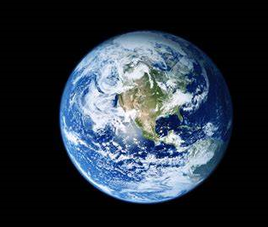
Have you ever thought about?
There are so many different minibeasts in our wonderful world. How did they all become part of the world?
How did the world begin?
How did each animal come to have different legs or eyes or colours?
Different people believe different things.
Listen to What a Wonderful World by Louis Armstrong

Slide 3
Read or watch the Christian story of creation.
https://www.youtube.com/watch?v=DnWXtV-CyYc
In this book Nick Butterworth and Mick Inkpen have re-written the Christian story of creation. It comes from the book of Genesis in the Bible.

Slide 4
What do you love about the world?
Draw or take a picture of something that you think is truly beautiful. Write a few sentences to say why you like it so much and what is beautiful about it.

Slide 5
The Creation by James Weldon Johnson
And God stepped out on space,
And he looked around and said:
I'm lonely--
I'll make me a world.
And far as the eye of God could see
Darkness covered everything,
Blacker than a hundred midnights
Down in a cypress swamp.
https://www.bing.com/videos/search?q=James+Weldon+Johnson+-+creation+poem&&view=detail&mid=9B999EB5DF67364BC8C99B999EB5DF67364BC8C9&&FORM=VRDGAR&ru=%2Fvideos%2Fsearch%3Fq%3DJames%2BWeldon%2BJohnson%2B-%2Bcreation%2Bpoem%26FORM%3DHDRSC4

Slide 6
Then God himself stepped down--
And the sun was on his right hand,
And the moon was on his left;
The stars were clustered about his head,
And the earth was under his feet.
And God walked, and where he trod
His footsteps hollowed the valleys out
And bulged the mountains up.

Slide 7
Then he stopped and looked and saw
That the earth was hot and barren.
So God stepped over to the edge of the world
And he spat out the seven seas--
He batted his eyes, and the lightnings flashed--
He clapped his hands, and the thunders rolled--
And the waters above the earth came down,
The cooling waters came down.

Slide 8
Then the green grass sprouted,
And the little red flowers blossomed,
The pine tree pointed his finger to the sky,
And the oak spread out his arms,
The lakes cuddled down in the hollows of the ground,
And the rivers ran down to the sea;
And God smiled again,
And the rainbow appeared,
And curled itself around his shoulder.

Slide 9
Then God raised his arm and he waved his hand
Over the sea and over the land,
And he said: Bring forth! Bring forth!
And quicker than God could drop his hand,
Fishes and fowls
And beasts and birds
Swam the rivers and the seas,
Roamed the forests and the woods,
And split the air with their wings.
And God said: That's good!

Slide 10
Then God walked around,
And God looked around
On all that he had made.
He looked at his sun,
And he looked at his moon,
And he looked at his little stars;
He looked on his world
With all its living things,
And God said: I'm lonely still.

Slide 11
Then God sat down--
On the side of a hill where he could think;
By a deep, wide river he sat down;
With his head in his hands,
God thought and thought,
Till he thought: I'll make me a man!

Slide 12
Up from the bed of the river
God scooped the clay;
And by the bank of the river
He kneeled him down;
And there the great God Almighty
Who lit the sun and fixed it in the sky,
Who flung the stars to the most far corner of the night,
Who rounded the earth in the middle of his hand;
This great God,

Slide 13
Like a mammy bending over her baby,
Kneeled down in the dust
Toiling over a lump of clay
Till he shaped it in is his own image;
Then into it he blew the breath of life,
And man became a living soul.
Amen. Amen.
James Weldon Johnson

Slide 14
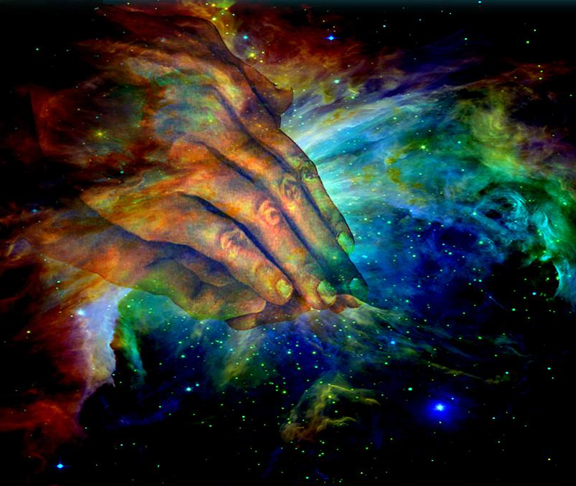
What must the Christian God be like?
Think about everything you have read in the poem and talk about what the Christian God is like.
Use lots of describing words
Describe why you think He is like this, use evidence from the poem in your answers

Slide 15
If God created this beautiful planet then why is it important for us to look after it, including all the living things?
Design a poster that could be displayed in a school displaying ideas about how pupils could care for God’s planet.

Slide 16
If this was your overgrown garden, what would you do to look after it?

Slide 17
Christians believe that God ultimately owns everything but it has been put in to human hands to be looked after,
Humans are stewards or caretakers of the world for God.
What sort of things can humans do in order to be good stewards?

Slide 18
There are many ways that humans can look after the world and they go beyond just looking after nature.
People can give their time, money and talents to look after everything and everyone. How can we, as a school, give our time, money and talents to look after everything and everyone?

Slide 19
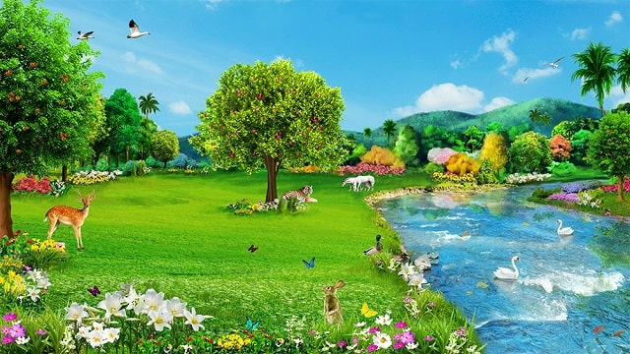
God said….
“I have given you every plant with seeds on the face of the earth and every tree that has fruit and seeds. This will be your food. I have given all the green plants as food to every land animal, every bird in the sky and every animal that crawls on the earth – every living, breathing animal”
Genesis 1 : 28-30

Slide 20
These are some instructions for looking after creation, which ones do you think are good ones? Why?
All Christians should be vegetarian
Do what ever you want with the earth – you are the boss!
Care for plants and animals – they belong to God, but you are the gardeners and the farmers
Put all the animals in the zoo so that you can show that you are ruling over them
Leave the earth alone – it does not belong to you
There is plenty of food for all, but don’t be greedy

Slide 21
Why do Christians believe it is important to make a difference in the world?

