Slide 1


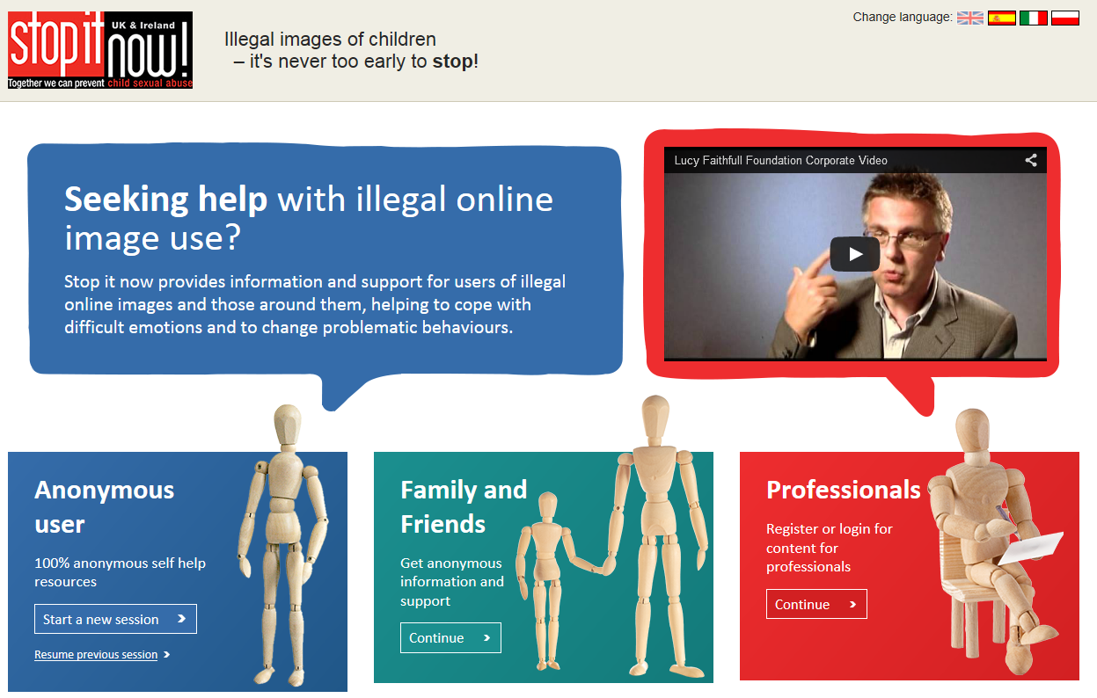
Introduction to the campaign
The Lucy Faithfull Foundation is launching a major new Stop It Now campaign on Tuesday 13th October to tackle significantly increased viewing and sharing of indecent Images of Children (IIOC) in the UK by deterring would-be offenders
We have created three short films that will target both perpetrators and the families and friends of those who might be viewing and sharing child pornography
We have also developed a confidential and anonymous website offering a wide range of online resources for people looking for help to stop accessing indecent images of children, as well as concerned partners, family members and friends.
Read on to see how you can support us:

Slide 2

How you can help at launch
Follow us on Twitter- @stopitnowuk
Tweet out and RT our tweets and videos using the #stopitnow hashtag
Add us on Facebook www.facebook.com/stopitnowukandireland
Share and like our posts and videos
https://www.youtube.com/user/stopitnowukireland
Share the social infographic, which urges concerned partners to seek help
Provide supportive quotes to media – why you feel the campaign is important or encouraging people to view and share the videos
Issue a press release in support of the campaign

Slide 3
What you can do in the longer term
Link to our confidential, anonymous self-help website: http://get-help.stopitnow.org.uk
Embed our videos on your website, available: https://www.youtube.com/user/stopitnowukireland
Share updates about the Lucy Faithfull Foundation and Stop It Now’s work with your partner organisations
Share our videos and news in your organisation’s newsletters, magazines, and internal communications
Continued social media engagement

Slide 4
Launch key messages for partners
A major new initiative has been set up by Stop it Now! – a child protection campaign run by the Lucy Faithfull Foundation which is the only UK-wide charity focused solely on the risk of children being sexually abused.
The campaign is targeting perpetrators and the wider public in order to raise awareness, deter would-be offenders from accessing indecent images of children online (IIOC) and ultimately reduce child abuse
We urge anyone who has concerns about their online behaviour to visit the anonymous and confidential self-hep website www.get-help.stopitnow.org.uk
We want to reassure families and friends who are concerned that someone they know may be accessing this material to know that they are not alone. Stop It Now can help. Confidential, anonymous advice and support is available through the freephone helpline 0808 1000 900
Stop it Now! has produced a series of films which illustrate:
  There are no grey areas – viewing or sharing a sexual image of someone under 18 is illegal.
  This isn’t a victimless crime – the experience is extremely harmful to the children involved.
  The consequences can be devastating to the family, partners and friends of offenders, and may include: loss of job, arrest, prosecution and becoming a registered sex offender.
  There is help to stop.

Slide 5
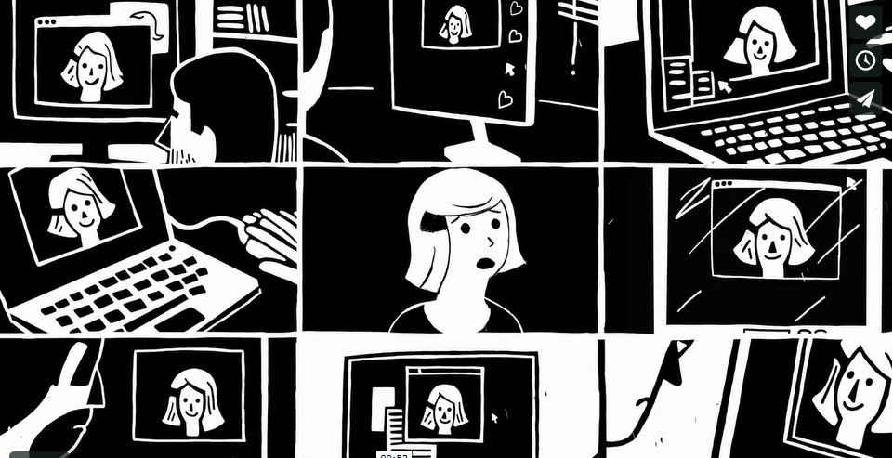

The videos
Our three new videos will be available at: https://www.youtube.com/user/stopitnowukireland

Slide 6
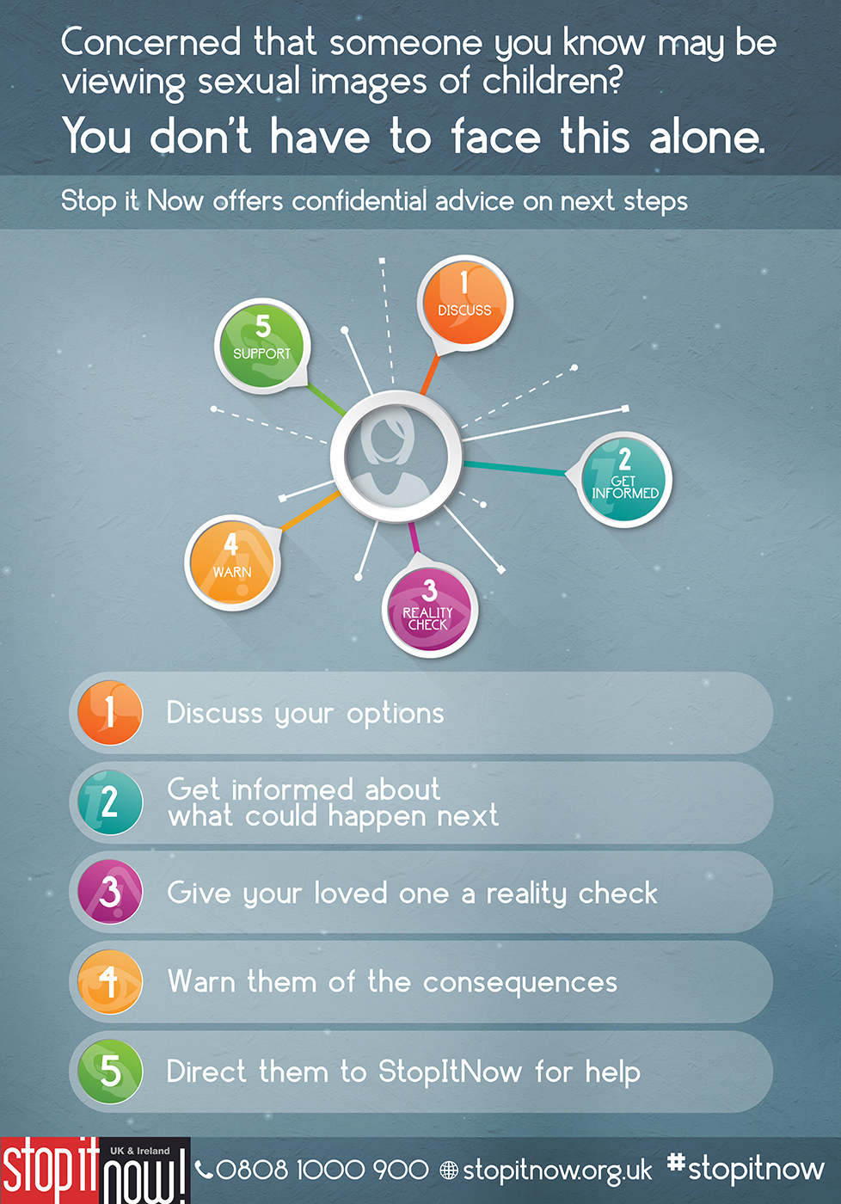
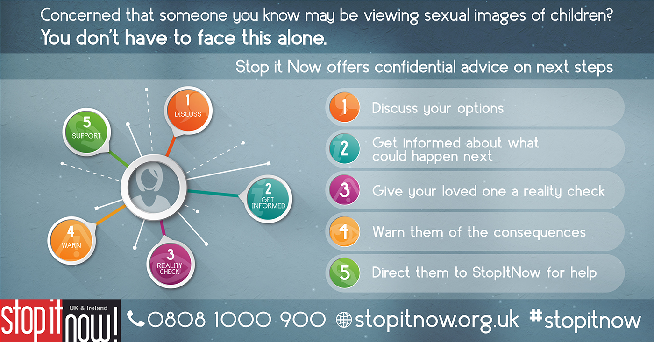
The infographic

Slide 7

Suggested supportive tweets
New #stopitnow campaign aims to stop child sexual abuse by deterring people from viewing indecent images of children http://get-help.stopitnow.org.uk
This @StopItNowUK video provide advice & guidance for concerned friends & family [link to third film] #stopitnow
Many who look at sexual images of under 18s tell themselves that they’re not hurting anyone, but there’s no justification #stopitnow (1/2)
Watch @StopItNowUK ‘No Justifications’ film for more information and advice #stopitnow [link to first film] (2/2)

Slide 8

Suggested supportive Facebook posts
A new StopItNowUK campaign (link to https://www.facebook.com/stopitnowukandireland) aims to reduce child sexual abuse by deterring people from accessing indecent images of children . Their new website provides advice & guidance for concerned friends & family http://get-help.stopitnow.org.uk #stopitnow
A new StopItNowUK campaign (link to https://www.facebook.com/stopitnowukandireland) aims to reduce child sexual abuse by deterring people from accessing indecent images of children . Many who look at sexual images of under 18s tell themselves that they’re not hurting anyone, but there’s no justification. Watch their ‘No Justifications’ film for more information and advice #stopitnow [link to first film]
Watch a video from the StopItNowUK campaign (link to https://www.facebook.com/stopitnowukandireland) which provides simple steps for people concerned that someone they know is accessing indecent images of under 18s [link to third film] #stopitnow

Slide 9
The press release: 1/3
**Strictly embargoed until 00:01 BST Tuesday 13 October 2015**
Groundbreaking new campaign aims to tackle online child pornography use
A major new public awareness campaign is launched today to tackle significantly increased viewing and sharing of indecent images of children (IIOC) in the UK by deterring would-be offenders.
Latest estimates from the Child Exploitation and Online Protection Centre (CEOP) indicate that 50,000 individuals in the UK were involved in downloading or sharing IIOC material in 2013 (1). This estimate was based on file sharing activity alone, and did not include open web searches or activity in the dark net.
The new initiative has been set up by Stop it Now! UK & Ireland – a child sexual abuse prevention campaign run by the Lucy Faithfull Foundation (LFF). The Lucy Faithfull Foundation is the only UK-wide charity focused solely on reducing the risk of children being sexually abused.
Welcoming the launch of the campaign, Director of Research and Development at the Lucy Faithfull Foundation, Donald Findlater, said:
“However many benefits digital technology offers, we know it is also used to cause great harm. Whilst we have tough laws concerning child sexual abuse, as well as the viewing, sharing and making of indecent images of children, we know that tens of thousands of people (mostly men) go online to access this material regularly.
This campaign is designed to stop as many of them as possible, by clarifying what the law says; by telling them of the harm done to children by making and viewing this material; by bluntly showing them some of the likely consequences of their behaviour on their families and themselves; and by directing those who are struggling to stop to anonymous, free, confidential resources that can help.
But the campaign needs the public to play their part – by talking about child sexual abuse and how to prevent it. And by being alert to the signs that a loved one may be viewing sexual images of children online and knowing how to respond.”

Slide 10
The press release: 2/3
As part of the campaign, Stop it Now! has produced a series of innovative films (2), which will deter would-be offenders by making clear:
• There are no grey areas – viewing or sharing a sexual image of someone under 18 is illegal.
• This isn’t a victimless crime – the experience is extremely harmful to the children involved.
• The consequences can be devastating to the family, partners and friends of people who access sexual images of children, and may include: loss of job, arrest, prosecution and becoming a registered sex offender.
• There is help to stop.
Film 1 can be watched here: https://www.youtube.com/watch?v=Bq-rTc7x_a4&feature=youtu.be
Film 2 can be watched here: https://www.youtube.com/watch?v=HfMVIYeERVM&feature=youtu.be
Film 3 can be watched here: https://www.youtube.com/watch?v=OEYYFYv8Yv0&feature=youtu.be
Since 2002 Stop it Now! has helped thousands of people to change their behaviour towards children, both directly as well as online. It has also provided support, advice and information to families and friends concerned about a loved one’s behaviour.
The campaign has enhanced its confidential and anonymous website- www.get-help.stopitnow.org.uk , offering an even wider range of online resources, designed to help those troubled by their online behaviour to stop. The website also provides support and information to friends and families with concerns. These resources enhance the anonymous and confidential support that is already available via the Stop it Now! Helpline, which has received over 48,000 calls since it was set up in 2002.
-Ends-

Slide 11
The press release: 3/3
For further information, and to discuss interview opportunities, please contact:
Matt Whitticase (Media and Communications Manager): t: 01372 847169 / 07540 690 315 mwhitticase@lucyfaithfull.org.uk
Alexandra Bevis (Account director, Consolidated PR): t: 020 3697 4250 Alexandra.Bevis@consolidatedpr.com LucyFaithfullFoundation@consolidatedpr.com
Hannah Mackenzie (Senior account manager, Consolidated PR) t: 020 3697 4270, Hannah.Mackenzie@consolidatedpr.com, LucyFaithfullFoundation@consolidatedpr.com
Notes to Editor:
1) The CEOP threat assessment is available in full here. The 50,000 figure comes from the CEOP threat assessment published in 2013, shortly before CEOP became a Command of the National Crime Agency.
It should be noted that this is an estimate based on available information and intelligence analysis at the time. The relevant paragraph reads: "Although it is clearly not possible to establish a precise figure, CEOP estimates that there were around 50,000 individuals in the UK involved in downloading and sharing IIOC during 2012."
The 50,000 figure was a hypothecated total number based on different data sources and was not a list of individuals.
The most recent NCA threat assessment covering child sexual exploitation and abuse can be found here: http://www.nationalcrimeagency.gov.uk/publications/560-national-strategic-assessment-of-serious-and-organised-crime-2015/file
2) The campaign films are based on key findings from a Lucy Faithfull Foundation survey of men arrested for accessing online child pornography. The survey identified many of the reasons people both access indecent images, and persist in downloading and sharing them. These include a failure to understand that all indecent images of children under 18 are illegal and a lack of awareness of the harm their caused to the children involved, as well as the damage to their own family and friends. Many expressed a desire to stop, but had little awareness of organisations like Stop it Now! that can help.

Slide 12
Thank you
If you have any queries on any aspect of the campaign, please contact:
Matt Whitticase
The Lucy Faithfull Foundation
Nightingale House
46-48 East Street
Epsom
KT17 1HQ
Email: mwhitticase@lucyfaithfull.org.uk or LucyFaithfullFoundation@consolidatedpr.com
Tel: 01372 847160

