Slide 1
GENEROUS GIVING: Giving Mechanisms
June 17th 2021

Slide 2
GENEROUS GIVING CAMPAIGN: Transforming our giving in response to God’s generosity
September 12th – October 3rd 2021

Slide 3
Agenda
Legacy Giving
Cashless Giving
Parish Giving Scheme
Q&A
salisbury.anglican.org/parishes/giving-and-generosity

Slide 4
Cashless Giving

Slide 5
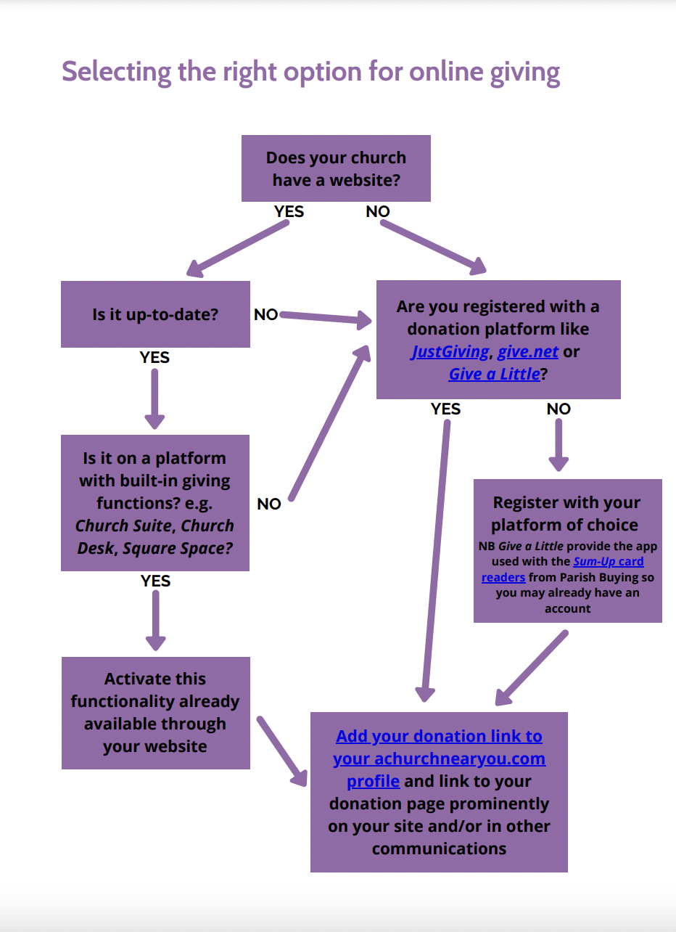
Cashless Giving
Online
Contactless
QR codes

Slide 6
Latest updates Give a Little/Sum Up
One account can offer online giving and contactless
Free premium membership through Parish Buying at least until the end of 2020
New contactless units available
Widget for A Church Near You coming soon

Slide 7
Cashless Giving
Online
Contactless
QR codes

Slide 8
Average donation sizes

Slide 10
Parish Giving Scheme (PGS)

Slide 11
Benefits for Givers
The individual benefits from:
Retaining control of how much they give, how often and to which church
Using a simple giving method that means regular financial support to their church
The option to increase giving annually to protect their gift against inflation
Anonymity, if preferred
Peace of mind that the Direct Debit Guarantee Scheme protects their gifts

Slide 12
Benefits for Parishes
The treasurer benefits from:
Reduced administration and paperwork
Easy access to monthly and annual (both tax and calendar year) statements
Saving time; for themselves and those who count the money from plate collections
The church benefits from:
Stable and often increased planned giving, by launching PGS alongside a Giving Review
Efficient and regular reclaim of Gift Aid, improving cashflow
Protection against static giving, by offering donors the option to index-link their gift

Slide 14
Digital Service pilot 7 Dec – 22 Feb
Results from pilot with five Diocese
657 new donations set up online
94% monthly – average gift £68.00
1% quarterly – average gift £135.00
5% annual – average gift £407.00
85% Gift Aided
41% opted into the inflationary increase scheme

Slide 15
GENEROUS GIVING CAMPAIGN: More webinars (all Thursdays 12:30-13:15)
June 24th: Planning your involvement in the campaign
July 8th: Theology of giving
July 15th: Preaching workshop

Slide 16
QUESTIONS?

