Slide 1
Encouraging Legacy Giving in your Parish
Helen Simpkiss
National Advisor for Legacies and Funding

Slide 2
All Angels & St Michael’s Church Alphington, Exeter
https://vimeo.com/369591539/6884ec06d7
Notes:
I want to start by sharing a film with you from a church in the Diocese of Exeter that received a substantial legacy which transformed their mission and ministry to the wider community.

Slide 3
Has your church received legacies? What have you used them for?
Notes:
Talk briefly to your neighbour about whether your church has received any legacies in the last few years and what they have been used for.
2 mins
Hope that film gave a good sense of why and how legacies can be utterly transformational for churches. This presentation is going to talk through some of those key themes and equip you with the tools and resources to make you feel confident to go back to your churches and encourage people to consider giving in this way.
But it’s not just about big legacies – we also need to celebrate small legacies as any gift of any size can make a difference.
Hands up who knew their church had received a legacy and how it was used?
Hands up who didn’t know? Celebrating legacies is key, as we will see.

Slide 4
Why encourage gifts in wills?
Financial opportunity for future sustainability
Low cost & high return
Part of Christian Giving
Life Affirming
Generosity makes people happy – World Happiness Report 2019
Notes:
Today I’m going to talk about legacies as a financial opportunity
But framed within the context of Christian Giving
For me legacies are life affirming. The living wishes of the individual, and they include them in their will when they are alive. They’re only activated by death.
Therefore they’re appropriate for us to talk about, as Christians but also as a religious fundraising charity.
I’m not going to talk about prospects & suspects – if you’re hoping to spot who’s next going to pop it in your pews I can’t help
Nor am I going to talk about mortality rates and the Church of England
Finally there is no face to face fundraising. I’m not asking you to go back to your congregations and ask everyone to include a gift in their Will. Legacy fundraising is very gentle, very drip drip. It’s about saying to people ‘did you know your church is a charity too, we welcome gifts in wills and if you’d like to find out more, here’s further information.
World Happiness report 2019 – survey of more than 1m people in 130 countries measured that donating to charity is one of the top six predictors of life satisfaction around the world

Slide 5
Amazing Source of Income
Voluntary Sector
Worth over £3 billion p.a.
Estimated to be £10 billion by 2050
Church of England
Worth over £60 million p.a.
Estimated £5.5 trillion will pass between generations in next 30 years
Notes:
Invest now or risk losing out – need to be in someone’s Will 7-10 years before they die

Slide 6
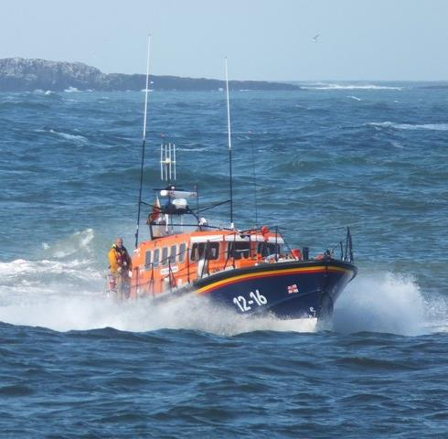
6 out of 10 lifeboat launches are only possible thanks to a gift left in someone’s will

Slide 7
2019 - 36% charitable wills contained just 1 bequest – most popular cause is a place of worship!
3 x as many Anglicans include a charity legacy as a church one
Notes:
Might seem a bit scary – how will your church compete with all these big brands? BUT reason for hope and optimism
That means there are lots of opportunities to get into wills and be the only charity
This is a fantastic stat – we only need to explain why our churches can receive legacies – we have a captive audience that clearly already get it!

Slide 8
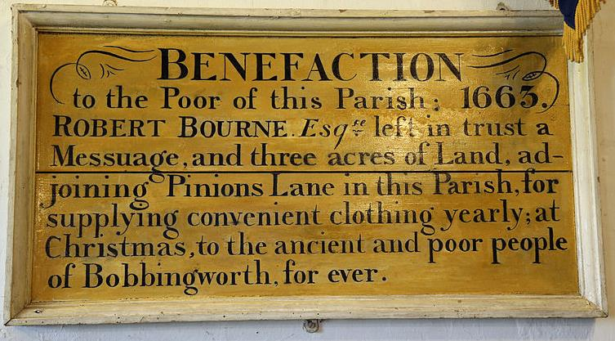
Christian Generosity
Generosity and Thanks
Honouring God – Matthew 25:31-46
Hope
Rejection of Fear
Proportionate Giving
In Memory of a Loved One
Notes:
So if we think about legacy giving as part of broader Christian generosity, we can explore how they are something to be considered as part of our church giving.
Legacies are an important part of Christian Giving.
Another way of giving. Another way of saying thank you. Reflecting God’s generosity in the gift of creation and the gift of Himself in Christ
They are a generous and sacrificial gift.
Hope - Enduring values of our church into the future - People want to feel their values are living on – your values endure if your community endures. We have to move away from fear that our church wont use it well, or the church wont survive. We have to rely on hope and trust in God
We also teach proportionate giving in our churches. Tithing?
Bobbingworth benefaction from a church in Essex - Sheep & Goats – ‘whatever you did for one of the least of these brothers and sisters of mine, you did for me‘
Imagine if every congregation member left 1% in their will to your church, or even 5% or 10% - impact would be significant – not the same as leaving to the poor of the parish but think about what your church could achieve. By funding ministry or mission in your church, we can think of our church’s activity in the same way as the RNLI

Slide 9
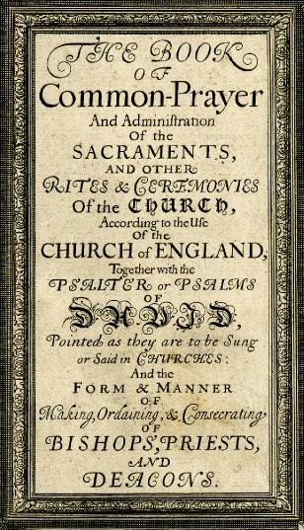
Writing Your Will
A simple act of good stewardship since 1662
“let him then be admonished to make his Will… for the better discharging of his conscience, and the quietness of his Executors… men should often be put in remembrance to take order for the settling of their temporal estates, whilst they are in health”
Book of Common Prayer, 1662
Notes:
So we’ve talked about why gifts in wills are important – we need to actually work out how to get them
That starts with Will writing. Around 54% of adults do not have a Will and many people who do have a Will don’t know about charitable gifts in Wills so I want to look at this briefly.
-Archbishop Cramner wrote the first Prayer Book in the English Language over 500 years ago
Will writing – nothing new. Priests encouraged their parishioners to make a Will - good stewardship.
For the better discharging of his conscious – you feel better when you have a will. When you know your loved ones are provided for
And the quietness of his Executors – the worst legacy you can leave your loved ones is to not write a will. Incredibly expensive and distressing to administer an estate where there is no will
Whilst they are in health – again a message for the living. About setting your affairs in order, good stewardship – just as you have done throughout your lifetime.

Slide 10
Writing Your Will
A simple act of good stewardship for 2020
Your Choice
Your Children
Your Property
Modern Family Life
Inheritance Tax
Charitable Gift
Peace of Mind
Notes:
- Archbishop Cramner wrote the first Prayer Book in the English Language over 500 years ago
Will writing – nothing new. Priests encouraged their parishioners to make a Will - good stewardship.
Choice – dying intestate you have no choice as things follow a set pattern
Children – appointing a guardian for under 18s
Property – if you are not married to your partner they may not benefit if you don’t have a will, even if you live together
Modern family life – if you have been married or divorced since your wrote your last will it may not be valid anymore
IHT – proper planning can reduce this burden
Charity gift
Peace of mind – everything in order for your family
Encourage your vicar to mention Will writing at life event moments – baptisms and weddings – a good time to think about this
Free Will Writing Schemes and IOF Treating Donors Fairly

Slide 11
Encouraging Gifts in Wills: 4 Simple Steps
Request a Free PCC Legacy Toolkit
Discuss making a Legacy Policy at PCC, and communicate it widely
Make information available
www.churchprinthub.org
Notes:
Four simple Steps
Toolkit provides an overview of the literature available which you can request free of charge and use as part of your campaign / make available in church
Within Toolkit is a template for making and communicating a legacy policy
Legacy Policy is very important – it shows that the PCC have met to discuss legacies, that they welcome legacies and will use them for significant projects within the parish. It encourages unrestricted gifts to allow for flexibility and most importantly identifies a contact person. If you have any difficulties like being part of a multi church parish etc then a legacy policy can set out how gifts will be used.
Make literature available, back of church, PDF of leaflet on your website, pew bible bookmark etc. make it visible

Slide 12
Encouraging Gifts in Wills: 4 Simple Steps
4. Talk about Legacies
Case Studies
Celebrating Legacies
Parish Magazine
Thank You Letters
Testimony
APCMs
Preaching
Small Groups
Website
Emails
Consider holding a parish legacy event – by Zoom!
Notes:
Best way to encourage legacies is to talk about them
When it’s appropriate, when the opportunity seems right – but the more you make it the norm, the more people will recognize it’s just another way to give.
Thank you letters – easiest way, just add in a line - after thanking people for their regular giving, one off donations, gift aid, thank all those who’ve included the church in their will.
Testimony is the greatest motivator for someone leaving a legacy. If you can find someone in the church or community who has left a legacy and is happy to talk about why they’ve left it – very powerful.

Slide 13
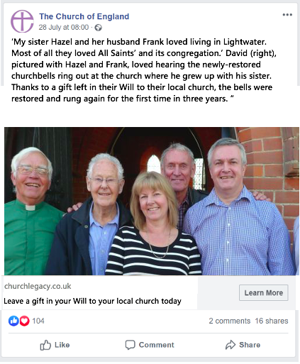
ANNUAL THANK YOU LETTER
At this time of year we write to thank you for your support to our wonderful St Mary’s Church.
Thank you to everyone who has given to the weekly collection, monthly via Standing Order, to help fund the new organ and to everyone who has included a gift in their will.
All these gifts help us to continue our ministry and mission to the community. Thank you

Slide 14
‘A Good Time to Write a Will’
‘A Generous Legacy left to Transform St Helen’s Future’
‘How to Support our work at St Helen’s’
‘Keeping our Church at the Heart of our Community’
Thanks to gifts in wills…
Every bereaved family is comforted
Every school assembly is taken
Every baptism is celebrated
Every foodbank is stocked
Every sermon is preached
Every person is shown the love of Christ through our care, compassion and comfort.

Slide 15
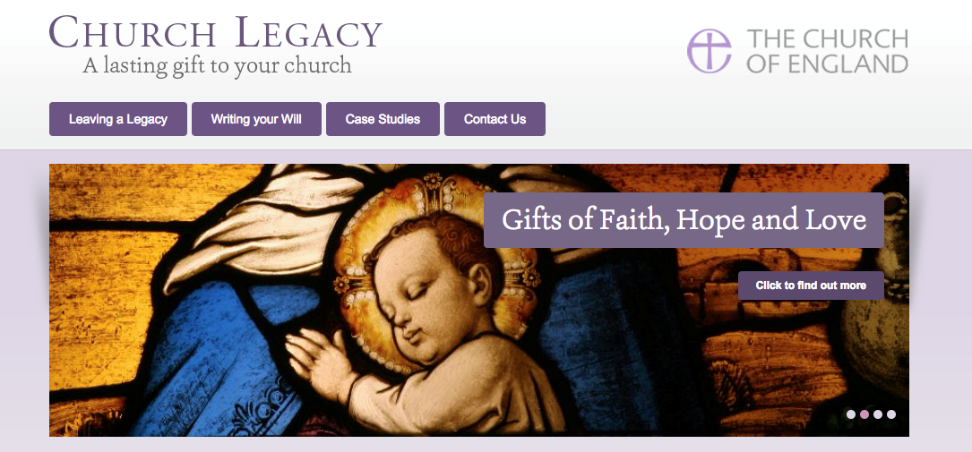
Resources to Help You – Church Legacy
www.churchlegacy.org.uk
Notes:
For individuals and solicitors

Slide 16
Questions,
@: giving@churchofengland.org
: 020 7898 1564
www.churchlegacy.org.uk
www.churchofengland.org/legacies

