Slide 1
GENEROUS GIVING: Planning your involvement
June 24th 2021

Slide 2
GENEROUS GIVING CAMPAIGN: Transforming our giving in response to God’s generosity
September 12th – October 3rd 2021

Slide 3
Agenda
Sneak preview of the resources
Using the planning template
salisbury.anglican.org/parishes/giving-and-generosity

Slide 4
Shape of the campaign
Sunday September 12th: A week of prayer
Sunday September 19th: God’s Generosity
Sunday September 16th: Thanksgiving
Sunday October 3rd: Our response

Slide 5
Sneak preview of resources

Slide 6
Already available
Online giving guide
Clergy story videos
Campaign Guide for PCCs and Deaneries
National Giving Team Resources
Generosity Toolkit
salisbury.anglican.org/parishes/giving-and-generosity

Slide 7
Available in July
Printed leaflet for all church attendees
Liturgical resources
Slides for use in services
Template communications e.g. email

Slide 8
Available in August/September
National Giving video
Bishops’ video sermons

Slide 9
Printed resource

Slide 10
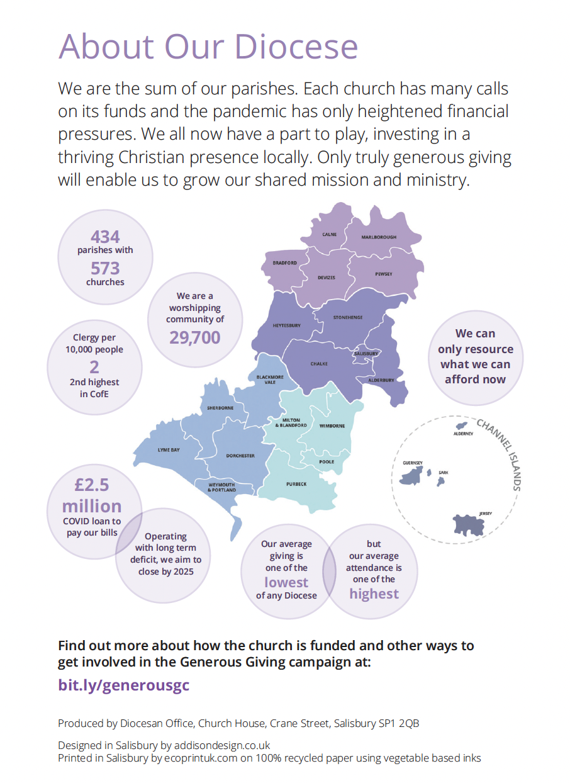

Slide 12
Middle section

Slide 13
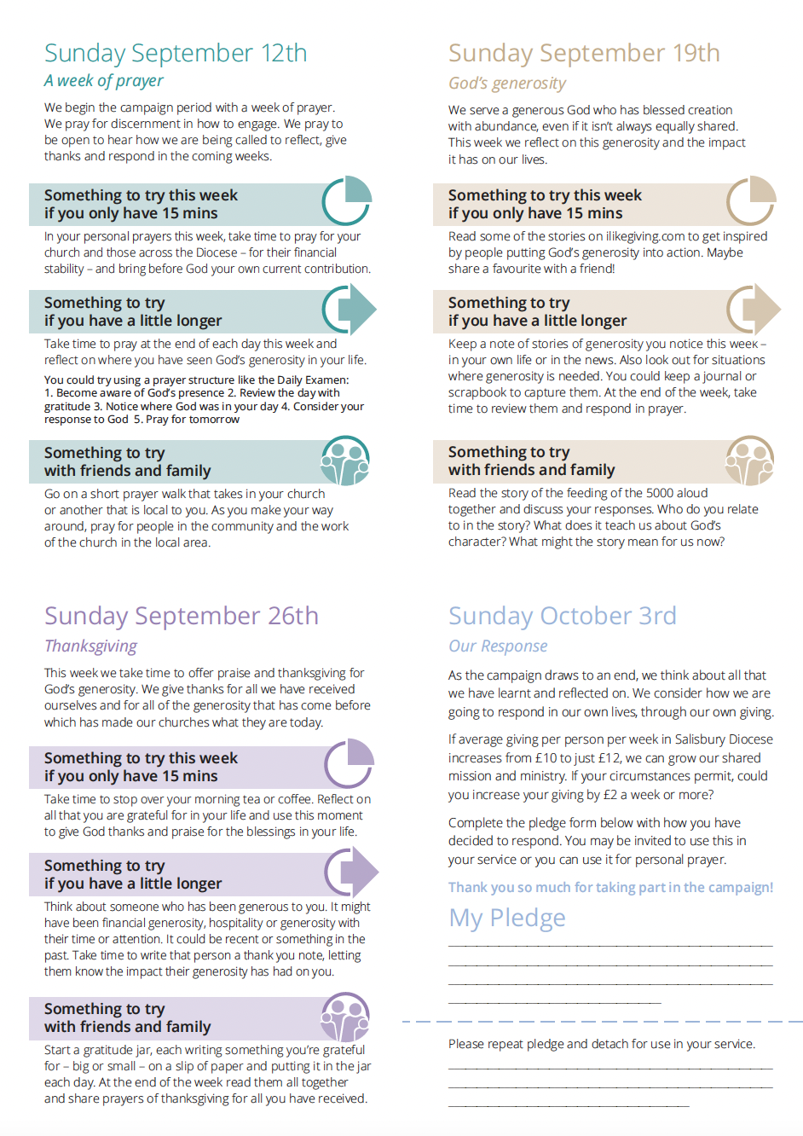

Slide 14
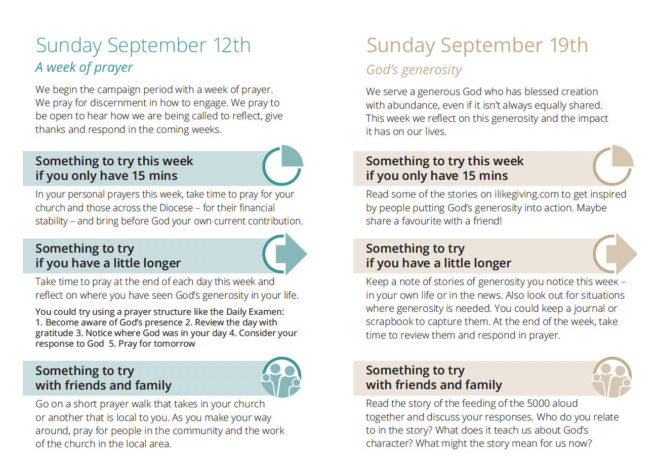

Slide 15
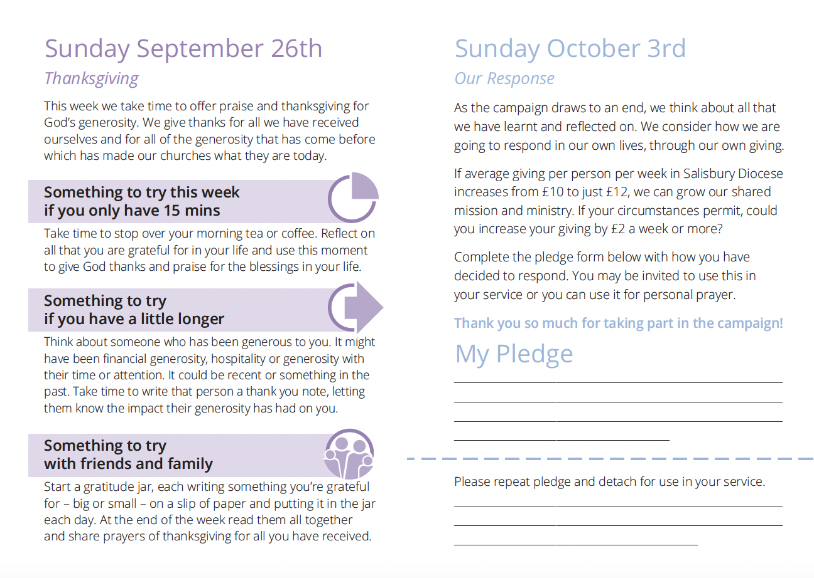

Slide 16
Liturgical resource pack (inc planning tool)

Slide 17
What will be included
Introduction
Planning tool
Liturgical resources
September 12th 5
September 19th
September 26th
October 3rd
Follow up information
Other useful resources
Suggested reading

Slide 18
For each week’s theme you’ll have
Intro to theme
Suggested bible readings
Sermon notes
Prayer points/intercessions
All age ideas

Slide 19
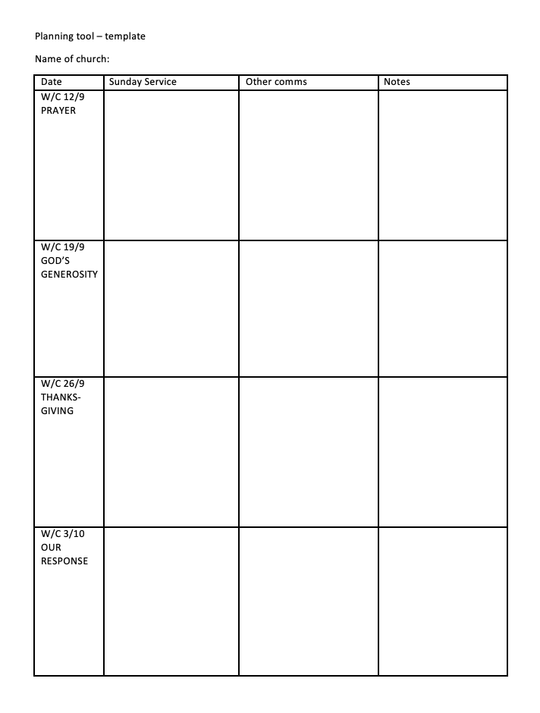
Planning tool

Slide 20
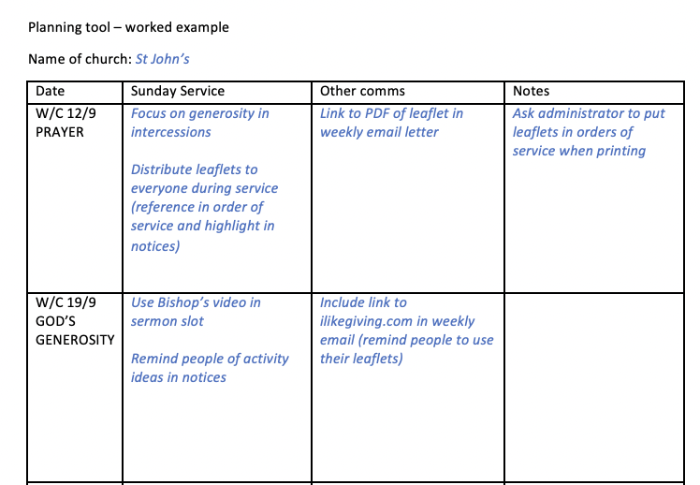
Planning tool – example 1

Slide 21
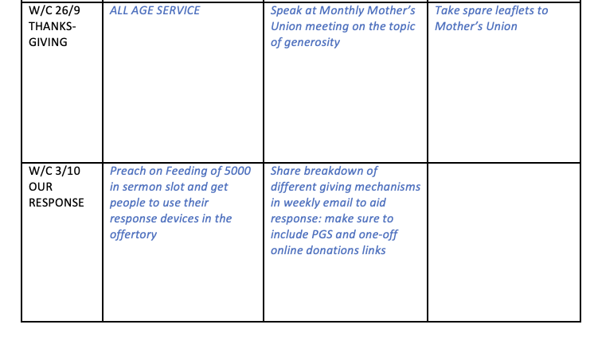
Planning tool – example 1

Slide 22
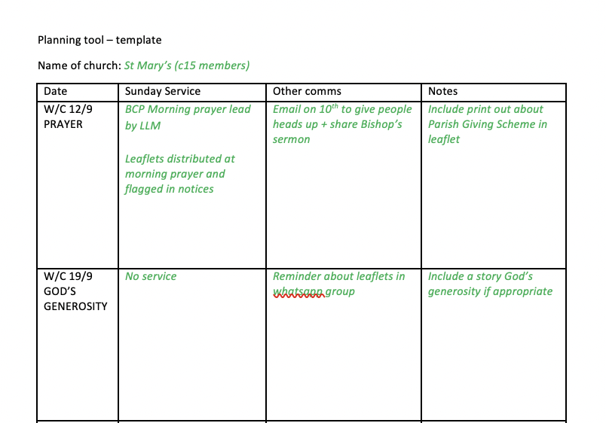
Planning tool – example 2

Slide 23
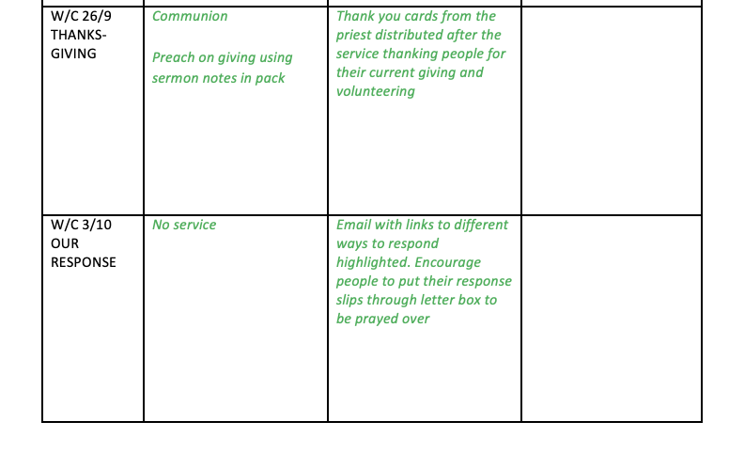
Planning tool – example 2

Slide 24
DISCUSSION What initial ideas do you have to incorporate the campaign? What does your church already do that you could include or build on?

Slide 25
GENEROUS GIVING CAMPAIGN: More webinars (all Thursdays 12:30-13:15)
July 8th: Theology of giving
July 15th: Preaching workshop

Slide 26
QUESTIONS?

