Slide 1
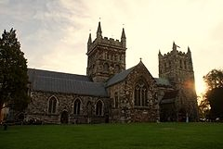
Wimborne Deanery Plan
2016-2020
Notes:
Chris -Welcome to the Deanery Mission Action Plan presentation. Over the past five years we have worked together to share the good news of Jesus Christ across the Wimborne Deanery. We have pushed the boundaries both across our church traditions and ecumenically, and seen his Kingdom grow and flourish. Now we look to build on this good work and by God’s grace see the Deanery work together even better as we build on the Bishop’s vision of Fulfilling Hope, through prayer, service and growth. What we are presenting tonight is a draft plan, put together by the Standing Committee of the Deanery, based on the work already done over the past five years, and taking into account the Diocesan and National Church strategies to see growth in the church. But at this stage nothing is sacrosanct, so please feel free to take notes and then ask questions at the end of the presentation and challenge the Standing Committee if you feel we are being too ambitious or not courageous enough.

Slide 2
Archbishop’s 3 Priorities
Notes:
Chris – I just want to set the plan against the background of the national scene and particularly in the light of the Archbishop’s 3 priorities when he came into office. Prayer, Reconciliation, Evangelism and Witness.

Slide 3
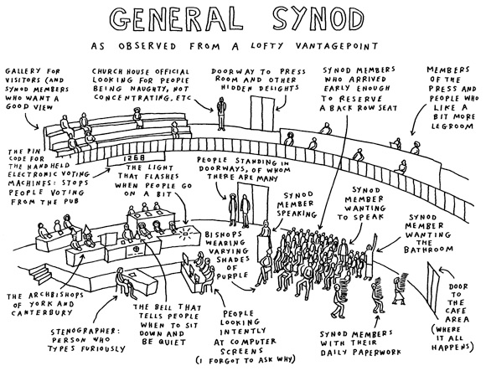
Renewal & Reform
Evangelism
Resourcing Ministerial Education
Shared Conversations on human sexuality
Notes:
Chris – How does this translate to the National Church. The church is on the move, with Anglicans being encouraged to share their faith much more readily and openly IN addition, there is a review of all things we do called renewal and reform, seeking to simplify the way the church does what it does, and through that renew and grow. Vocations and ordained and lay training is a massive challenge as the number of ministers falls off a cliff in the next 10 years. And now the question over women’s ministry and women bishops is largely resolved, there is a real willingness to wrestle with the elephant in the room, Human Sexuality, and see where God is leading the Church of England through a process of Shared Conversations.

Slide 4
Notes:
Gill
Perfect Timing - DAP 2012 – 2016
Bishop Nicholas’s visit March 2015 – energised by this – large numbers - just at the right time for reviewing and refocusing our DAP
Pray Serve Grow
Pray - Worship and prayer are at the heart of what we do and who we are. It is the heartbeat of our church.
Serve - Whom do we serve? It is good ministry which is the purpose and mission of the church.
As part of the Church of England, we in Wimborne Deanery aim to have a flourishing Christian presence in our community.
Grow – Our primary focus is on prayer and serving others and through this we will aim to grow.
We aim to grow in depth, in impact and in numbers.
Our June meeting last year was in discussion groups which threw up a huge range of ways we could further develop prayer in our deanery and individual parishes and benefices and ways in which we could serve others.
And in our proposals for our renewed DAP, we have used these key words to steer our project plan, as we try to rise to Bishop Nicholas’ challenge to us to Pray Serve Grow.

Slide 5
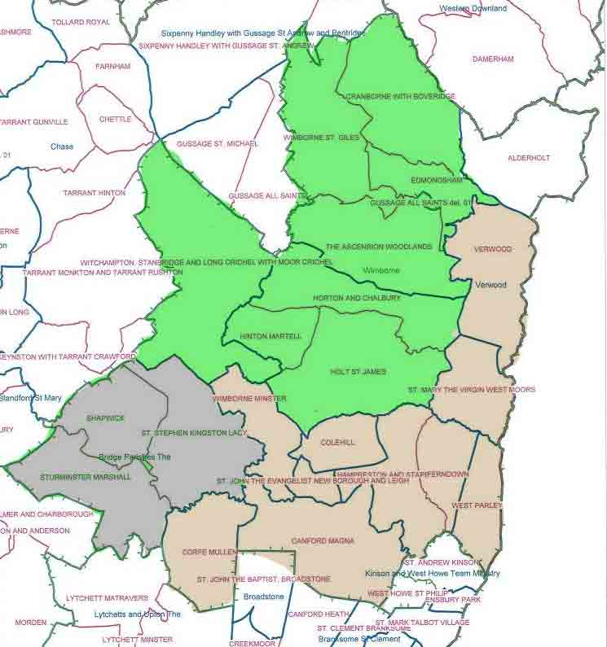
Changes since last plan
‘Bridge’ parishes
transferred to
Milford & Blandford
Deanery
Approximately
90,000 population
FS = 2628 (2015)
2627 (2005))
Notes:
Chris - So what’s happened since the last plan? Well, we ‘exported’ the Bridge Parishes to Milford and Blandford Deanery, which made sense as they are a much smaller deanery and there was a natural link with their sister parishes in the Lower Stour benefice below Blandford. This left a Deanery of two halves – the suburban in khaki, and the rural in green. Although in February last year the Bishop said that we were a Deanery that had declined in numbers, actually that was after taking out the numbers transferred to M&B and actually over the 10 year period we bucked the trend and actually grew by one whole member!

Slide 6
Wimborne Deanery
Second largest deanery in Salisbury Diocese
Mixture of rural and suburban
Wide range of traditions
CYP
20 church state schools (including QE)
Three Academy Trusts with church schools
3 independent schools with Christian foundation
Approximately
90,000 population
FS = 2628 (2015)
2627 (2005))
Notes:
Chris Wimborne Deanery is the second largest deanery in the Diocese with a population of just under 90,000. Our Fairer Share number was 2,628 at the last count in 2015, which puts us at just under 3% of the population, an average for the Diocese which is the second largest % in the Church of England behind Hereford. We are 100% of our numbers in 2005 and so have grown more than the average in the diocese, which has seen shrinkage of 0.7% p.a. over the past 10 years, a number similar to the national church trend. Our growth is largely due to rises in larger suburban churches, which have offset the decline in other parishes and in the rural areas. Without wishing to get hung up on labels, we represent the complete spectrum of churchmanship, from Anglo-Catholic to Central Liberal to Charismatic evangelical and conservative evangelical. Although we highest percentage of retired people in Europe we also have a strong family and children scene, and a number of church schools both primary and secondary and three Academies.

Slide 7
WIMBORNE DEANERY PROJECT REGISTER
No | Project name | Goal / benefits | Status | Project manager | Progress | Due date
1 | Youth Bus | Create a sustainable meeting point with the young people of rural East Dorset | Proposal: Synod date 8/11/12 | Andrew Roland
2 | Men’s meeting; CVM day out | Create an environment for churched and un-churched men to meet and discuss matters of common interest including their faith and core beliefs. | Idea | Andy Rimmer
3 | Learning about Fresh Expressions with Paul Bradbury | To share best practise and experience concerning new ways of being church in a post modern culture and inspire ideas & action in the Wimborne Deanery. | Proposal: Synod date booked for 5/3/13 | Chris Tebbutt
5 | Consider how Energising Local Ministry (ELM) may apply to our rural parishes | Release ordained ministry to focus on new areas of ministry and outreach | Idea. Quarterly lunches planned | Anne Gee
6 | Consider planting churches to reach those untouched by present services | Re-deploying energised church members from flourishing churches to those that are struggling. | Idea | Peter Breckwoldt
7 | Consider shared services across benefice boundaries | Make best use of worship opportunities without increasing clergy workload. | Already in place | Charles Booth
8 | Deanery visit to Sudan – Yambio diocese | Develop life giving links with parishes and church communities in the Sudan across the Deanery | Proposal: Synod 8/11/12 | Vanessa Herrick
9 | Directory of deanery pastoral services (web site?) | Communicate information on pastoral services delivered by individual churches thereby drawing in deanery wide support | Idea | Ann Pollard
10 | Deanery wide “Open the Book” scheme | Create / strengthen links between churches and primary schools | Idea | Gillian Clarke
Notes:
Section 3 – Gill
Quick review of the Deanery Plan 2012 – 2016 – can’t and don’t need to read but this was our working document – our project plan. Colour coded from time to time with traffic lights

Slide 8
Projects discontinued RecEi
Shared services across benefice boundaries
Directory of Deanery pastoral services
Notes:
Section 4 – Gill
Two projects from our 2012 DAP we are recommending don’t continue
Shared services tried and not particularly successful – eg Education Sunday
Directory of Deanery pastoral services – never got off the ground

Slide 9
Projects completed or on-going RecEi
CYP training
E.g. Open the Book training
Fresh Expressions
ELM
Notes:
Section 4 – Gill
Three areas that have been a great success and are either on-going, or completed…. And here are some photographic examples ...

Slide 10
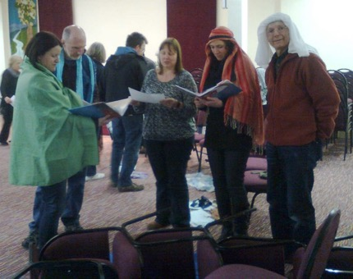
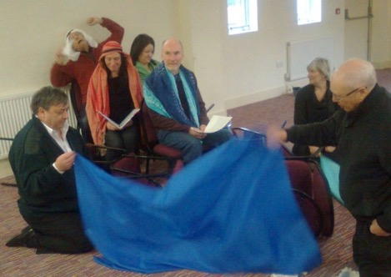
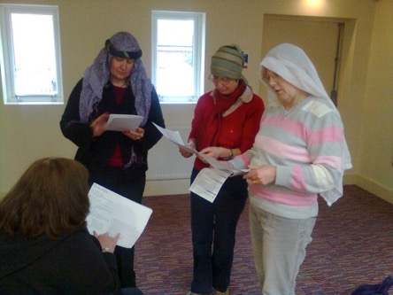
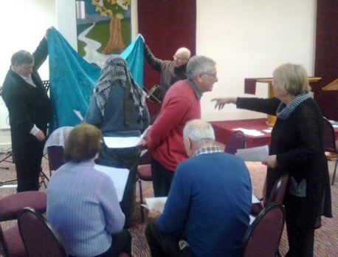
CYP Training – Open the Book

Slide 11
FRESH EXPRESSIONS
Community Café
Re-create
Streetlight Centre
Breakfast Church (4)
Messy Church
Community project - Kingfisher
Notes:
Section 4a - Gill
But following our DS meeting Talk from Paul Bradbury – March 2013 – lots of exploration of Fresh Expressions in Deanery
These continue and might be part of a different focus in new DAP
Talk from Paul Bradbury – March 2013

Slide 12
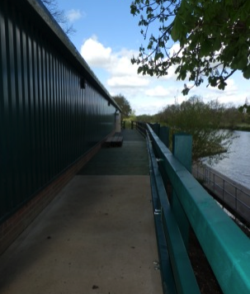
Fresh Expressions
Notes:
Gill: Here’s an example of a Fresh Expression that one of our parishes opened in 2015 …. Partly inspired by Paul Bradbury’s pioneering work in Poole Missional Communities.

Slide 13
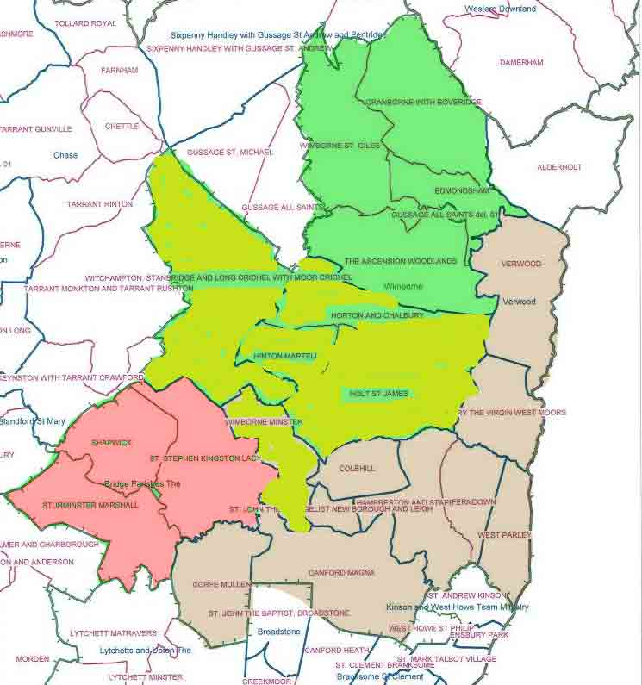
ELM
Wimborne Minster and Northern Villages
Joint ministry scheme
Plan Recommendation
Continue to explore possibilities for creative pastoral schemes
Notes:
Section 5 - Chris – another example of where we progressed our key goals was Energising Local Ministry. Or ELM. We had the opportunity to take a fresh look at staffing and deployment as one of our rural benefices became vacant and we progressed an idea that some said would never work – a Minster model around Wimborne Minster and the Northern Villages. This is proving to be a very fruitful and successful partnership where both the synergy and diversity is celebrated. As vacancies arise in the deanery, we continue to look for opportunities to re-deploy and re-organise where we can see benefits for both parishes and the Diocese.

Slide 14
On-going and extend… Rec
Children & Young People
Coach in the Community
CYP ‘Champion’
Bridging the youth work gap
South Sudan project
Men’s events
Church Planting
Notes:
Gill

Slide 15
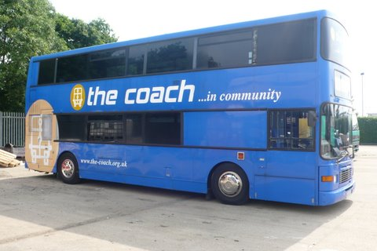
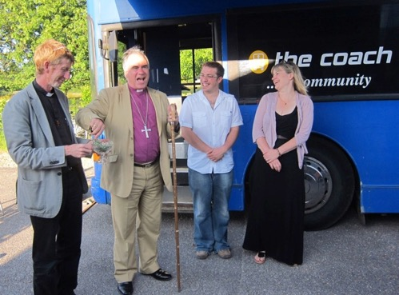
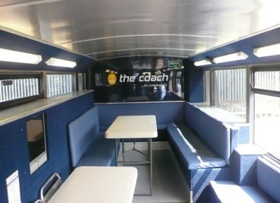
COACH IN THE COMMUNITY
Notes:
Andrew Rowland to talk to this.

Slide 16
Men’s Meetings
Two events
2013 and 2015
Notes:
Derek Howshall to talk to this.

Slide 17
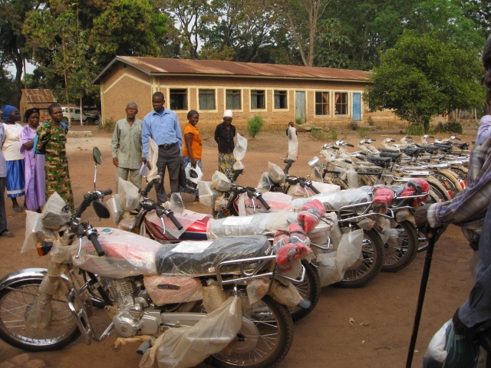
Salt and Soap Training priests/ Bicycles/ Rotary Project Chris and Vanessa - visit to South Sudan
Notes:
Chris

Slide 18
Notes:
Chris

Slide 19
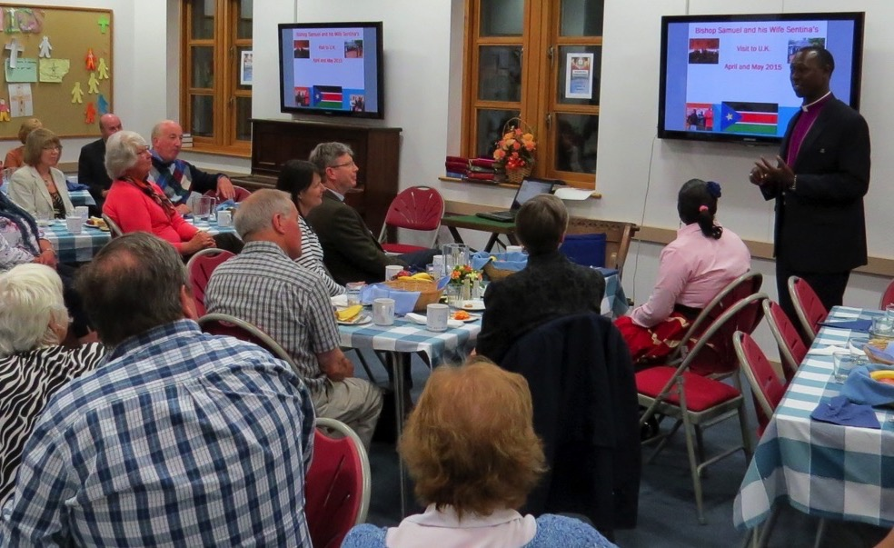
Deanery Supper with Bishop Samuel
Between 2013 and 2015 £18,296 has been given by parishes to South Sudan plus important new community link through Wimborne Rotary
Notes:
Chris - - problems with on-going support, but one off projects could work. Recent experience of funding theological students, and salt & soap would continue.

Slide 20
Possible New Initiatives Rec
Vocations & growing discipleship
Music & worship
Eco-church
Church planting -New housing hubs
Notes:
Section 4 – Gill
Four projects we are proposing to look at are, Vocations and discipleship, music & worship, on how to become an Eco-Church, and then also the call to plant new churches in areas of new housing.

Slide 21
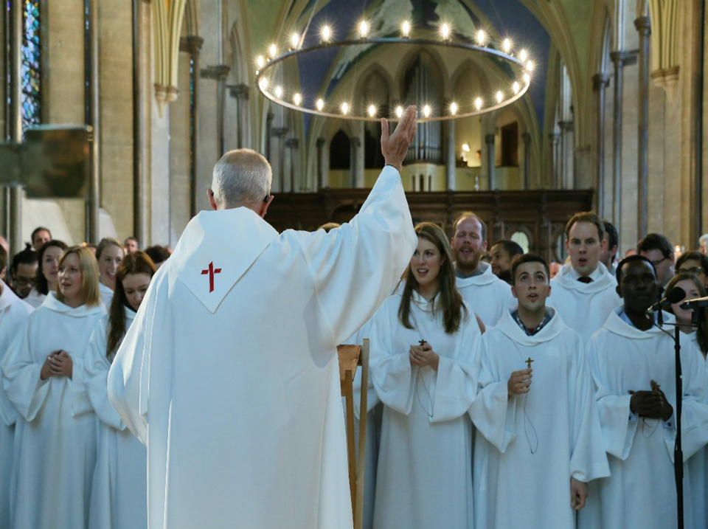
VOCATION
Exploring and nurturing discipleship
Encouraging and supporting strong leaders
Learning about vocations
Prayer
Notes:
Section 12 – Vocation – Gill
Vocation – widest sense
Diocesan Discipleship Co-ordinator
Role of deanery in diocesan aim to help individuals and groups to grow as Christians – resources available?
We need leaders – leaders need training – an area we can address in future Deanery meetings as part of our DAP
Perhaps a continuation of some of the aspects involved in Fresh Expressions and Energising local Ministry
But this focus on Vocation is vital to our ned to GROW – in our own spiritual maturity and understanding and also in numbers – of leaders and members of our congregation
Lots of points relating to this idea of strengthening discipleship in discussion feedback in June – training for prayer, opportunities for prayer, improving our devotional lives, extending Home Groups etc

Slide 22
Deanery Music
Coordinator
e.g. Passion Sunday
Choral Sing-in and Performance
Notes:
Chris – Passion Sunday. Good Friday and Prom Praise. Appointed Heather Waldsax to be Deanery Music Co-rdinator.

Slide 23
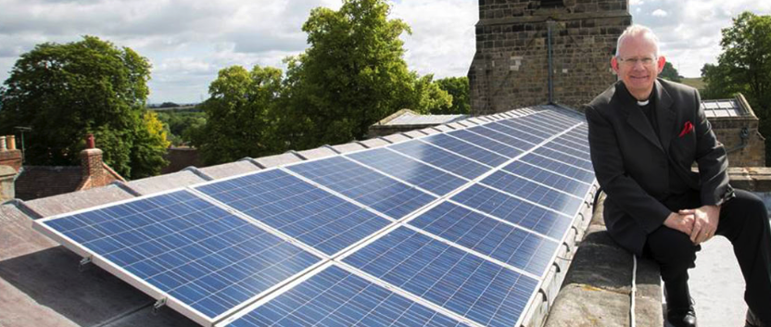
ENVIRONMENT Eco-Church
Worship and teaching
Church buildings and land
Personal lifestyles
Opportunity for community engagement
Notes:
Section 14 – Eco-Church – Gill
Bishop Nicholas leading the way nationally and internationally with his talks and action on Climate Change
A focus too for the Pope in his encyclical Laudato Si’ “Praise be to you”—a line from the Canticle of the Sun by St. Francis of Assisi
And of great concern to many people, not least the younger generation.
We have arranged for this to be the topic at our June Synod meeting – grateful to David Morgan for arranging for Ruth Valerio, an expert and activist in environmental issues, to coming to talk to us and introduce us to the Eco-Church project

Slide 24
Reaching new communities
Wimborne - Cuthbury allotments 220
Wimborne - South of Leigh Road 350
Colehill - Cranborne Road 600
Corfe Mullen 250
Ferndown - Holmwood Park 110
Ferndown - Coppins 30
West Parley - East of New Road 320
West Parley - West of New Road 200
Verwood - North West 230
New Homes in EDDC 2310
Notes:
Derek – new housing hubs

Slide 25
Proposed Plan Projects Rec
CYP -Bus project
Men
South Sudan
Church Planting - new communities
Vocation & Discipleship
Music & worship
Environment & Eco-church
Notes:
Chris – in summary – these are the proposed on-going or proposed plan projects

Slide 26
2016-20 MAP Process Rec
10/3 Launch new plan
10/5 Discuss Chapter
May/June PCC’s review and feedback
15/6 Deanery Standing Committee
30/6 Deanery Synod review + Eco- church
Sept/Oct Submit plan to Senior Staff 17/11 Deanery Synod confirm plan
Notes:
Chris – and this is the process to discuss, and confirm our new Deanery Mission Action Plan.

Slide 27
Notes:
Section 6 – Gill – now need you to get into your groups and consider the following questions?

Slide 28
2016-20 MAP Process Rec
Questions
Is there anything missing from the Deanery Plan
Would our church get behind this plan?
What resources might we need or be able to give?
Notes:
Chris – and this is the process to discuss, and confirm our new Deanery Mission Action Plan.

