Slide 1
Celebrating the Seasons
Epiphany and Candlemas

Slide 2
Practicalities
Check the latest Coronavirus guidance
If in doubt ask your Archdeacon!
Weblinks:
Church of England:
https://www.churchofengland.org/more/media-centre/coronavirus-covid-19-guidance-churches
Salisbury Diocese (front page)
https://www.salisbury.anglican.org/whos-who/news-and-events/coronavirus
Risk assessment
Check copyright

Slide 3
Journey
Pilgrimage
In person
Connect with ramblers
Walk for charity
Virtual Pilrgimage
Descriptive walks with photos, reflection and prayer points
Filmed walk with songs, reflections and poems as backing track
Could we involve local youth groups?

Slide 4
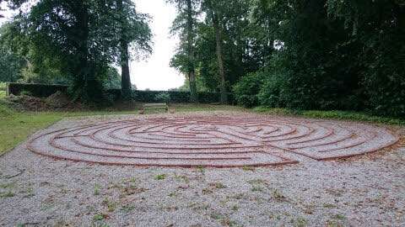
Journey
Labyrinths
Tin cans (foodbanks)
Stones…sand…ropes…hosepipes…plant pots!
In the snow?!
For the housebound
Gift bags – finger labyrinths, reflection and night light, star biscuit…
Could we involve local youth groups?

Slide 5
Journey
Discipleship
Online or in person - small groups
On-line enquirers’ course
Prayers and reflections on seasonal themes e.g.
light and hope
Lament in the psalms
Life’s Big Questions
Look ahead to Lent…

Slide 6
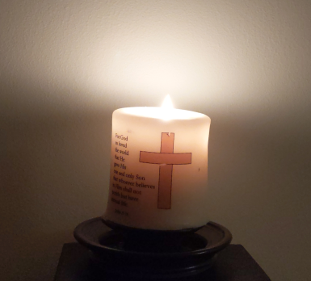
Light
Knitted stars - Treasure hunt?
Can we light up the church/community building with a star?
Paint stones for a cairn or trail
Follow the Star – lots of ideas for all ages from posadas to prayers to promises
https://www.churchofengland.org/sites/default/files/2018-11/Star%20activities%20tidied_Christmas%20to%20Epiphany_LAYOUT.pdf
;

Slide 7
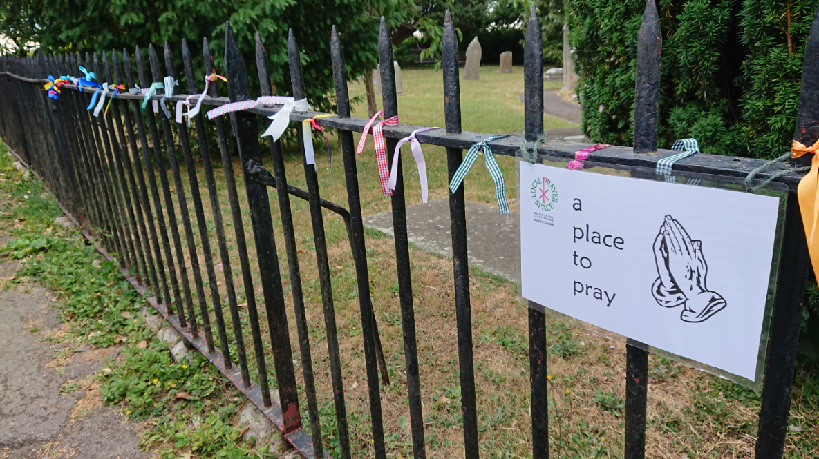
Prayer
Dedicated prayer groups
Prayer Spaces in the Community
Prayer bags for the community
Prayer stars
Candles for windows
Star shaped bakes

Slide 8
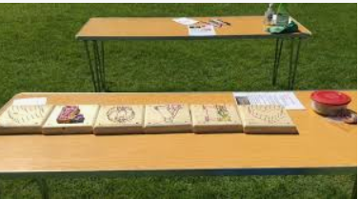
Prayer
24-7 prayer rooms – in situ and online
https://www.24-7prayer.com/virtualprayerrooms
Prayer Spaces in Schools:https://www.prayerspacesinschools.com/
Check out Bishop Cannings CE VA Primary School (includes a labyrinth):
https://www.salisbury.anglican.org/resources-library/schools1/spirituality/bishops-cannings-prayer-spaces-2020/bishops-cannings-prayer-space-2020-writeup
Charities
E.g. Christian Aid – lots of resources for prayer

Slide 9
Christingle @ Candlemas
Party!
Online via Zoom (pre-distribute bags and invitations)
In person – picnic party
BYO tea
BYO blanket
Create individual boxes of activities – name them!
Families take craft home
Store boxes for another time and replenish with a new activity
Opportunities to connect with baptism families to celebrate their baptisms
See ideas for Christingle from Christmas webinar
;
https://www.childrenssociety.org.uk/how-you-can-help/fundraise-and-events/christingle

Slide 10
Care Homes and older people
BRF resources – www.brfonline.org.uk/
Anna Chaplaincy - https://www.annachaplaincy.org.uk/
Messy Vintage - https://www.messychurch.org.uk/messy-vintage
Faith in later life - https://faithinlaterlife.org/resource-hub/
Daily Hope a free phone number (0800 804 8044)

Slide 11
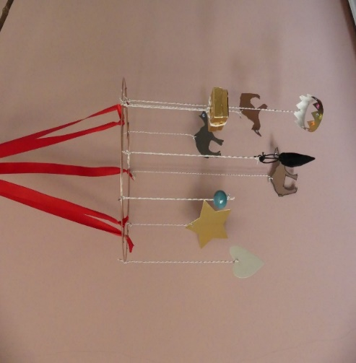
Care Homes and older people
Group activity – e.g. mobile
Individual activity – e.g. painted jam jar/battery night lights
Recorded reflections on a cd
Prayer space in the home
Epiphany season resources: Messy Vintage, Jill Phipps and Katie Norman, BRF, 2021, used by kind permission of BRF, brfonline.org.uk.

Slide 12
Carers
Carers – in care homes
Thank you bags
BRF resources available in support of carers
Carers in the community
The families – what can we offer in support?
Could there be a support group for carers?
Epiphany season resources: Messy Vintage, Jill Phipps and Katie Norman, BRF, 2021, used by kind permission of BRF, brfonline.org.uk.

Slide 13
Worship
for the Epiphany Season:
Liturgy and music resources on the web-link
All-age services e.g. from Revd Canon Sandra Millar E&D, CofE:
Beyond the Stable
Share the Light
Traditional services
Special services for the rural New Year celebrations e.g.
Wassail – blessing the orchards for a good harvest
Blessing the plough
Imbolic (at Candlemas)

Slide 14
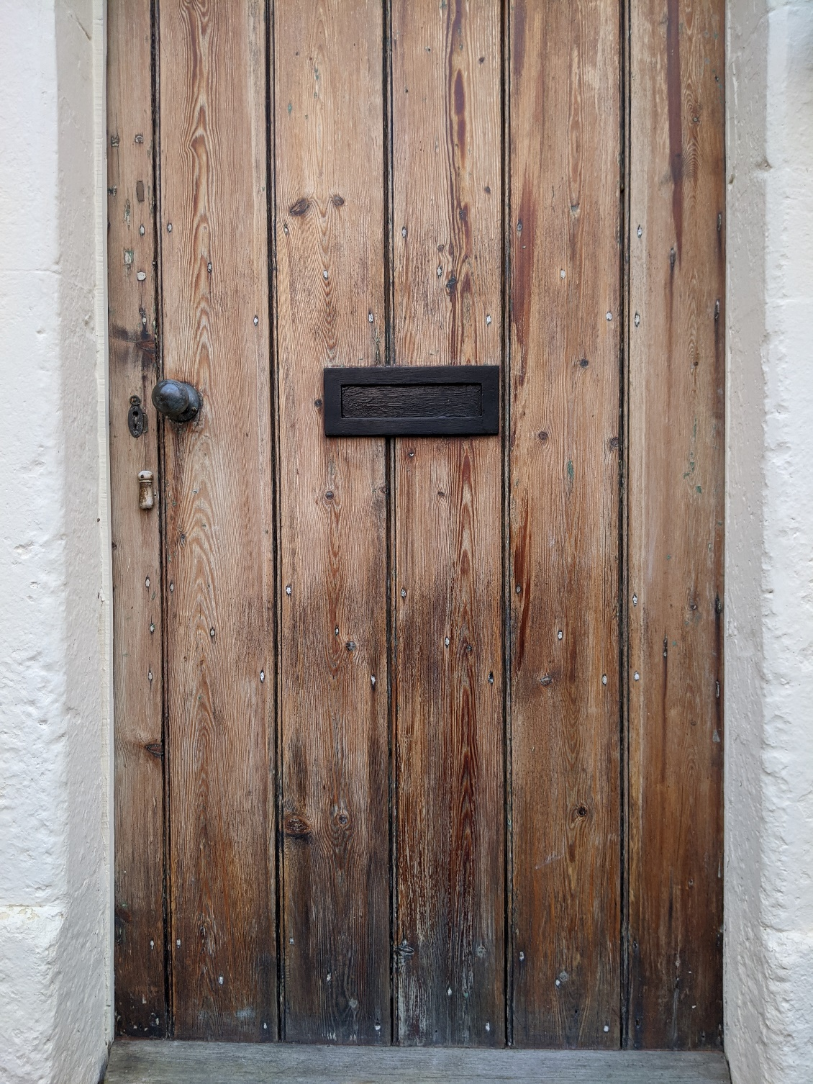
Worship
20 + C + M + B + 21
Chalking the Door…

Slide 15
Worship
Chalking the Door House Blessing :
20 + C + M + B + 21
Traditionally Twelfth Night
Gather to ask God’s blessing on our homes, communities, workplaces
What you need
A piece of chalk!
The numbers are the year
The letters could be
Caspar, Melchoir, Balthazar
Christus Mansionem Benedicat – ‘May Christ bless this home’

Slide 16
Worship
Resources for the Epiphany Season:
Prayers for lighting a candle
Music resources and hymn/song suggestions
Ideas for talks and sermons
Could there be a sermon series on shining God’s light into the community?
How about a camel rap?!
https://www.barnabasinschools.org.uk/search?keywords=epiphany
Books on the festivals – links on the handouts

Slide 17
Worship
for the Epiphany Season:
Outdoor worship
Forest Church
Fire pits and marshmallows?
Bonfires and sparklers?
Activities in the churchyard
Conversations about conservation

Slide 18
Celebrating the Seasons
Resources
Celebrating the Seasons:
https://www.salisbury.anglican.org/resources-library/ministry/rural-hope/celebrating-the-seasons/?searchterm=celebrating%20the%20seasons
Rural Field Officers:
Dorset Richard Hancock: rfodorset@salisbury.anglican.org
Sarum Claire Horton: rfosarum@salisbury.anglican.org
Sherborne Margaret Preuss-Higham rfosherborne@salisbury.anglican.org
Wilts Rhona Floate: rfowilts@salisbury.anglican.org
Energising Local Ministry:
Janet Smith plumsmith18@gmail.com
Ministry for Mission Resources Officer:
Steve Inglis: stepheninglis@salisbury.anglican.org
Claire Horton, Rural Field Officer, Sarum Archdeaconry 2020

