Slide 1
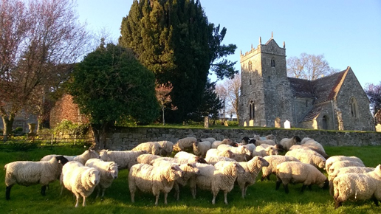
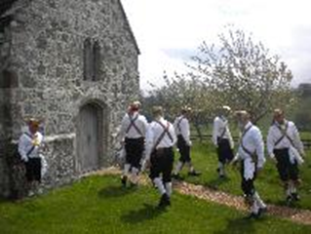
Rural Hope
Presentation to
Danish Clergy Field Trip
by The Revd. Canon Richard Hancock. TSSF
Rural Field Officer for Dorset Archdeaconry
25th February 2020
1

Slide 2
Role of the RFOs
Support local mission initiatives and fresh expressions
Local team of lay and ordained people ‘lead’ the initiative; RFO ‘facilitates’ the process
RFO works intensively with three initiatives every six months including THRIVE groups.
Action not talk
Support rural leadership development
RFO identifies any training needs in the local team
Works with the RMDO to organise suitable courses
Works with M4M Resource Officer to signpost to learning hubs and other resources

Slide 3
Four Pillars of Mission and Growth in the Rural Church
Intentional
Relational
Collaborative
Holistic

Slide 4
Intentional
Rural Theology – Vol 15 No1 David Voas Intentionality, Numerical Growth and the Rural Church.
Churchmanship has no correlation to growth.
A have a go attitude is more important than worship styles.
We need to be risk takers for the Gospel.
In order to start things, we need to look at what to stop.
Do not be afraid of failure or death, remember we are a church of the resurrection.

Slide 5
Relational
Take the church to the people not the people to the church [Fresh Expressions]
Develop links with key organizations particularly schools
Learning to be guest rather than hosts
Make the church a community focal point – [Buildings fit for purpose]
Communicate in ways people can understand.
Develop regular initiation courses such as Alpha, Emmaus or Pilgrim.

Slide 6
Collaborative
Discipleship is for all – Priesthood of All believers, our baptism unites us.
New models of leadership based on sharing and trust, clergy are enablers.
Laity need to see themselves as disciples not simply the vicar’s helpers and clergy need to place their trust in others.
Keep boundaries loose, share across parishes, benefices and deaneries where possible.
Make lay training realistic and where possible local.
Free the clergy for mission, reduce administration, focus on clergy wellbeing.

Slide 7
Holistic
There are no one trick wonders, one size does not fit all in rural mission.
Understand your context and the community where your church/es serve
Join the dots, have an overall strategy that links everything together.
[Do Less Effectively]
Be persistent and persevere, change and growth won’t happen overnight.
Radical Welcome to all – be inclusive not exclusive.
All of this must be founded on prayer, a generous spirit and love of service.

Slide 8
Prayer for Renewal
Heavenly Father, in Jesus name we ask for a fresh outpouring of your Holy Spirit on our Churches. Help us to grow in our experience of your love, forgiveness and healing. Challenge our contentment to stay as we are. Renew our vision of what it means to be a disciple of Jesus Christ. That through our words and the way we live, others may be drawn to his way. Give us the wisdom to seek your will and grant us the joy that comes from wholeheartedly following it. For your Glory and the good of all your people. AMEN.
[Canon Nicholas Gandy OGS]

Slide 9
Thank You!

