Slide 1
What makes a successful rural Church?
Mark Betson
National Rural Officer

Slide 3
What does success look like?
Lots of people?
Lay leadership?
Community engagement?
Social action?
Committed disciples?
Financially sustainable?

Slide 4
Reality Check
We would probably like all of the above.
But we can’t do everything, be everywhere and generally people don’t do what you want/expect.
It also doesn’t happen as quickly as you may like.
Trying to see what God is doing here is not always easy.

Slide 5
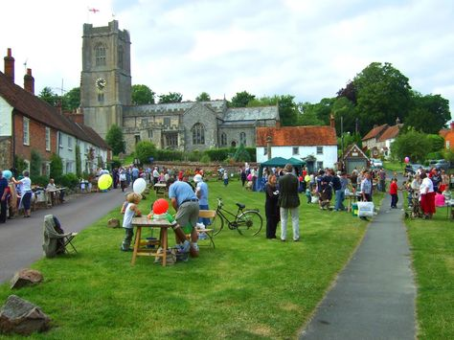
Rural Challenges
Aging population:
2017 – urban 37.5, rural 44.6
2002 difference 3.4 years, 2017 5.6 years
Fewer young people – jobs and housing
Pressure on schools:
Student numbers
Sustainability
Transport
Access to services
Healthcare
Public services
Broadband

Slide 6
What has rural got?
I was once invited to the Japanese embassy. Over lunch, a senior official told me: ‘We have a big problem in Japan. We cannot get our people to live in the countryside. Everyone wants to live in Tokyo or Osaka. What does your government do to make people move out of towns?’
I explained that it was the opposite in the UK, where people aspire to live in the countryside. A move to the provinces is seen as a mark of success. This desire for rural life is a defining part of our nation, but doesn’t happen in France or Italy. Indeed, the only people who yearn to live in the French countryside are the British.
Mark Hedges, Country Life
https://www.countrylife.co.uk/country-life/want-live-countryside-166707#4iGM98yWMz0Ydc5O.99

Slide 7
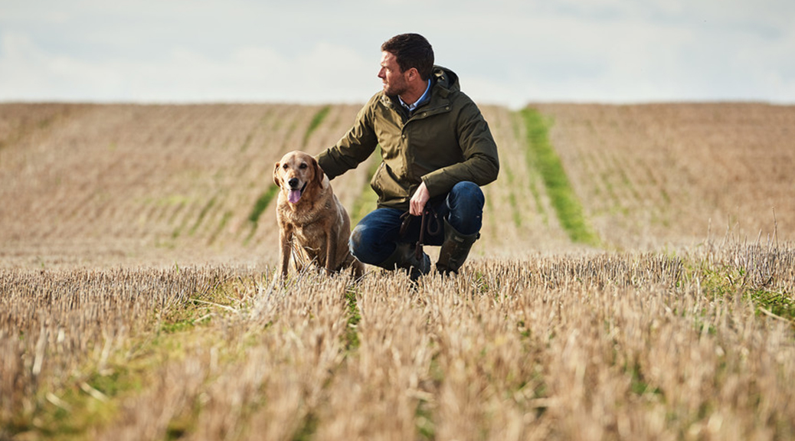
What has rural got?
Fresh air
Lower crime rates
More space
Wildlife
Beautiful scenery
Community bonds
Outdoor adventure and free exercise
Country pubs and locally sourced food
See the stars
More convenient than you’d think
https://www.naylors.com/blog/10-reasons-to-live-in-the-country/

Slide 8
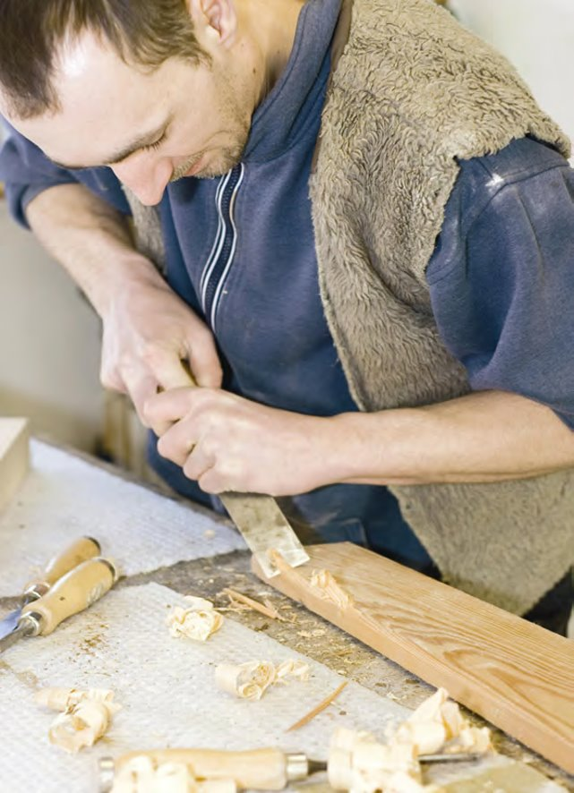
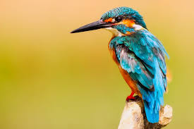
What has rural got?
Where my family has always lived
Shop floor
Home to wildlife
Nowhere else to go
The countryside can be a place of community, innovation, wellbeing, work and connection to nature.
It can be a place for being close to God (Job: 38-39).

Slide 9
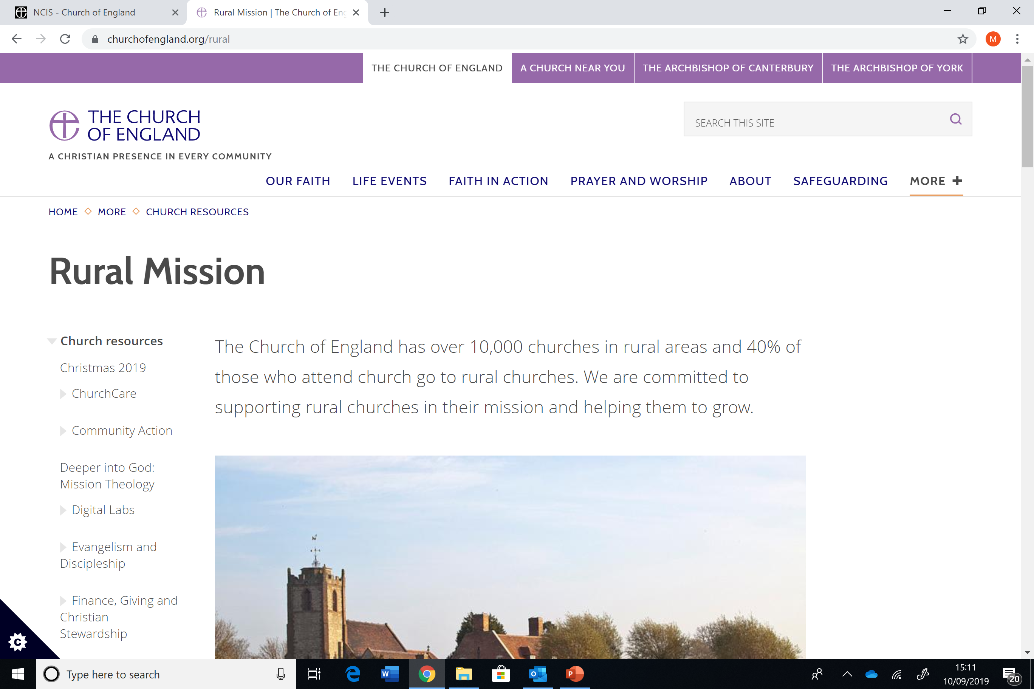

Slide 10
Elements of Success
We can’t do everything, but we can do something…

Slide 11
Coffee Caravan

Slide 12
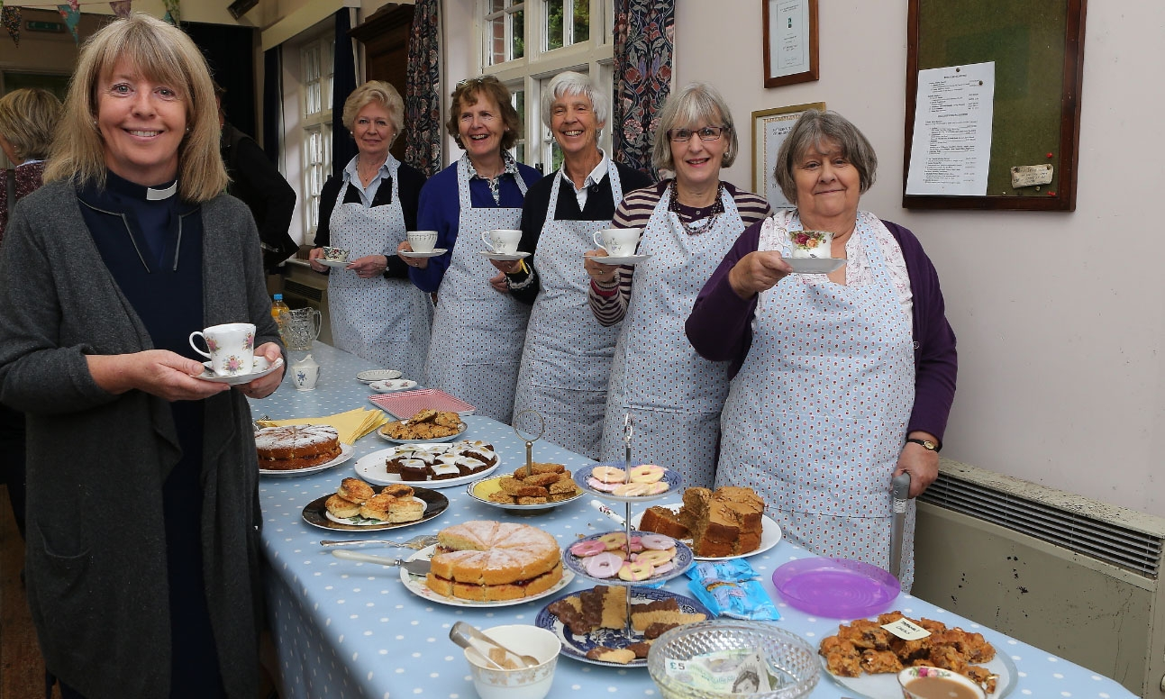
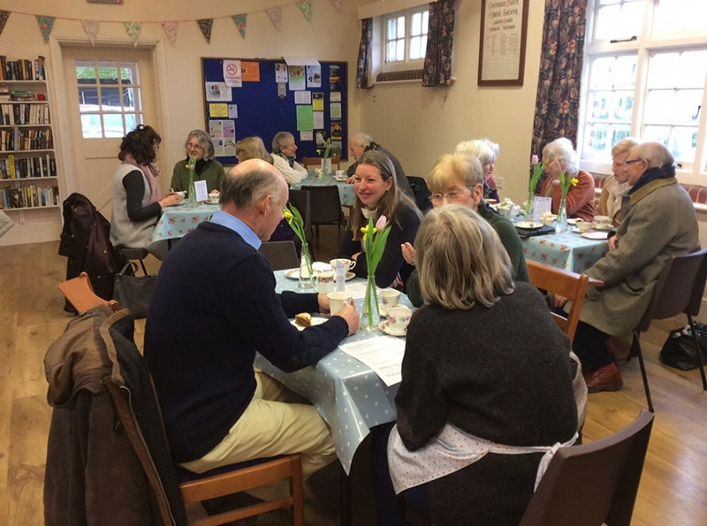
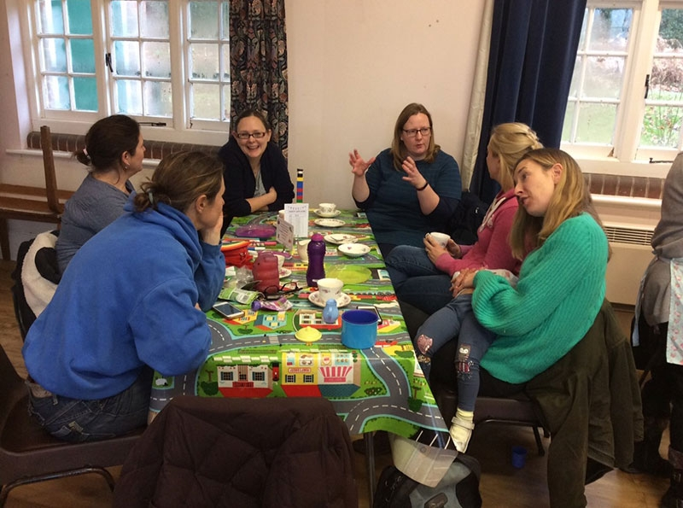
Cafe
Notes:
Julie Sear, Trinity Café, 2nd/4th Thursday

Slide 13
Fresh Expressions: Gateways

Slide 14
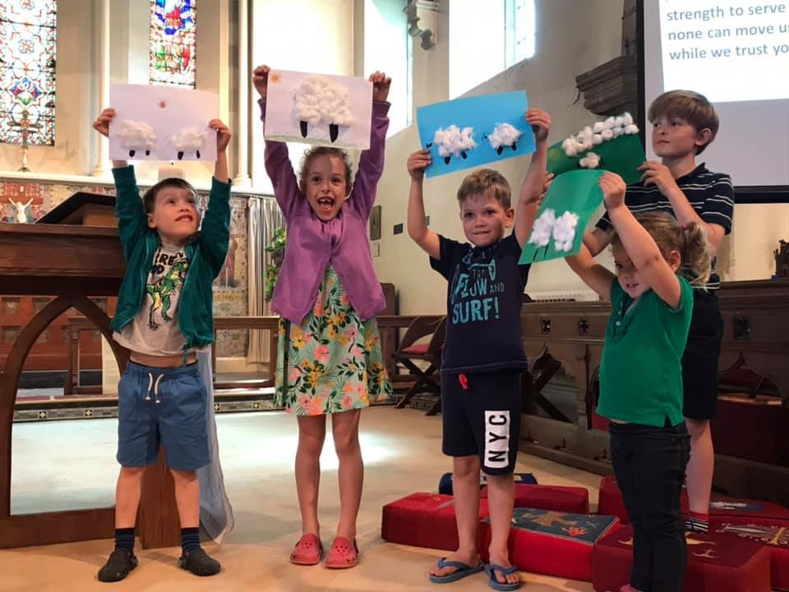
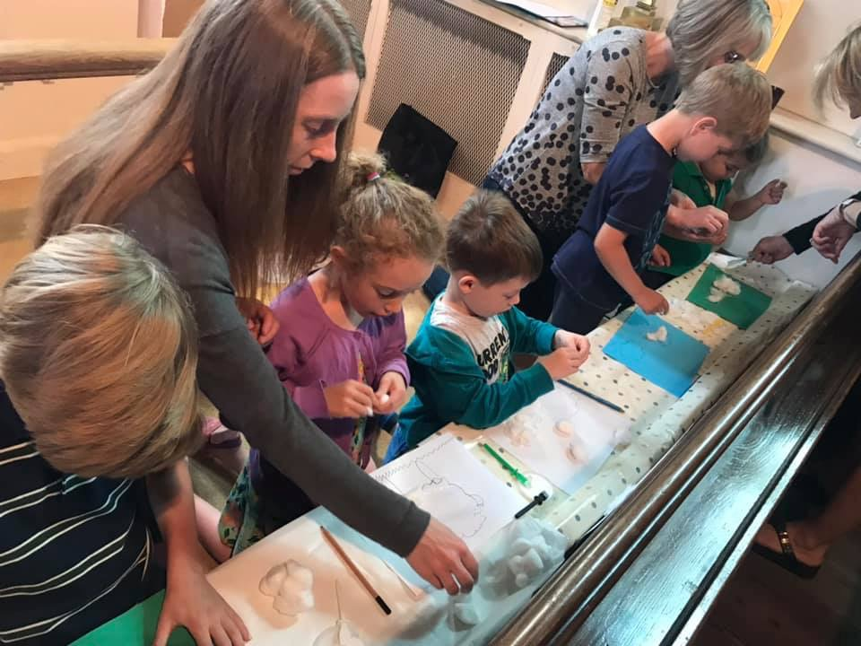
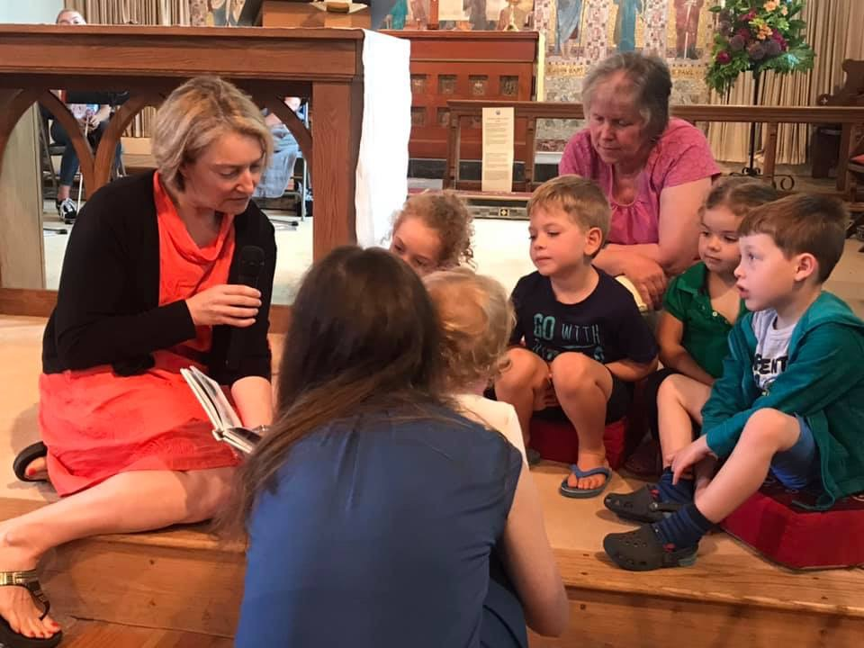
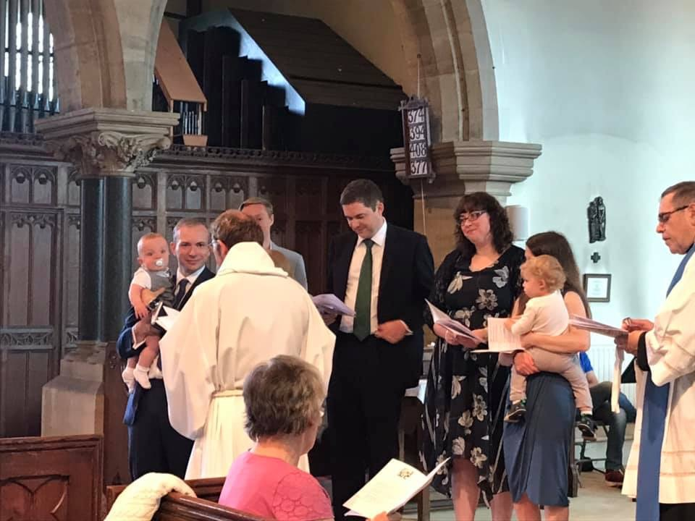
Family Worship

Slide 15
Basics
Basics – clean, welcoming, cared for buildings. Good signage, web presence, Facebook etc…
Open Welcome and Accessible Welcome (Germinate)
www.achurchnearyou.com
Church of England Digital Labs

Slide 16
Festival Churches
The Festival churches concept is designed to help churches focus on what they are successful at.
They can feature the following elements:
https://www.churchofengland.org/more/diocesan-resources/strategic-planning-church-buildings/association-festival-churches
A reduction in the governance structure (in terms of needing to have a PCC etc)
A transfer of some responsibility for the building maintenance and insurance
A removal of the requirement of worship every Sunday
A refocussing of worship around locally significant festivals

Slide 17
Leadership
Mentoring helped to develop confidence and skills in both lay and ordained
Informal approaches to training and development of lay people had the greatest impact and effectiveness
Formal courses were more effective when provided as locally as possible, so that more people could participate with limited travel distances
those whose roles included developing the ministry of others benefited from training and support to mentor others
multiple shorter courses to build confidence and help reflect on experience are helpful rather than longer periods of training
online approaches to learning are helpful, particularly ‘bite-sized’ courses.
https://derby.openrepository.com/handle/10545/624022

Slide 18
Some questions for churches:
What does everyday faith where you live look like?
How effectively does your Church build relationships with people outside itself?
Who are you expecting to deliver evangelism and discipleship – just the clergy, laity – is any training/support needed?
How do you envisage social action and the role your church plays in delivering it?
How do you measure the effect of what you do?
Most importantly, how do you ground these things in prayer?
Notes:
Salisbury diocese seeks to be a beacon diocese for rural ministry and mission. The diocese is working, in close partnership with Sarum College, to identify and encourage those with a vocation to rural ministry; to train and equip ordinands for rural ministry; to give serving clergy experience of rural ministry; and to support clergy and lay people in evangelism and mission. Key elements of the project include developing a Rural Church of England Ministry Experience Scheme (CEMES) alongside theological training at Sarum College; a rural training pathway, designed in conjunction with Sarum College, to train and equip ordinands for rural ministry; rural placements for all ordinands and curates and post-curacy and mid-ministry placements for clergy with little or no experience of rural ministry; a four-year development programme for ordained and lay rural church leaders to lead their churches into growth; and support for parishes in local mission and ministry through facilitation, seed-corn funding for mission projects, topic-based training and mentoring. The diocese aims to achieve the following key outcomes:
8 interns on the Rural CEMES programme discover a vocation to rural lay or ordained ministry;
50% of those on rural placements discover a vocation to rural ordained ministry;
50% increase in number of applicants for rural incumbencies;.
75% of rural clergy are part of the residential programme or a member of a rural learning community;
All rural parishes are linked into the programme and addressing matters of ministry and mission;
By 2021, the total worshipping community increases by 500 above the projected 2019 baseline;
The number of fresh expressions of church increases by 10% to 100 by 2021.
Attendance at fresh expressions increases by 10% by 2021 against the projected 2018 baseline.
The overall cost of the project is £1.98m, towards which £1.27m of Strategic Development Funding over 4 years was awarded in June 2017.
Exeter: Support for Rural Churches
Exeter diocese has 607 church buildings, of which 88% are listed. More than half are in a rural location but with only 25% of the total population of the diocese. Many have very small congregations and, although some are thriving, others struggle to cope with the care and maintenance of their church buildings and with filling key roles.
The diocese is seeking to develop the use of its rural church buildings by establishing a Rural Church Building Project Team to work alongside the diocese’s Mission Team, Mission Communities and local communities to find the best possible sustainable outcomes for their church buildings. To assist the Team in its work, the diocese has formulated eight legal models for rural church buildings which involve varying levels of community involvement with the buildings. It is developing a model of rural community engagement, in consultation with the Churches Conservation Trust. The diocese will develop four Rural Resource Hubs to provide a coordinated source of support. Rural PCCs and Mission Community Leadership teams will be given regular access to Consultant Mission Enablers to work with them over a three year period. The diocese aims to engage with around 100 rural churches during the initial seven year project. It anticipates that the proactive approach will release existing church members to focus their time, money and energy on growing in prayer and making new disciples and also that the act of engaging and partnering with the wider community will in itself be missional. The overall cost of the project is £1.8m, towards which £1m of Strategic Development Funding over seven years was awarded in June 2016.
In rural Suffolk, the project will invest in developing the existing Suffolk Fresh Expressions Community through forming small missional ecclesial groups enabling fresh expressions of church and three rural resourcing churches.
Hereford diocese is aiming to stimulate and achieve spiritual and numerical intergenerational growth over the next five years. This will be achieved by placing intergenerational missioners in six parishes across the diocese (in three market towns and three of the diocese’s poorest communities) with great potential for growth and focusing in particular on reaching children and young people. Each missioner will lead the formation of new worshipping communities that nurture journeys to faith and journeys in faith among people of all generations. The missioners will also spend around 20% of their time on diocesan work focusing on key aspects of intergenerational mission, planning and delivering key diocesan events with an intergenerational focus; and teaching clergy and lay leaders. The diocese anticipates the following key outcomes by the end of 2022:
Reach 1,800 unchurched people with the gospel of whom 450 will be new disciples. At least half will be young people and adults under 35.
New faith pathways in place in each parish, including twelve courses for enquirers per year and twelve courses per year for growing disciples (two of each, in each location).
A mixed economy of at least 12 new worshipping communities meeting at least twice a month (two per location).
Twelve new voluntary intergenerational missioners trained or in training (two per location) working collaboratively with local mission teams that are trained or training and growing.
The overall cost of the project is £1.05m towards which Strategic Development Funding of £525,000 was awarded in June 2017.
Winchester: Benefice of the Future
15% growth in membership across 3 pilot benefices, including 160 new and returning disciples and 40 retained through reversing decline; 60% from missing generations. Five new fresh expressions of Church launched, including a total of 100 participants, with 35% of all attenders previously not engaged in church and 60% under 30 years of age. 70% of fresh expressions of Church to be lay led. 30 new lay leaders and four new vocations to ordained or LLM ministry.

