Slide 1
Using Modern Communication

Slide 4
FIRST BIG TIP: find someone who does something well, and learn from them.

Slide 6
LOGO & FONT WELCOME NOTICEBOARD LEAFLETS POSTERS MAGAZINES MEDIA WEBSITES SOCIAL MEDIA

Slide 7
LOGO & FONT WELCOME NOTICEBOARD LEAFLETS POSTERS MAGAZINES MEDIA WEBSITES SOCIAL MEDIA

Slide 8
LOGO & FONT WELCOME NOTICEBOARD LEAFLETS POSTERS MAGAZINES MEDIA WEBSITES SOCIAL MEDIA

Slide 9
LOGO & FONT WELCOME NOTICEBOARD LEAFLETS POSTERS MAGAZINES MEDIA WEBSITES SOCIAL MEDIA

Slide 10
LOGO & FONT WELCOME NOTICEBOARD LEAFLETS POSTERS MAGAZINES MEDIA WEBSITES SOCIAL MEDIA

Slide 11
LOGO & FONT WELCOME NOTICEBOARD LEAFLETS POSTERS MAGAZINES MEDIA WEBSITES SOCIAL MEDIA

Slide 12
LOGO & FONT WELCOME NOTICEBOARD LEAFLETS POSTERS MAGAZINES MEDIA WEBSITES SOCIAL MEDIA

Slide 13
LOGO & FONT WELCOME NOTICEBOARD LEAFLETS POSTERS MAGAZINES MEDIA WEBSITES SOCIAL MEDIA

Slide 14
LOGO & FONT WELCOME NOTICEBOARD LEAFLETS POSTERS MAGAZINES MEDIA WEBSITES SOCIAL MEDIA

Slide 15
LOGO & FONT WELCOME NOTICEBOARD LEAFLETS POSTERS MAGAZINES MEDIA WEBSITES SOCIAL MEDIA

Slide 16
SECOND BIG TIP: your diocesan Comms Team is here for you if you need us. Get in touch.

Slide 17
‘OFF THE RECORD’ ‘SORRY’ ‘HELP!’ FACTS ‘NO COMMENT’
RING COMMS

Slide 18
‘OFF THE RECORD’ ‘SORRY’ ‘HELP!’ FACTS ‘NO COMMENT’
RING COMMS

Slide 19
‘OFF THE RECORD’ ‘SORRY’ ‘HELP!’ FACTS ‘NO COMMENT’
RING COMMS

Slide 20
‘OFF THE RECORD’ ‘SORRY’ ‘HELP!’ FACTS ‘NO COMMENT’
RING COMMS

Slide 21
‘OFF THE RECORD’ ‘SORRY’ ‘HELP!’ FACTS ‘NO COMMENT’
RING COMMS

Slide 22
‘OFF THE RECORD’ ‘SORRY’ ‘HELP!’ FACTS ‘NO COMMENT’
RING COMMS

Slide 23
‘OFF THE RECORD’ ‘SORRY’ ‘HELP!’ FACTS ‘NO COMMENT’
RING COMMS

Slide 24
THIRD BIG TIP: take communicating seriously.

Slide 25
TEXT
Ideally, what you say will ‘do the job’, fit the space nicely, and have a suitable visual.

Slide 26
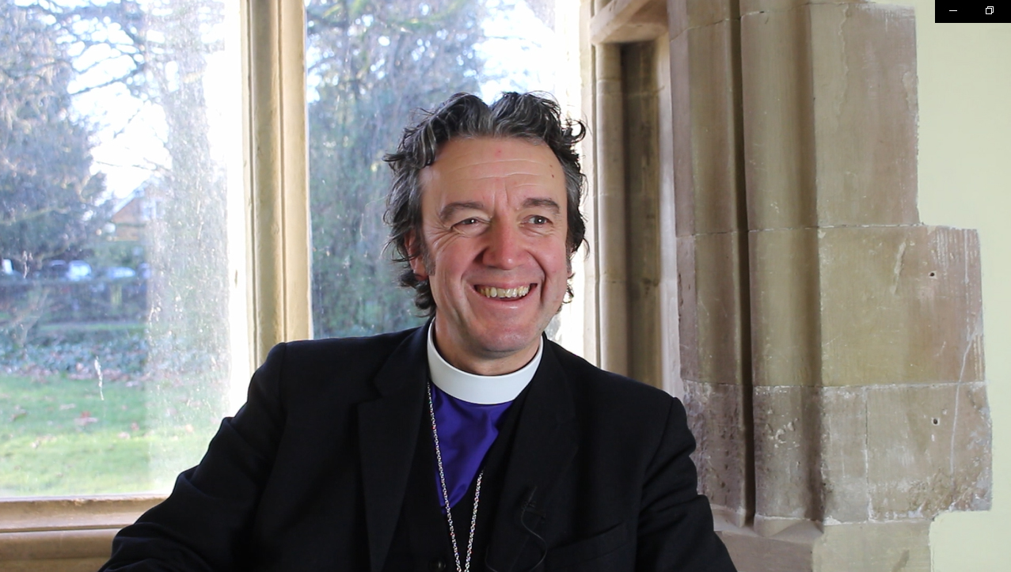

Slide 27
FOURTH BIG TIP: try to see yourself/ your church with fresh eyes. How do you come across?

Slide 28
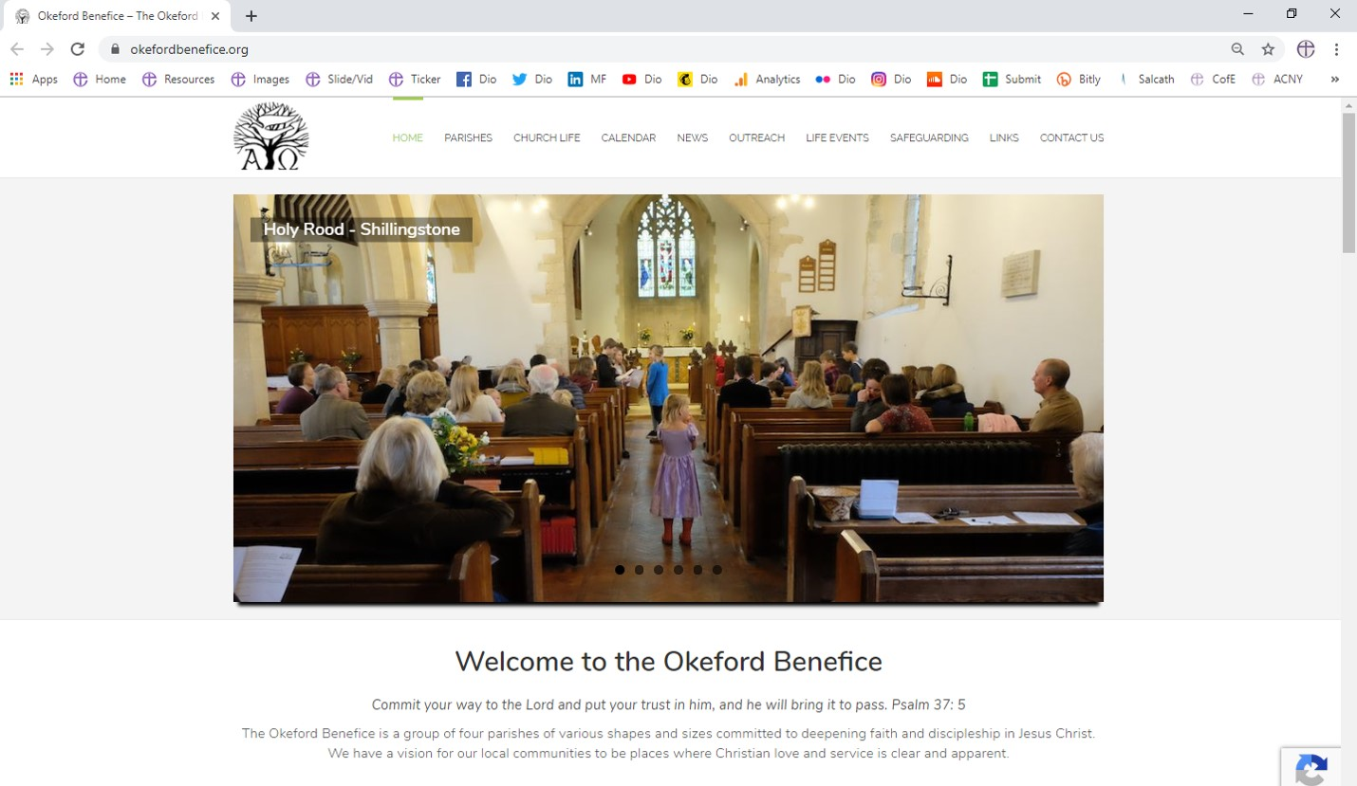

Slide 29
FIFTH BIG TIP: have a bit of fun. It’s infectious.

Slide 30
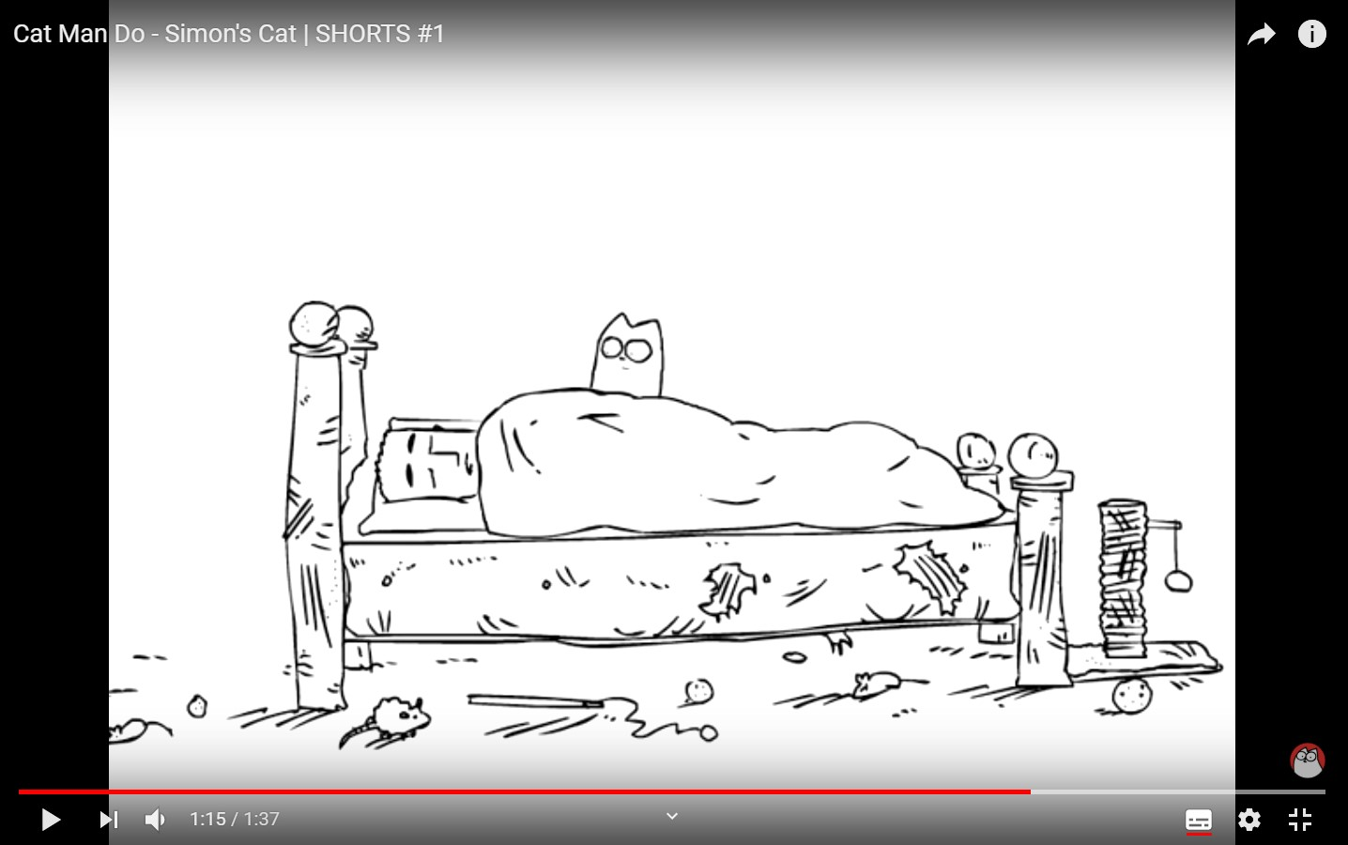

Slide 31
f
YT
t
I

Slide 32
f

Slide 33
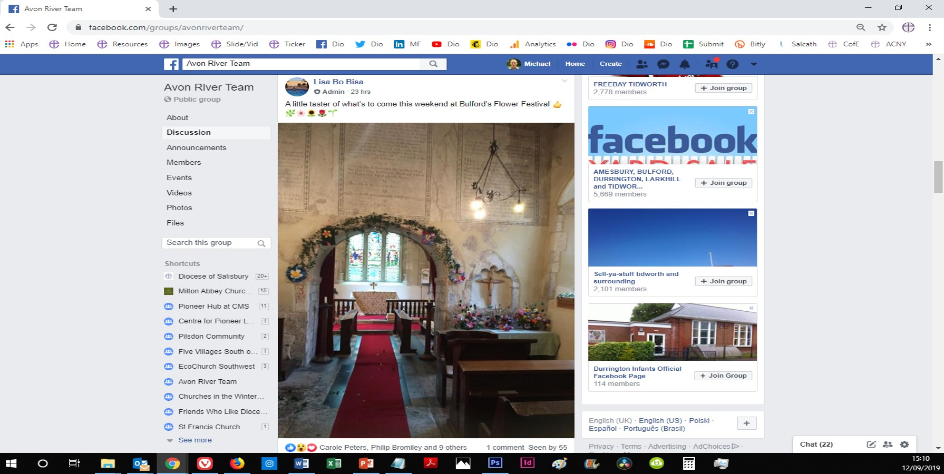

Slide 34
YT

Slide 35
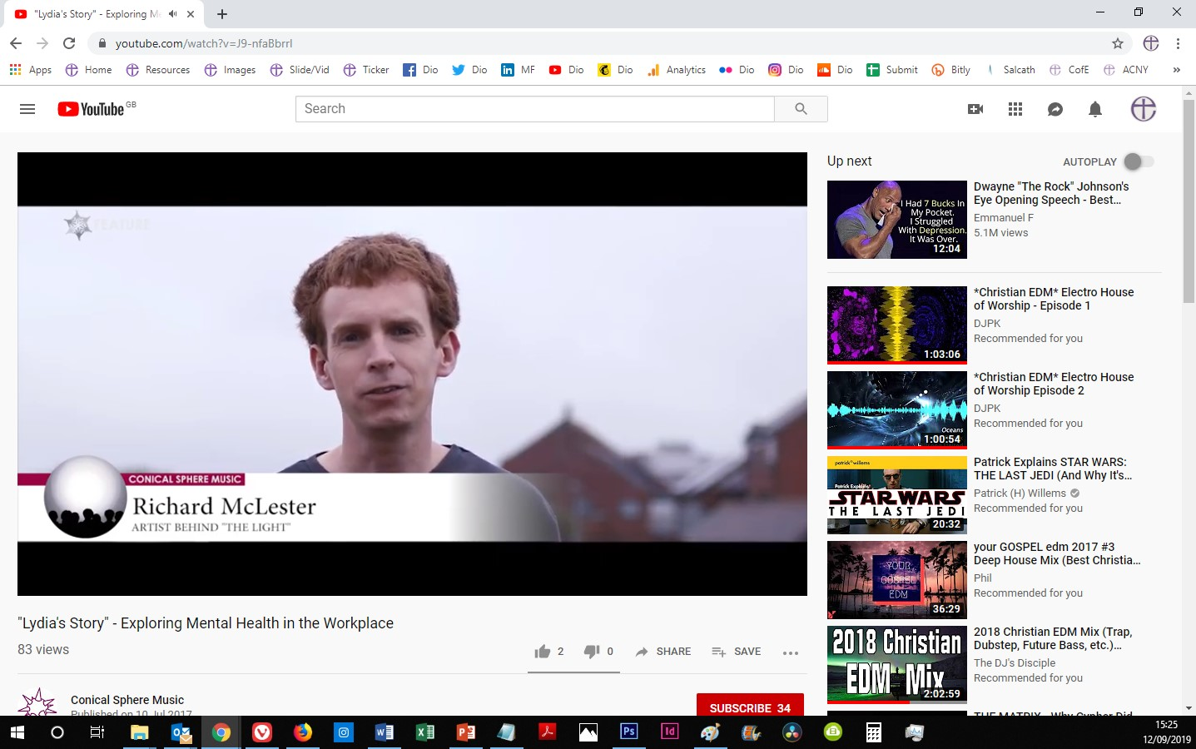

Slide 36
t

Slide 37
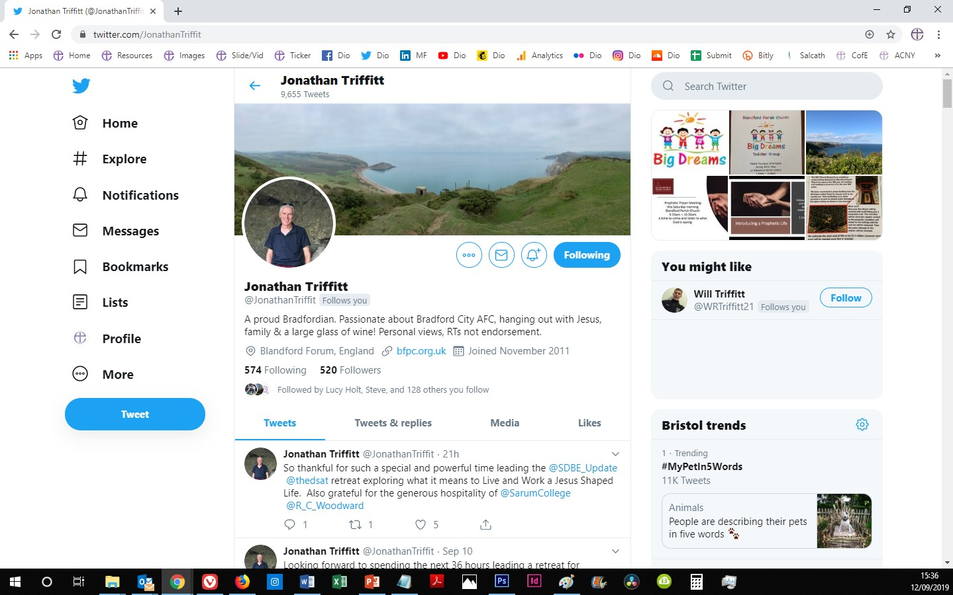

Slide 38
I

Slide 39
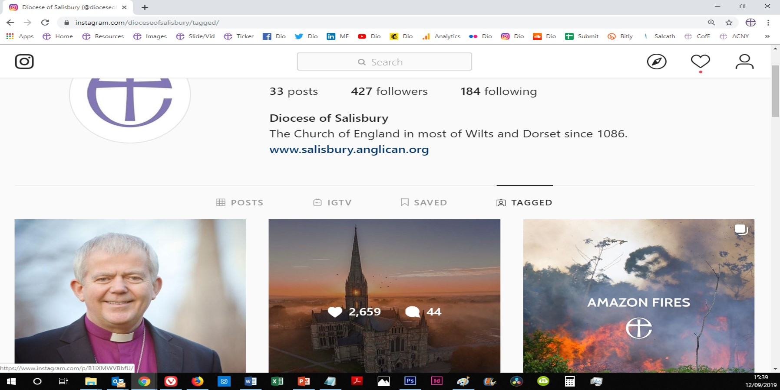

Slide 40
FINALLY…

Slide 42
Michael Ford Digital Missioner 01722 438652 michael.ford@salisbury.anglican.org

