Slide 1
Diocese of Salisbury
Treasurers’ workshop
Kay Short, Church Insurance Consultant
19th May 2022

Slide 2
Who we are
135 years insuring and reinstating churches
Leading UK insurer of churches and heritage buildings
Owned by a charitable trust – Benefact Trust Ltd
Specialist Church team:
    Underwriters
    Surveyors
    Risk Management Consultants
    Claims
    Church Insurance Consultants

Slide 3
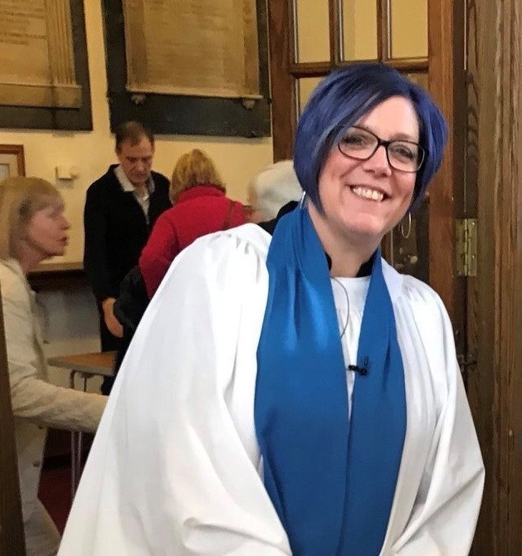
Your Church Insurance Consultant
Kay Short
07467 482022
kay.short@ecclesiastical.com
Supports the Dioceses of Truro, Exeter, Bath & Wells, Bristol & Salisbury
35 years + experience in risk management and insurance
Buildings for Mission – Diocese of Leeds
Past Churchwarden & Treasurer
PCC Member / Deanery Synod Rep / Lay Chair
Licensed Reader
Enabling parishes to do God’s mission

Slide 4
Examples of how we can help
We aim to provide support, guidance and assistance with your church insurance
We offer practical help and a friendly listening ear.
We have worked with, and continue to work with Dioceses to develop training and information on a variety of topics to support churches.
These are just some of the topics covered in our workshops and training, and most can be tailored to your specific needs.
We can use digital platforms for meetings and training events if preferred.
Training can be arranged at parish, benefice and deanery level as well as via the Diocese
Attending PCC and deanery, archdeaconry and diocesan meetings and events
Security
Health and safety
Risk management
Cyber security
Fundraising
Fire Risk Assessment
Theft of Metal
Open Churches
Understanding your Insurance policy

Slide 5
Why Ecclesiastical?
    Expertise
    Sustainable pricing to ensure we are around for the long term
    We care about churches - Compassionate, passionate, dedicated staff
    We are there to makes things easy when difficulties arise – many property claims are settled during the initial call
    Use wider experience to provide appropriate solutions e.g. open churches
    Indexation capping
    Unlimited Theft of Metal cover available
      Forensic solutions – we pay for SmartWater registration
      Cover restricted when scaffolding is in place

Slide 6
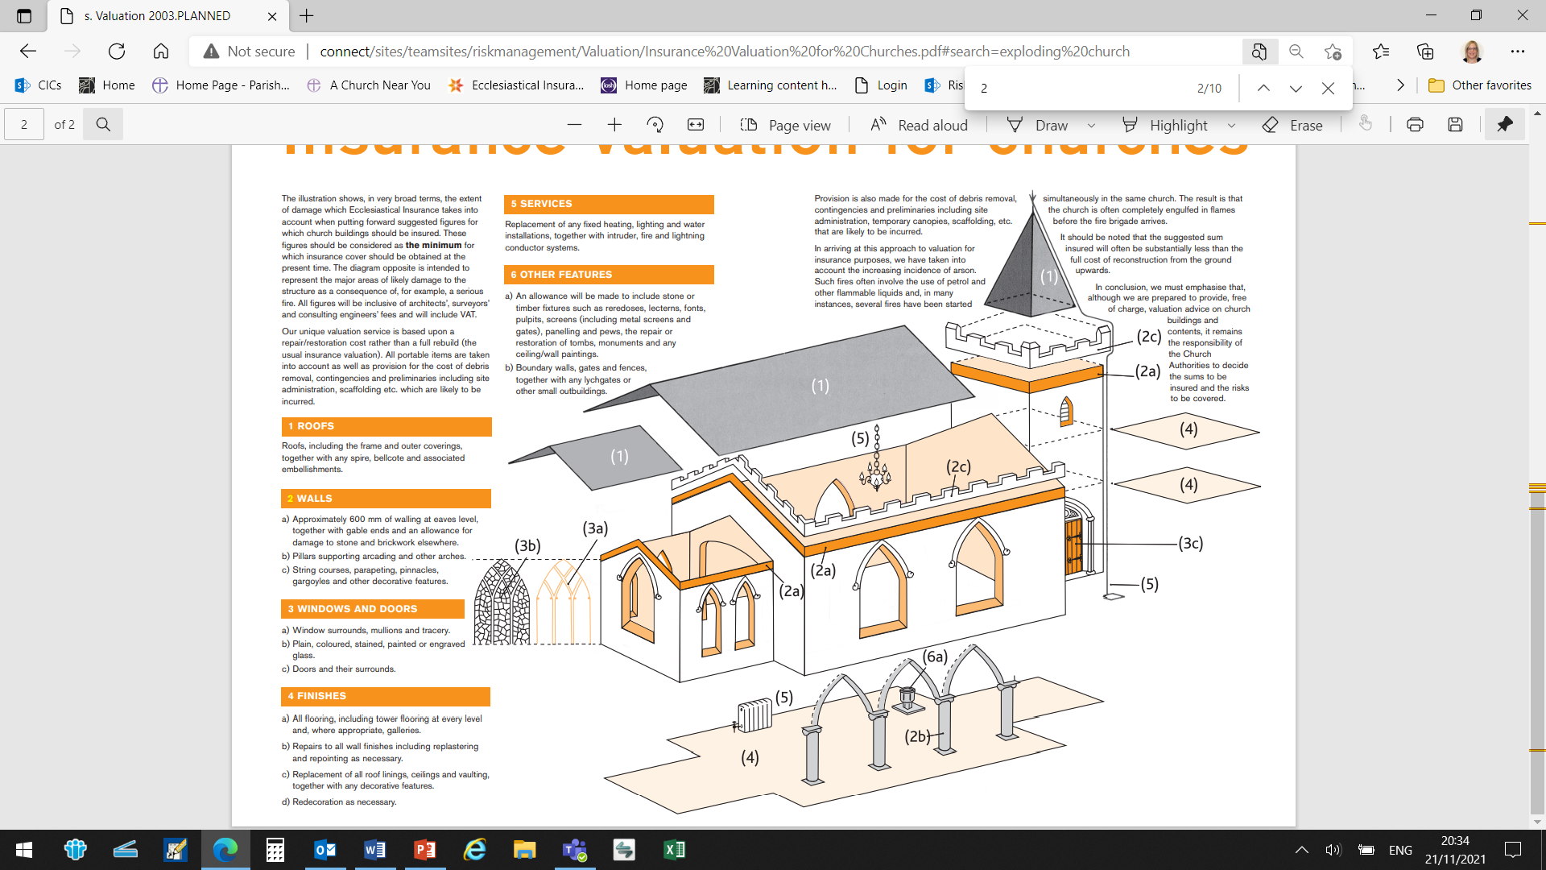
Insurance valuation for churches

Slide 7
Things we need to know
    Building works
    Large scale events and ‘hazardous’ activities
    Closing buildings
    Accidents where someone has needed medical attention
    Change of correspondent
    Changes to Parish name / Setting up a Joint Council

Slide 8
Joint Councils
    The Church Representation Rules 2020 enable connected parishes to form Joint Councils
    Parishes are connected if they :
        belong to the same benefice
        belong to benefices held in plurality
        are in the area of the same group ministry
    Joint Councils formed under CRR 2020 are separate legal entities and will require their own insurance, the extent of which will be dependent on the scheme terms
    Connected parishes who form a Joint Council can transfer to it:
      All property, rights, liabilities and functions of the individual PCCs – the Joint Council does everything
      Only certain property, rights, liabilities and functions of the individual PCCs as specified in the scheme – the PCCs continue to function alongside the Joint Council. If this is the case, we believe property and liabilities would need to be transferred to the Joint Council to enable a single policy for the parishes to be provided

Slide 9
Joint Councils
    Where some property, rights, liabilities and functions are split between PCCs and a JCC the scheme will need to be reviewed in detail to determine the correct requirements in terms of insurance and responsibilities for ensuring legal compliance e.g with health & safety legislation
    Inevitably where elements are split between parties they both need insurance for each party’s liabilities. This is not a duplication as each legal entity needs to cover its own liabilities.
    All a parish’s church buildings / halls used for church purposes should be insured under one single policy so there is no duplication of cover e.g. liabilities, personal accident. Do check yours!
    Our Parish Protect product will be launched shortly which will enable churches that require differing levels of cover to be catered for more simply.

Slide 10
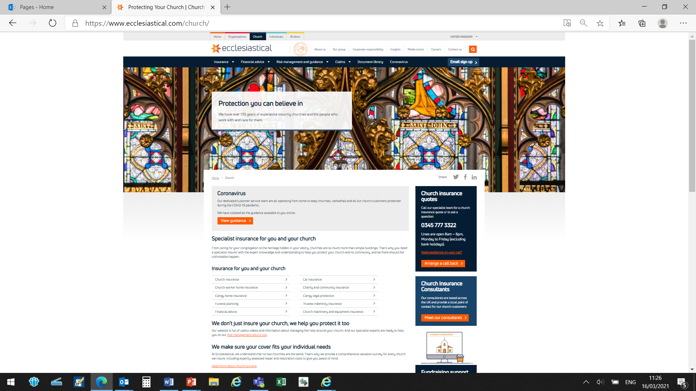
Support for Churches
    https://www.ecclesiastical.com/church
    Church Queries
    0345 777 3322
    Church Claims
    0345 603 8381 (24/7)
    Risk Advice Line
    0345 600 7531
    Church Insurance Consultant
    kay.short@ecclesiastical.com
    07467 482033

Slide 11
Fundraising

Slide 12

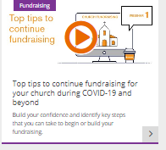

Summary of our fundraising resources:
Fundraising Hub
www.ecclesiastical.com/church/fundraising
Webinars
www.ecclesiastical.com/church/fundraising/fundraising-webinar/
Fundraising in a Box
Planning
Researching donors
Making the ask
Saying thank you
Thank you poster
Research template
Top Tips
List of Funders
Researching possible donors & funders
Checklist for grant applications
Case for support guidance
Outputs and outcomes guidance
Five webinars:
  Top tips
  Digital fundraising
  Keeping in touch with your congregation, community and supporters
  Successful grant applications
  Measuring and reporting the success of your project
  Factsheet and slides accompany each webinar
Fundraising helpline
To speak to a friendly Church Insurance Consultant for help with our resources

Slide 13
Ecclesiastical Insurance Office plc (EIO)
Benefact House
2000 Pioneer Avenue
Gloucester Business Park
Brockworth, Gloucester
GL3 4AW, United Kingdom
Ecclesiastical Insurance Office plc (EIO) Reg. No. 24869. Registered in England at Benefact House, 2000 Pioneer Avenue, Gloucester Business Park, Brockworth, Gloucester, GL3 4AW, United Kingdom. EIO is authorised by the Prudential Regulation Authority and regulated by the Financial Conduct Authority and the Prudential Regulation Authority. Firm Reference Number 113848.

