Slide 1
Fairer Share Survey Results and Next steps 12 February 2022 – Diocesan Synod
DBF Chair – Nigel Salisbury
Director of Parish Support – Elizabeth Harvey
Photo by Tim Mossholder on Unsplash
Notes:
Thank you to the 313 PCCs that participated in the this survey which represents 72% of our parishes and thank you for the all the additional feedback you provided, some with comprehensive and considered views and suggestions

Slide 2
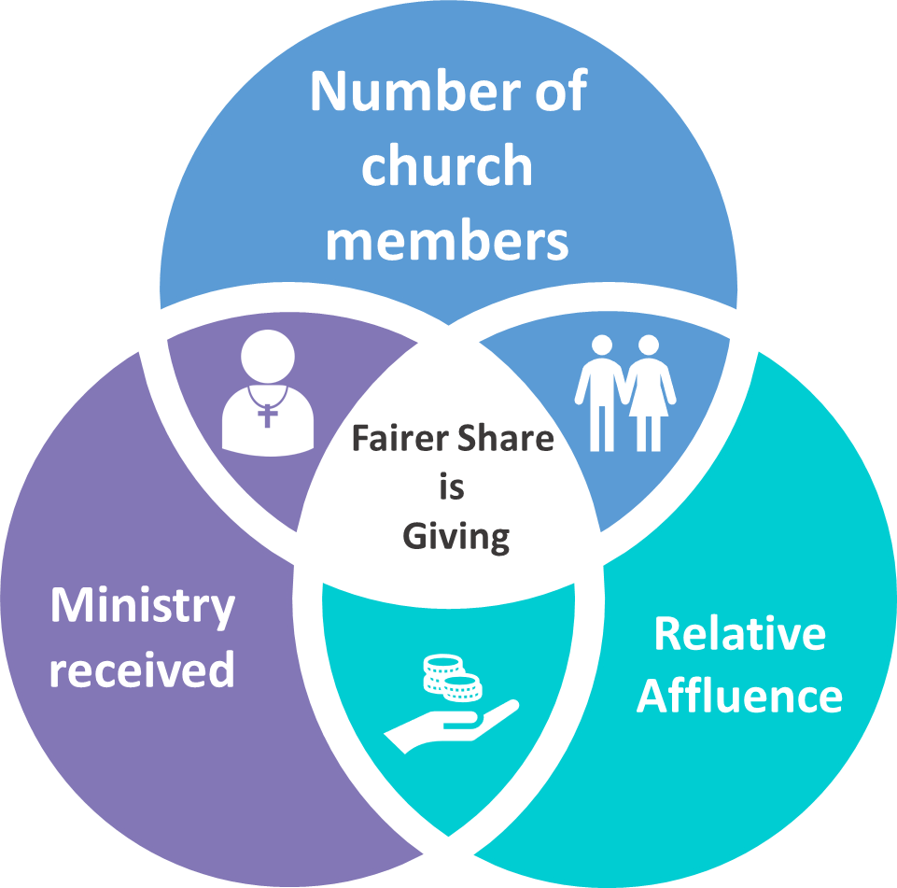
Fairer Share Survey Purpose
Seeking PCCs views about current system and its 3 core principles….
What needs to change, or do we need to replace it?
Notes:
This survey asked PCCs views about the current system – what is working or not working. We did not include options and alternatives as this will be explored during the next stage of consultation

Slide 3
Fairer Share Survey Results
Strong support (84%) for some form of membership-based system
Strong support (73%) for some form of membership count to determine relative size
A range of views about the current way membership is counted
Rural parishes are more dissatisfied with the current way membership is counted than urban parishes
Core Principle:
Membership
Notes:
There remains strong support for a membership-based system, but a range of views about how this is defined and therefore counted.
Many parishes stated that the current count is not fit for purpose, is open to interpretation, considered a cumbersome process and would welcomed clearer guidance
There is also a call to review the 3-year rolling average (smoothing effect); particularly following COVID, it would accord too much weight to pre-pandemic figures.

Slide 4
Fairer Share Survey Results
Support (69%) for the principle of relative affluence
Most do not support (43%) the current way relative affluence is assessed
Rural parishes are more dissatisfied with this core principle of the current scheme than urban parishes
Core Principle:
Relative Affluence
Notes:
Parishes see supporting each other as part of living out our faith, responding to a generous God. Questions were raised as to what is reasonable to expect when we say ‘to give a little more’
The way we currently assess relative affluence generated the most feedback and most do not support the current self-assed approach, stating it is to subjective.
If it is to remain part of the system, it needs to be measured in a transparent and objective way.

Slide 5
Fairer Share Survey Results
Support (64%) for the principle of an adjustment in light of ministry provision received
The way we currently adjust for ministry provision (modification) is not widely understood
Rural and urban parishes responded very similarly to this question
Core Principle:
Ministry Provision
Image: Flaticon.com
Notes:
It is evident from the feedback that modification for ministry provision is not widely understood and there are wide-ranging issues when we link share to ministry provision, such as:
The need for ministry vs ability to pay
Geographical realities for rural benefices that include a number of churches spread over a wide area
Considering other ministry resources available, such as retired and self-supporting clergy and lay leaders etc.

Slide 6
Fairer Share Survey Results – Summary
Support for a membership-based system
Many questions how relative affluence is measured
For both, look at other methods and systems
Modification not widely understood; challenges linking share to ministry provision
Feedback highlight differences between the rural and the urban context
Notes:
This slides summarises the findings from the survey. I’d like to read a handful of PCC comments that provides further context:
“A system that’s heavily weighted towards membership numbers is seen as a tax on growth”
“membership and assumed affluence of parishioners does not equate with means or willingness to donate”
“as a benefice which includes a number of churches spread over a wide rural area, we need more clergy than would be the case in an urban benefice. We should not be penalised because our clergy to supporter ratio is higher than elsewhere.”
“if the church aspires to remain present in these places, it must find sustainable and fair mechanisms to fund the ministry without penalising the faithful few who labour there”

Slide 7
Recommendation to Bishop’s Council
Manage the expectations of change
Leave space to align share with mission and ministry provision
Sufficient time to explore alternatives and consult with parishes
2023 – tweaks based on your feedback
2024 – wider changes / new system
2023
Current share system with tweaks
2024
Wider changes / new system
Notes:
Having reviewed the survey results and feedback from parishes, the Fairer Share Review Group is recommending to Bishop’s Council that we continue with the current system in 2023 with some tweaks and to introduce wider changes or a new system in 2024.
This will help us to:
Manage the expectations of change: changing the fairer share scheme and apportionment to parishes, does not address the fundamental issue that the diocesan budget, which is mainly the cost of ministry provision and support (84%) is fixed and not very flexible.
It is important that Share reflects ministry and mission provision, and with the Bishop Designate arriving later this year we need to leave space to align the Share system to any changes that might be upcoming
We want to have sufficient time to explore different scheme options and the impact of these in the next phase of the consultation.

Slide 8
Proposed: 2023 scheme tweaks
Membership count: 5 weeks in May 2022
Change the ‘smoothing effect’
Provide socio-economic indices to help parishes choose self-assessed relative affluence category
Decouple modification adjustment and show separately from relative affluence
Provide calculation information at a parish and benefice level
Notes:
The proposed changes for 2023 are in response to points raised as part of the survey
A membership count in May
Changing the 3-year rolling average to a 2-year figure based on the pre and post pandemic count.
To assist parishes when assessing relative affluence we will make socio-economic indices available
We will provide more information around the modification adjustment that we hope will help to explain it better

Slide 9
Proposal: Working towards a 2024 ‘new scheme’ launch
Focus Group discussions
Options Online Survey
Diocesan Synod update, engage
Bishop’s Council Agree feasible options to be modelled
Proposed: Continue with current scheme in 2023 with tweaks
Modelling feasible options and assess impact
Diocesan Synod update
Engagement opportunities TBC
Bishop’s Council approval
Diocesan Synod Communicate new system
Disseminate information
Training
Resources
Implementation of new scheme
Transitional arrangements
Modelling & Impact
Options
Decision
Preparation
Launch
Feb-Oct
Nov-Feb23
Mar-Jun
Jul-Dec
2024
Notes:
The next stage of the consultation is to explore options and alternatives. We want to do this well and will make information available to enable parishes and Deanery Synods, to have time for discussions, raise questions and give their views between now and the Summer.
Next week through Working Together and email, we will share this presentation and recording, as well as a Survey Results Digest that includes responses and suggestions from parishes. Also included is more information on what share pays for and the diocesan budget, as several PCCs asked questions around this.
We will refresh the work we have done looking at share schemes from other dioceses and make this available to you.
There will be focus group discussions in May, so please let either myself or Liz Ashmead know if you would like to participate.
By June this year we would like to invite PCCs to participate in a follow-on survey on share options and alternatives to gather your views.
As already mentioned, the recommendation is to launch wider changes or a new system in 2024, and therefore we are working towards Bishop’s Council taking a decision by June 2023, leaving the remainder of the year to get ready and provide resources and support to parishes.

Slide 10
Thank you

