Slide 1

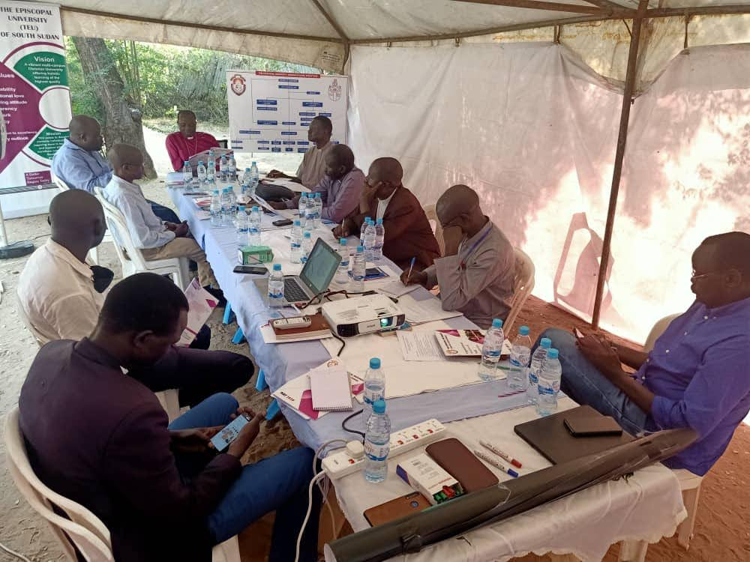
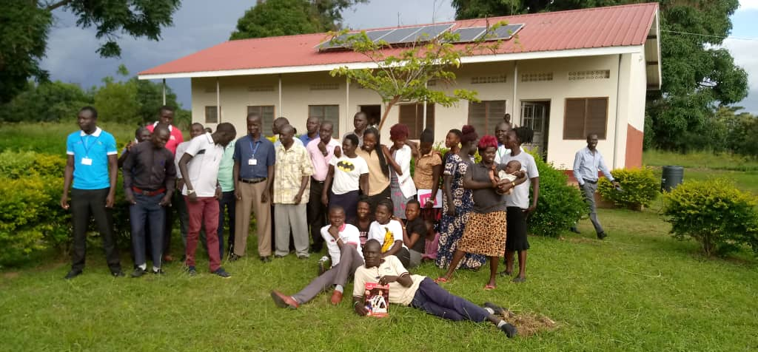
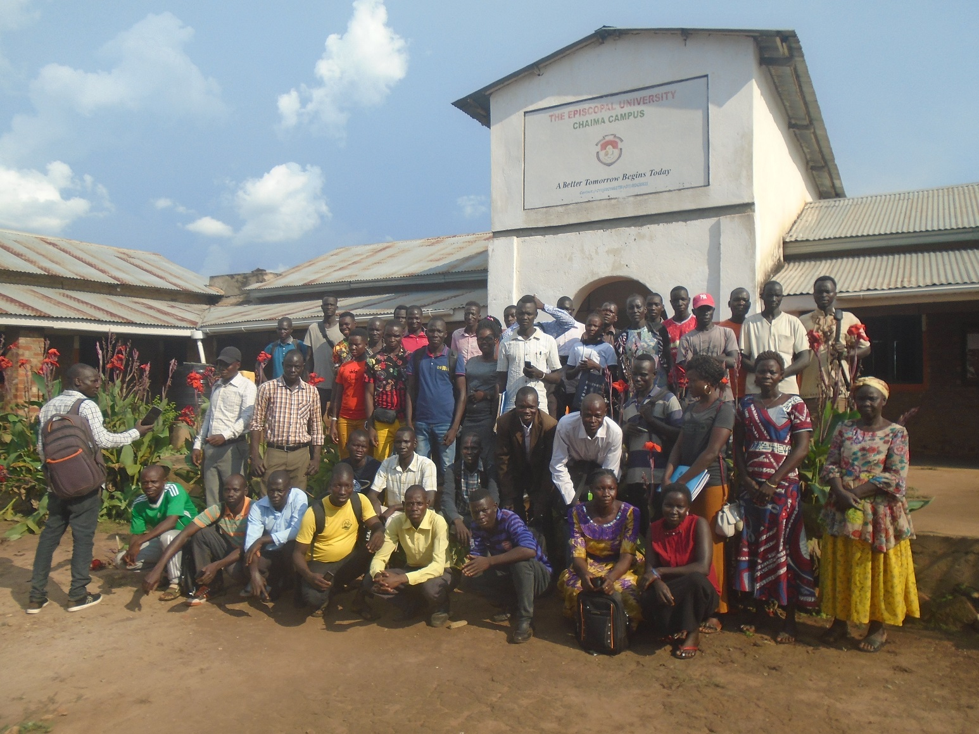

Slide 2

1.
Why?
2.
Meet people
3.
Achievements:
The Episcopal University
4.
Our work:
ECSSSUP
5.
Your part!

Slide 3


Slide 4
1.
Why?
2.
Meet people
3.
Achievements:
The Episcopal University
4.
Our work:
ECSSSUP
5.
Your part!

Slide 5
1.
Why?
2.
Meet people
3.
Achievements:
The Episcopal University
4.
Our work:
ECSSSUP
5.
Your part!

Slide 6
1.
Why?
2.
Meet people
3.
Achievements:
The Episcopal University
4.
Our work:
ECSSSUP
5.
Your part!

Slide 7
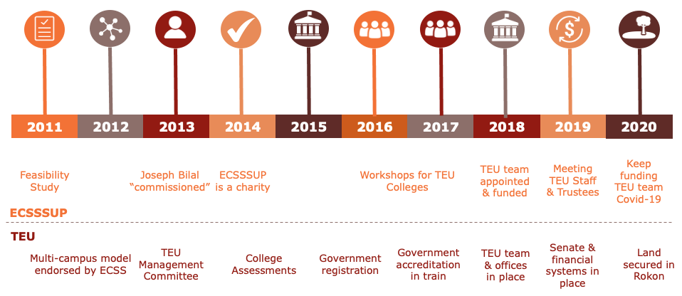

Slide 8
Policies
Gearing up for fundraising
Website & logo
Fundraising group
Strategy

Slide 9

Academic excellence
Scholarships for staff
Income for salaries
Expertise for curriculum development
Quality facilities & systems
Vehicle
Campus design & construction
Digital infrastructure
Sustainable growth
Capacity building for sustainable business planning
Vibrant partnerships
University partnerships

Slide 10
LAST YEAR …
Income:
2014 – 2019
£133,000

Slide 12
THANK YOU!

Slide 13







Slide 14

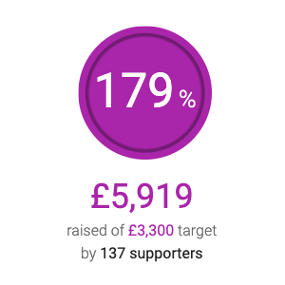


Slide 15
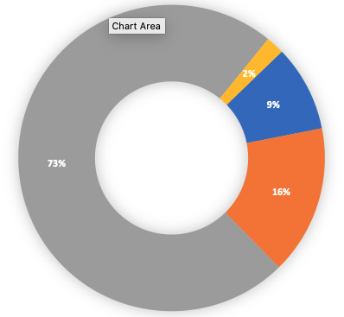
AN OPPORTUNITY
£ 200,792
Vehicle
Survey of Rokon site
Partnership with EMI *
* Engineering Ministries International

Slide 16
A CHALLENGE
£ 76,700
£ 25,000

Slide 17
1.
Why?
2.
Meet people
3.
Achievements:
The Episcopal University
4.
Our work:
ECSSSUP
5.
Your part!

Slide 18

Could it be you?
Treasurer | secretary
Regular giving
TEU | ECSSSUP evangelists!

Slide 19
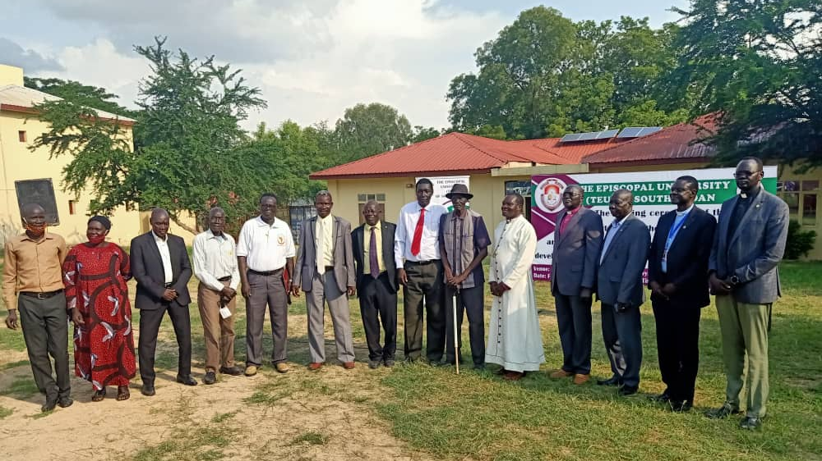
THANK
YOU!

